Slide 1
Notes:
IDENTIFIER SLIDE, FROM THIS POINT ON CLICK TO ADVANCE SLIDE

Slide 2
CDEMA Ongoing Initiatives & Potential Synergies
For the Japan-Caribbean Climate Change Partnership Inception Workshop

Slide 3
CDM Strategy 2014-2024

Slide 6
Notes:
The CDM Strategy and Framework identifies priority outcomes for 2014 to 2024 with respect to achieving resilience in the region

Slide 8
ONGOING INITIATIVES

Slide 9
Mainstreaming Climate Change in Disaster Management (CCDM) Project Phases I and II
Supported by the Government of Austria
Implemented by CDEMA between 2009 and 2015 in 2 phases, with the support of the 5Cs, the CPDC, national disaster management offices and other CDM Stakeholders

Slide 10
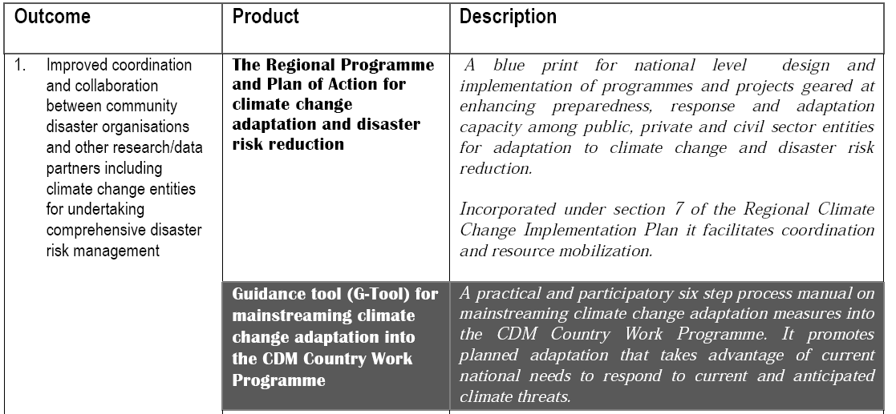
CCDM Phase I

Slide 11
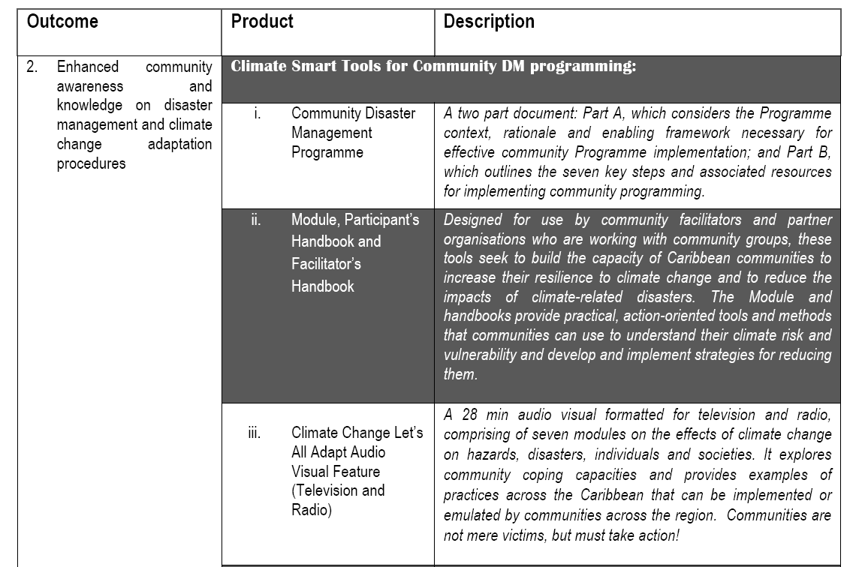

Slide 12
CCDM Phase II
Sought to implement the tools and systems developed in the first phase
Support provided to:
Development of Climate Smart CDM Country Work Programmes in 14 CDEMA Participating States; and
Development of Community Disaster Management Programmes and demonstration projects in 5 PS

Slide 13
What is a CDM Climate Smart Country Work Programme?
A CDM CS CWP captures the work being done or planned by a country to help reduce disaster risk including from projected climate extremes. The overarching aim is to make a country safer and more resilient.
It includes actions that would build on CCA and DRR synergies where appropriate.
Priorities for the CDM CS CWP are determined by a group of national level stakeholders representing all levels of society- public sector, private sector and communities who may be involved in planning for possible losses from threats which may be either natural or man-made.

Slide 14
Strengthening of the Capacity of the Caribbean Disaster Emergency Management Agency (CDEMA) Participating States and Coordinating Unit for Implementation of Comprehensive Disaster Management

Slide 15
Objectives
The overall objective of the project is to reduce the vulnerability of the Caribbean region to the long term impacts of natural hazards, including the potential impacts of climate change, thereby achieving regional and national sustainable development.
The specific objective of the project is to support strengthening of the capacity of the CDEMA Coordinating Unit (CU) and the National Disaster Offices (NDOs) for effective implementation, monitoring and evaluation of the Comprehensive Disaster Management (CDM) programme in Participating States.

Slide 16
Expected Results
Expected Result 1: Capacities of NDOs and other relevant national agencies strengthened for CDM implementation.
Expected Result 2: Capacity of CDEMA CU strengthened as the main coordinating body for CDM implementation in the region.
Expected Result 3: Capacity of the CDEMA System for Emergency Response Strengthened.

Slide 17
Activities
Activity 1.1: Provide support to NDOs in implementation of national and regional CDM Strategies through the Country Directed Fund (CDF) mechanism.
Activity 1.2: Provide support to the Technical Capacity of the NDOs through the CDEMA Technical Support (CTS) mechanism and the Technical Assistance Secondment Protocol (TASP).
Centre (RCC).

Slide 18
Activities
Activity 2.1: Provide support to CDEMA CU for strengthening its financial management and accounting systems to meet internationally accepted standards.
Activity 2.2: Provide support to CDEMA CU for strengthening the Office of the Executive Director for Monitoring, Evaluation & Reporting, Resource Mobilisation and Project Development.

Slide 19
Activities
Activity 3.1: Provide support for enhancement of the Regional Response Mechanism (RRM).
Activity 3.2: Provide support for the enhancement of the Regional Coordination Centre (RCC).

Slide 20
Should you have any queries, please contact:
CDEMA
Resilience Way
Lower Estate,
St. Michael, BARBADOS
Tel: 246 434-4880
Email: cdema@cdema.org

Slide 21
THANK yOU

