Slide 1

National Adaptation Plans: Essential Elements
Dr. Keith Bettinger, UNEP Consultant
24 September, 2019

Slide 2
Overview
UNFCC Guidelines
Linkages to SDGs, Sendai, National Priorities
Institutional coordination
Assessing Impacts and Risks
Monitoring and evaluation

Slide 3
What goes in a NAP?
Introduction
Stakeholder consultation procedures
Framework
Institutional arrangements
Vulnerability assessments
Prioritized adaptation measures
Policy/mainstreaming guidance/directions
Data & information arrangements
Timeline
Financing Plan
Monitoring and Evaluation

Slide 4
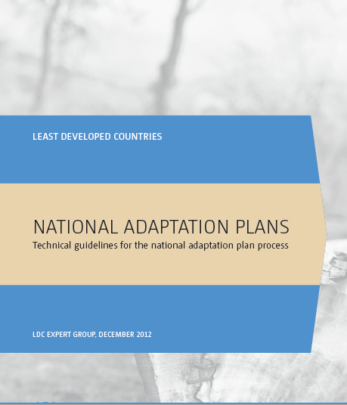
1. UNFCCC Technical Guidelines (2012)
General NAP elements (decision 5/CP.17):
  Laying the groundwork and addressing gap
  Preparatory elements
  Implementation strategies
  Reporting, monitoring, and review
Provides examples, suggestions
  Roles and responsibilities
  Further support and references
  Sample indicators
Non-prescriptive, country-owned, country-driven
Notes:
The LEG technical guidelines were developed by the LEG with input and feedback from the GEF and its agencies and experts from other organizations to support the NAP process following a request by the COP. They offer a range of options for dealing with each element of the NAP process and are based on guiding principles of the NAP process. As laid out in the initial guidelines that were adopted at COP17, the technical guidelines are framed around four elements of the NAP process: laying the groundwork and addressing gaps, preparatory elements, implementing strategies, and reporting, monitoring, and review. They are intended to facilitate country-owned, country-driven action.
The purpose is to provide Parties, as well as organizations assisting the Parties with adaptation, with technical guidance on the development of NAPs, covering areas such as:
Establishing a national process to coordinate adaptation planning at all relevant scale and with medium and long-term views in mind;
Identifying capacity gaps, and building capacity for planning and implementing adaptation for integrating climate change adaptation into national development planning processes;
Preparing national adaptation plans that contain activities, policies and programmes for adapting to climate change;
Establishing a monitoring and evaluation system of adaptation needs and measures, and plans to iteratively address emerging needs;
Designing a communication strategy on climate change;
Establishing plans for collaborating across sectors and within administrative units such as cities and local governments

Slide 5
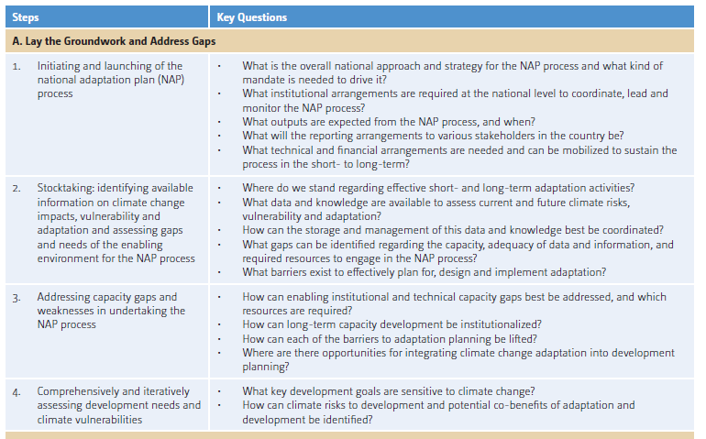

Slide 6
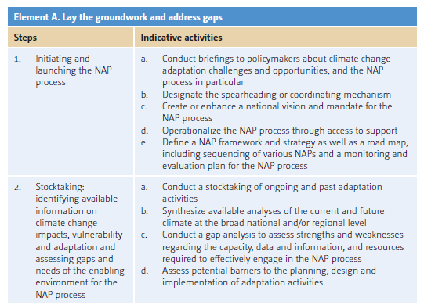

Slide 7
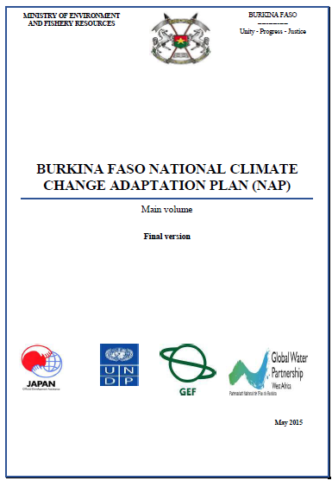
Example: Burkina Faso
Strategic objectives and priority adaptation for key sectors
National circumstances and stakeholders
  Climate, socio-economy, geography
Gaps and vulnerabilities
  By sector
How to reach the objectives
  Costs & benefits
  Alignment with other strategies
  Communications, implementation, M&E

Slide 8
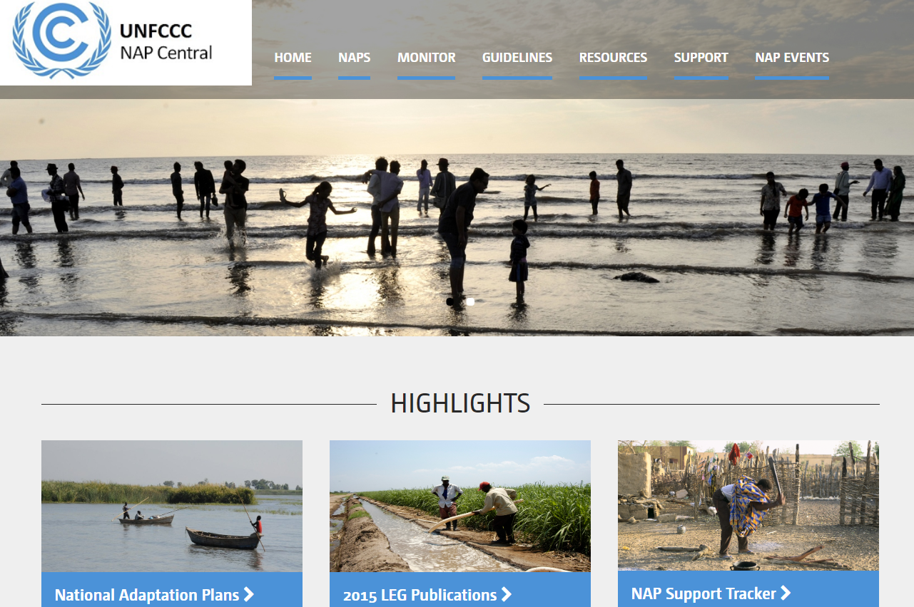
For more info & resources:
https://www4.unfccc.int/sites/napc/Pages/Home.aspx

Slide 9


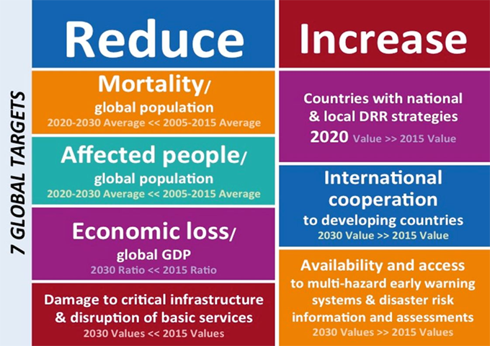
2. Linkages to other frameworks
Climate change affects many SDGs and other strategic goals!
  Food security/hunger, health, water, energy, infrastructure
Many overlaps and synergies
Entry points include:
  Sectoral planning processes
  Community, city, basin, regional planning
  Development themes: food, energy, water security
Notes:
The SDGs represent a benchmark for national development, and provide a complete/idealized representation of a national development process/system. They help to define boundaries for complete coverage of the development process, and collectively define success/development. They help define a future, as might be defined through a visioning exercise. That future us defined through essential functions of major components of the national development process.
Climate-resilient development helps us connect the national development process to adaptation and all of its forms in terms of impacts, exposure, climate drivers and hazards, vulnerability, risk, etc.
Adaptation covers both the transformational actions need to address fundamental shifts in climate and also the climatic extremes that lead to disasters, providing the overlap with DRR

Slide 10
NAP-SDG iFrame approach…
Analyzing SDGs and climate risk factors help in the selection of systems (food security: crop production, distribution, affordability, strategic reserves)
Component systems can be assessed for sensitivity to climate change, allowing for adaptation actions to be developed, prioritized, implemented
Implementation brings co-benefits: adaptation and sustainable development

Slide 11
SDGs
SDG 2 – Zero hunger
SDG 6 – Clean water and sanitation
SDG 7 – Affordable and clean energy
SDG 11 – Cities
Crop production
Climate hazards
Drought/aridity
Hydroenergy production
Strategic food reserves
Urban Water Resources
Rural Water Supply
Spatial units
Community/village
Urban area/city
Municipality
Country level
River basins
Region

Slide 12
Key contributions of NAPs
Establishing institutional linkages
  E.g. Interministerial working group on disaster risk reduction
Coordinating/harmonizing planning & IMPLEMENTATION!
Enabling mainstreaming of CCA
  Providing guidelines
  Providing data, information, and expertise

Slide 13

Ethiopia NAP: Aligned with national projects and international initiatives
NAP

Slide 14
18 Adaptation options:

Slide 15
3. Institutional Coordination
Climate change is a cross-cutting issue
Coordination: horizontal & vertical
Areas for institutional coordination
  Establishing mandate and scope
  Gender integration
  Intersectoral project development
  Subnational capacity development/planning/implementation
  Financing and planning
  Data/information sharing
  Tracking adaptation efforts

Slide 16
Relevant LEG Guidelines
A2: Stocktaking: identifying available information on climate change impacts, vulnerability and adaptation and assessing gaps and needs of the enabling environment for the NAP process
  Conduct stocktaking of ongoing and past adaptation activities
  Synthesize available analyses of the current and future climate at the broad national and/or regional level
A3: Addressing capacity gaps and weaknesses in undertaking the NAP process
  Identify and enhance awareness of potential opportunities for integrating climate change adaptation into development planning at different levels
  Design and implement programmes on climate change communication, public awareness-raising, and education
B5: Integrating climate change adaptation into national and subnational development and sectoral planning
C1: Prioritizing climate change adaptation into national planning

Slide 17
Sudan process for NAP preparation
Who participated:
18 focal points from all the states of Sudan
18 technical committees, each has 8 – 20 members representing the government, research, academia and civil society organizations
More than 350 participants in 4 National Workshops
More than 400 participants in 5 zonal/regional workshops
More than 1200 participants in 18 state-level workshops
20 national consultants
2 international consultants
  NAP activities in all states received high political support from the State’s governments

Slide 18
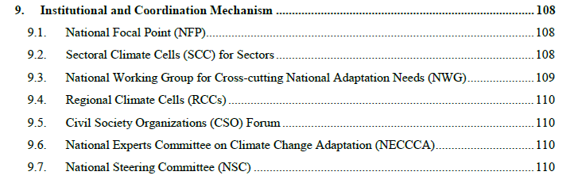
Sri Lanka Coordination

Slide 19
4. Assessing Impacts/Risks
NAPs are built on an evidence-based understanding of vulnerabilities, impacts, and risks
Requires data, information, gaps assessment, vulnerability/risk methodologies
  Sectoral-based? Geographic based?
  Many tools and methodologies…choose the right ones!
Relevant LEG Guidelines:
  B1: Analyzing current and future climate change scenarios
  B2: Assessing climate vulnerabilities and identifying options at the sector, subnational, and other appropriate levels
  B3: Reviewing and appraising adaptation optiones

Slide 20
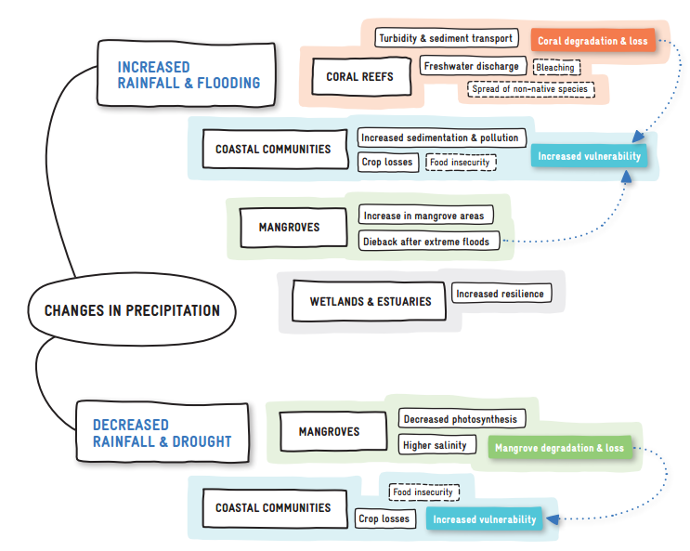
Key Concepts
Vulnerability: the degree to which a system is susceptible to, and unable to cope with, adverse effects of climate change
Risk: the degree to which is system is susceptible to harm from a hazard
  Incorporates probability
Consider physical processes + non-physical characteristics
Exposure, Sensitivity, Impacts, Adaptive Capacity

Slide 21
Elements of vulnerability (Vulnerability Sourcebook, GIZ 2017)
What are the data and information needs?
Notes:
Components of vulnerability. Source: Vulnerability Sourcebook: Concepts and guidelines for standardized vulnerability assessments. GIZ 2017 p20. They lifted it from adelphi/Eurac 2014

Slide 22
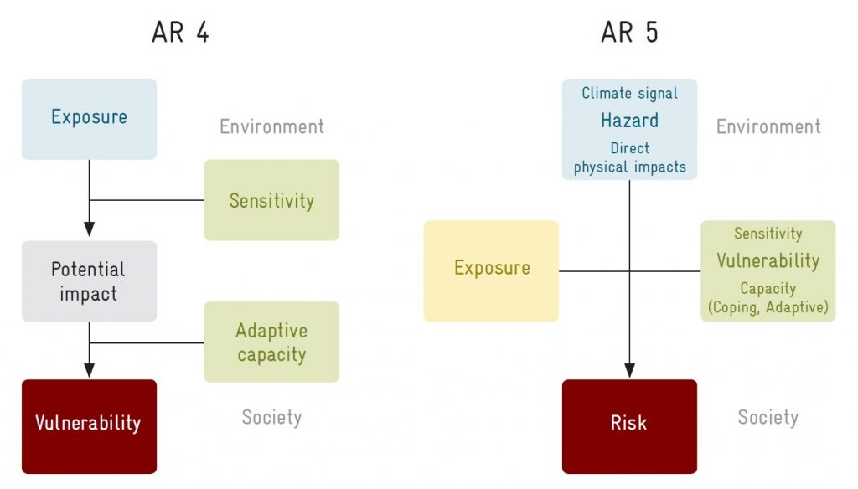
Vulnerability vs. Risk…
Source: AdaptationCommunity.net
Notes:
https://www.adaptationcommunity.net/vulnerability-assessment/

Slide 23
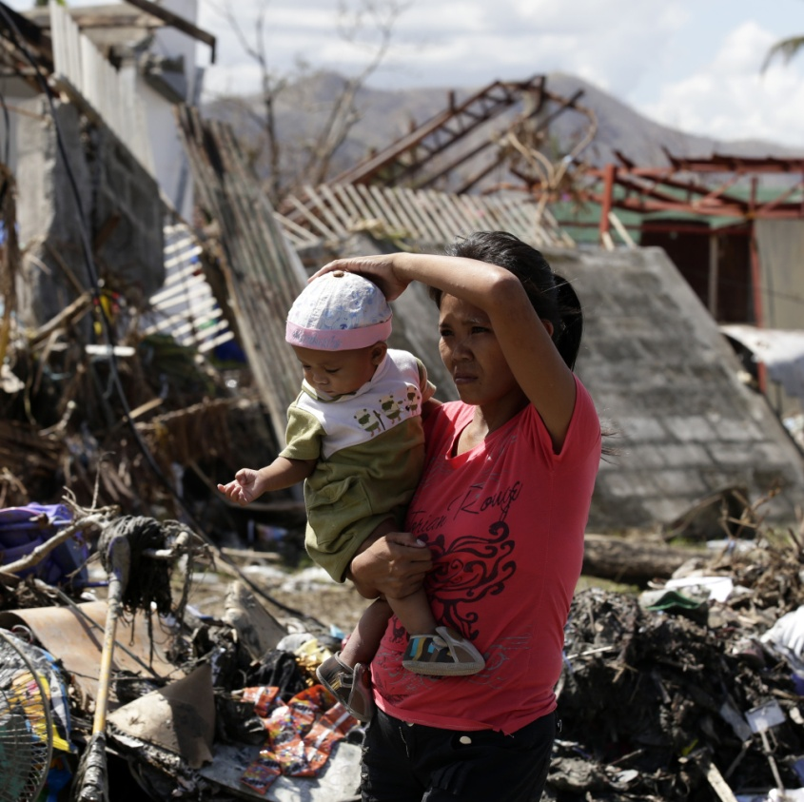
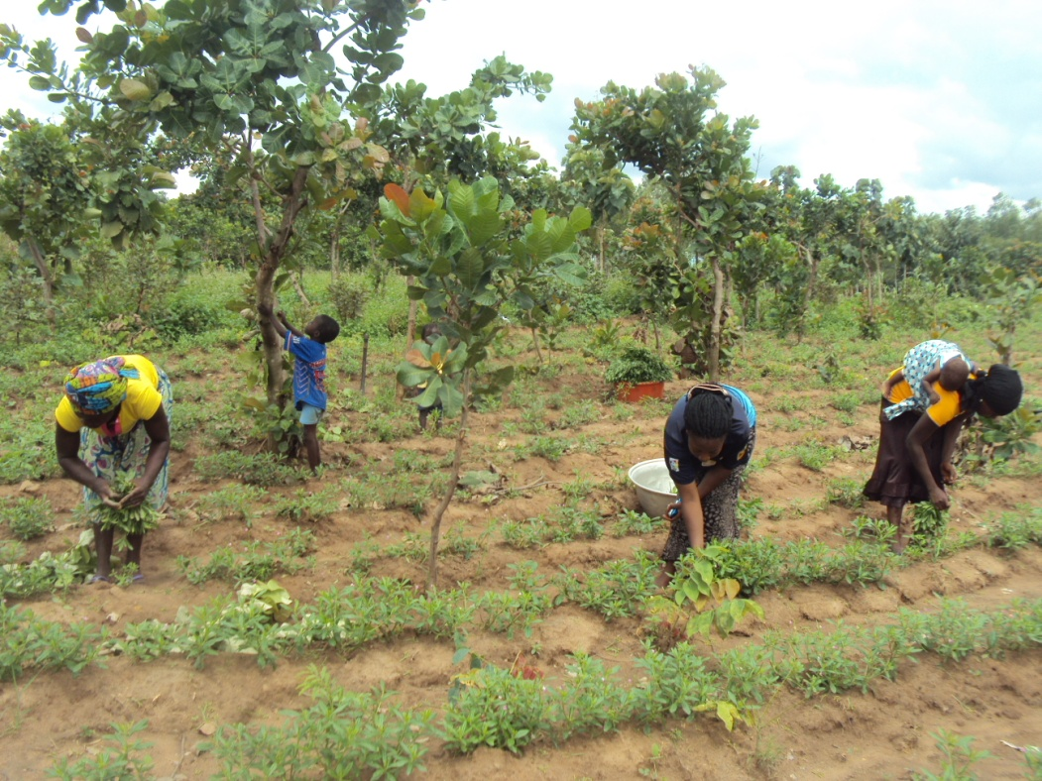
Differential Vulnerabilities
Climate change impacts people differently…Differential Impacts
  Gender
  Disability (PWDs)
  Ethnicity
  Migrant Status
Existing inequalities often made worse by changing environmental conditions
Consider Marginalizing Factors
Notes:
Factors contributing to gender differentials in vulnerability:
Higher dependence on natural resources. Women are overrepresented in agriculture and other natural-rsource dependent activities.
Less access to income-earning opportunities
Less access to educational opportunities. In some places girls drop out of school at higher rates.
Limited mobility. Women manage households and care for family members, limiting their mobility and increasing vulnerability.
Susceptibility to violence.

Slide 24
State level VAs: Sudan
Activities at the State level:
Assessment of current vulnerability of the water, agriculture (including food security) and health sectors
Identification of adaptation options for vulnerable areas and systems
Review of state-level institutions, policies and development plans
Consultation on priority adaptation options
Awareness and capacity building
3 stage process, each stage followed by a national workshop for exchange of experiences and sharing of lessons learned

Slide 25
Development Baseline
Climate Change Driver
Climate change Hazard
Channel
Health Impact
Barriers
Priorities
Strategy/Policy
Adaptation solution and inputs
Additionality
Result/Outcome
Industry: Mining, Fishing, Deforestation, Agriculture
Expansion of farming and pastoralism
Infrastructure: Damming rivers, Road building
Weather/Climate
Socio economic context: poverty, urbanisation, conflict, rapid population growth
Displacement and migration
Access to Energy
Water & sanitation
Health infrastructure
Increasing temperatures
Surface water - leading to a reduction in water accessed reduced
Reduction in drinking water
Dehydration
Insufficient health sector capacity: human and financial
Poor sanitation
Landslides
Contamination of water supply
Diarrhoeal disease
Ambient temperatures
Limited and fragmented HIS and meteorological data
Frequency in intense floods
Altering predator-prey relationships, thus
vector populations can increase
Heat/cold morbidity/
mortality
SLR
Uninhabitable land (prone to emergencies and disasters, undermining livelihoods)
Chronic diseases
Access to information
Reduced yields for food and fodder
Ecosystem and change of biodiversity (coverage, seasonal timing, dieback, composition)
Injuries
Cognitive lack of consideration of CC
Trigger Population displacement and conflict
Strategy/Plan
Project
Unpredictability of seasonal rains and increased intensity of rainfall events
Malnutrition
Access to energy
Coastal erosion and flooding, including flash floods.
Reduction of habitat (such as wetlands) and spawning areas water
Mental health
Uncertainty
Cyclones and storm surge
Create new habitats for insects, fish, mammals,
Vector borne diseases
Drought
Lack of water
Extreme weather events
Change in ocean and coastal ecosystems (i.e. salinity, pH, nutrient changes and contaminant runoff
Degradation of fresh water
Infectious disease
Growth and spread of bacteria (SLR)
Water borne diseases
Governance failures and political economy

Slide 26
5. Monitoring, Reporting, Evaluation
NAPs are iterative…cycle depends on country
Can be tied to national/subnational M&E frameworks…
  Use existing indicators and capacities where appropriate (e.g. Kenya National Performance and Benefits Measurement Framework)
Relevant LEG Elements:
  D1: Monitoring the NAP process
  D2: Reviewing the NAP process to assess progress, effectiveness, gaps
  D3: Iteratively updating the national adaptation plan
  D4: Outreach on the NAP process and reporting on progress and effectiveness
Notes:
The main outputs of this element would include a plan for monitoring and evaluation, with a plan for data collection and ongoing compilation and synthesis of new information on impacts and vulnerabilities to be used in updating the NAPs. NAPs would be disseminated internationally and through the UNFCCC secretariat. Regular progress reports would also be submitted to the UNFCCC through existing and new reporting channels, including countries’ national communications and submissions.

Slide 27
Importance of M, E & L
Attracting international climate finance
Evaluating adaptation policy, programme and project interventions
Informing future adaptation policy development
Mainstreaming adaptation in development through links with related indicators
Comparing adaptation achievements across sectors, regions, countries
Communicating adaptation progress to stakeholders
Informing political climate change negotiations in the international arena
Targeting, justifying, and monitoring adaptation funding and programs
Notes:
The results of the monitoring and evaluation would be used to improve the effectiveness and efficiency of the process, and facilitate incorporation of new assessments and emerging science as well as lessons learned.
The results would also be used to develop reports on the progress and effectiveness of the NAP process which could inform the COP through national communications and other reporting channels.

Slide 28
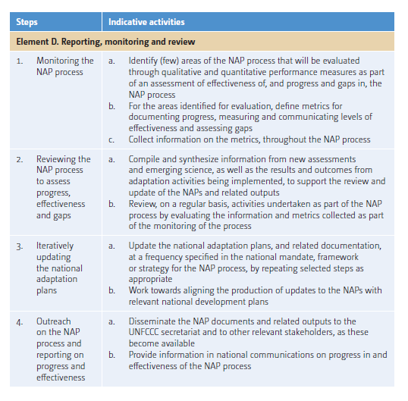
Key Elements of M&E
What is to be monitored?
  M&E happens at various levels
When will it be monitored?
Who is responsible for the monitoring?
SMART
What resources/ data/ Information/ capacity will be needed?
Communications, dissemination, learning
Notes:
Monitoring could be undertaken at different levels, such as at the national level to review and assess the overall NAP processes, at a level of implementation to assess whether goals and objectives are being met, at a programme or project level to assess results and impacts of activities. Given the many possibilities for monitoring the process, it is proposed that a country choose those areas to focus on which it determines as most relevant for measuring success of the overall process. Costs of the M&E system and synergy with other M&E efforts may also be considered.
What resources will be needed? M&E often requires data and information across multiple sectors, and about interviews taking place at both the national and subnational levels.

Slide 29
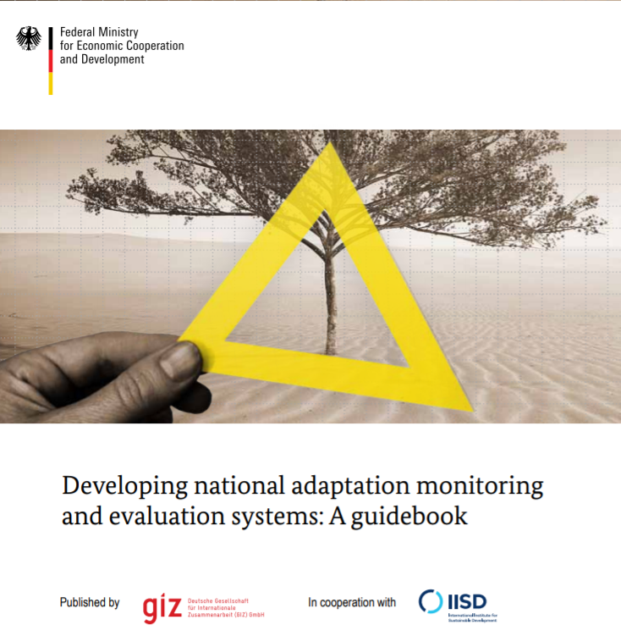
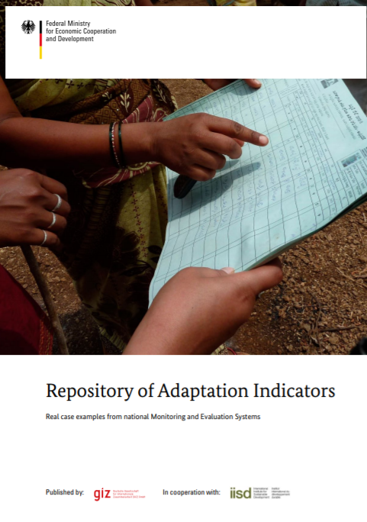
Some resources available at: http://napglobalnetwork.org/resources/?theme=66#resource_list

Slide 30

Thank you!
keithb@hawaii.edu

