Slide 1
Phase 1: NAP Preparation and Formulation

Slide 2
▶ Setting the Baseline
The Paris Agreement was signed in 2015 to settle a common effort to keep global temperature rise below 1.5°C by the end of the century as compared to pre-industrial levels.
Adaptation means learning to live in a world that has changed and keeps constantly changing.
There is no ‘one-size-fits-all-solution’ to adaptation and approaches may include technical solutions as well as nature-based solutions.
Ecosystem-based adaptation enhances the adaptive capacity of the most vulnerable communities as well as the resilience of ecosystems
The Agreement emphasizes the need for both climate change mitigation and adaptation.
through restoration of natural capital and biodiversity conservation, and/or regeneration measures.
Article 7 of the agreement outlines necessary climate adaptation activities, specifically highlighting the need for action at the national level.

Slide 3
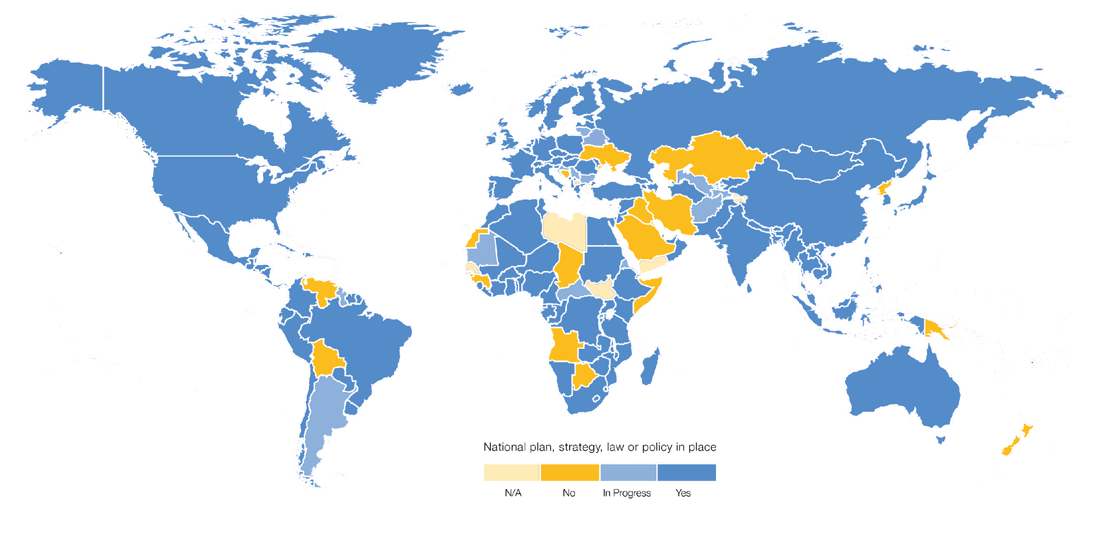
EHFG VGYDF CYGRVG CSU
▶ Essential elements of the NAP process
First Level
Second Level
EIWFH DCGGBC WEIUIVHKJ UDHF
Figure 1: Adaptation planning worldwide
UNEP (2021). Adaptation Gap Report 2020. Available at: https://reliefweb.int/report/world/adaptation-gap-report-2020
The National Adaptation Plan (NAP) process, established in 2010 under the Cancun Adaptation Framework.
It plays a central role in helping countries to approach climate change adaptation strategically, coherently, and consistently.
To date, 72% of its 190 signatories have adopted at least one national-level adaptation instrument.

Slide 4
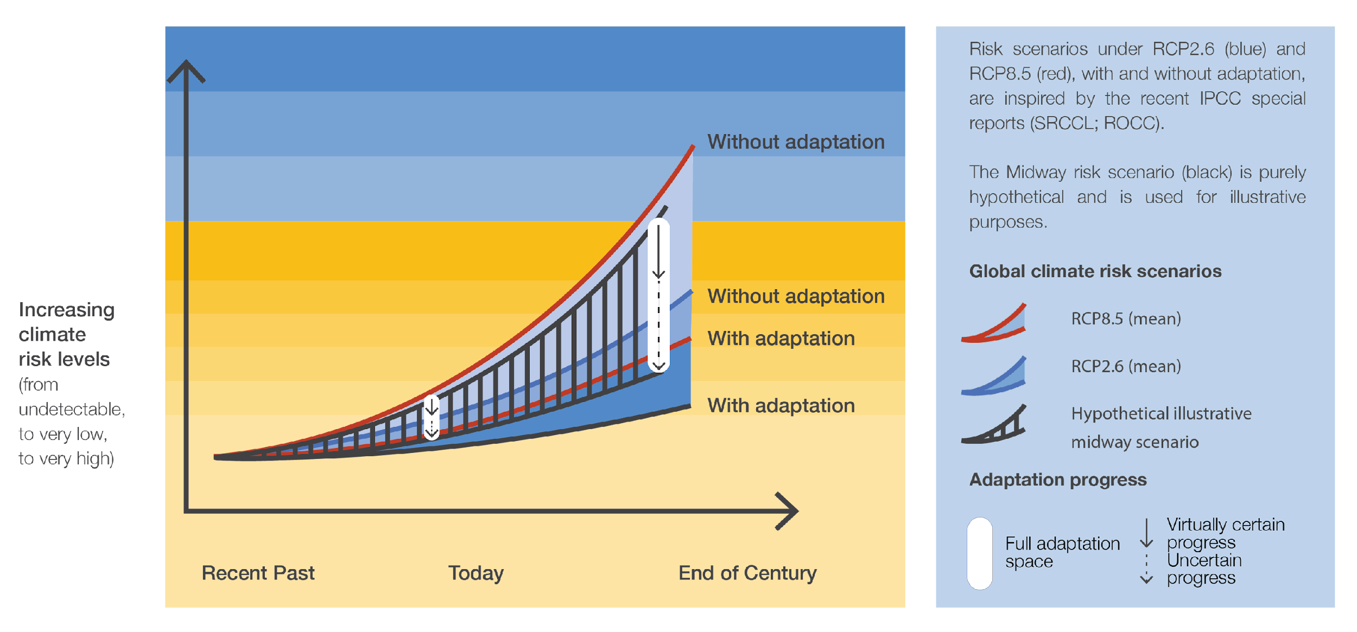
EHFG VGYDF CYGRVG CSU
▶ Essential elements of the NAP process
First Level
Second Level
EIWFH DCGGBC WEIUIVHKJ UDHF
Key reasons why countries should engage in the NAP process include:
Improve decision-making
Access finance
Live up to the commitments
Move forward on the UN Sustainable Development Goals
Safeguard against disaster risks
Figure 2: Progress in national-level adaptation
against different climate risk scenarios
UNEP (2021). Adaptation Gap Report 2020. Available at: https://reliefweb.int/report/world/adaptation-gap-report-2020

Slide 5
▶ Purpose and objectives of the NAP process
The objectives of the NAP process are:
To reduce vulnerability to the climate change impacts by building adaptive capacity and resilience; and
To facilitate the integration of climate change adaptation in relevant policies, programmes, and activities within relevant sectors and at different levels.
The purpose is to enable the planning, prioritization and implementation of different strategies, policies, projects, and programmes for reducing vulnerability to climate change, building capacity for adaptation, and integrating adaptation into development
The NAP process should be continuous, progressive, and iterative.
It requires building a strong evidence base, improving skills and capacity, and adopting learning.

Slide 6
▶ Origin of the NAP process
In simple terms, the NAP process is a strategic process that enables countries to identify and address their medium- and long-term priorities for climate change adaptation.
Led by national governments, the NAP process includes an analysis of current climate variability and future climate change and an assessment of vulnerability to its impacts.

Slide 7
▶ Links to NAPAs and NDCs
National Adaptation Programmes of Action (NAPAs)
focused on short-term adaptation needs and priorities;
was designed to produce one national adaptation programme of action
National Adaptation
Plans (NAP)
is intended to identify and address medium- and long-term adaptation needs
is designed to create a comprehensive system
to produce national adaptation plans on an ongoing basis;
is a domestic planning process
Nationally Determined Contributions (NDC)
developed to communicate a country’s contribution to meeting the goals of the Paris Agreement;
is a country’s pledge

Slide 8
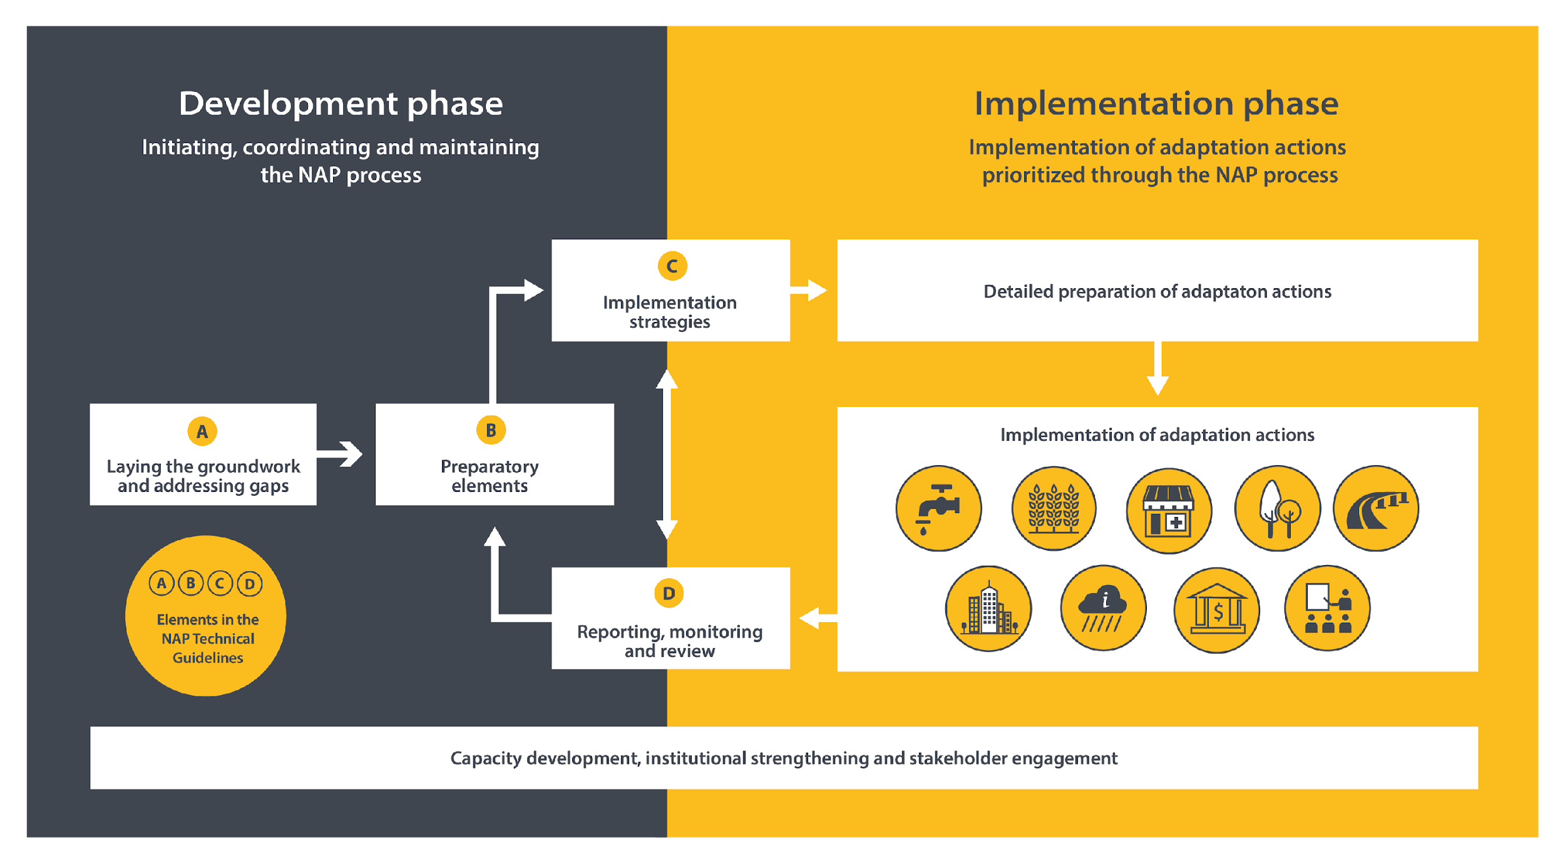
EHFG VGYDF CYGRVG CSU
▶ NAP core stages
First Level
Second Level
EIWFH DCGGBC WEIUIVHKJ UDHF
Two broad phases of the NAP process:
Development phase that includes actions taken to initiate, coordinate and maintain the NAP process on a continuous basis.
Implementation phase that encompasses the preparation and implementation of individual adaptation actions prioritized through the NAP process.
Figure 3: The General NAP Cycle Overview with Key Elements
NAP Global Network (2017). Financing National Adaptation Plan (NAP) Processes: Contributing to the achievement of nationally determined contribution (NDC) adaptation goals. Available at: https://www4.unfccc.int/sites/NAPC/Documents/Supplements/napgn-en-2017-financing-nap-processes.pdf

Slide 9
▶ Inclusion and participation
Inclusion begins with a realization that many of those who are impacted by climate change also have disproportionately low responsibility for causing the emissions responsible for climate change in the first place and little voice in changing the ways it works.
Gender and inclusion should also be considered via such crosscutting dimensions.
Inclusive NAP process can bring wide-ranging societal benefits and ensure a more robust and effective adaptation pathways.

Slide 10
▶ Preparation
Participants of the NAP process should be well-aware of the available sources of data, such as national, regional, and global data sets, observations, and analyses.
In this context, there are three types of information that should be taken into consideration:
Historical: historical observations that can be used to assess long-term trends, variability, and extremes.
Present: the routine provision of consistent and comparable information on the state of the climate.
Projected: projections generated from climate models used to estimate future changes of relevant climatic contributing factors.

Slide 11
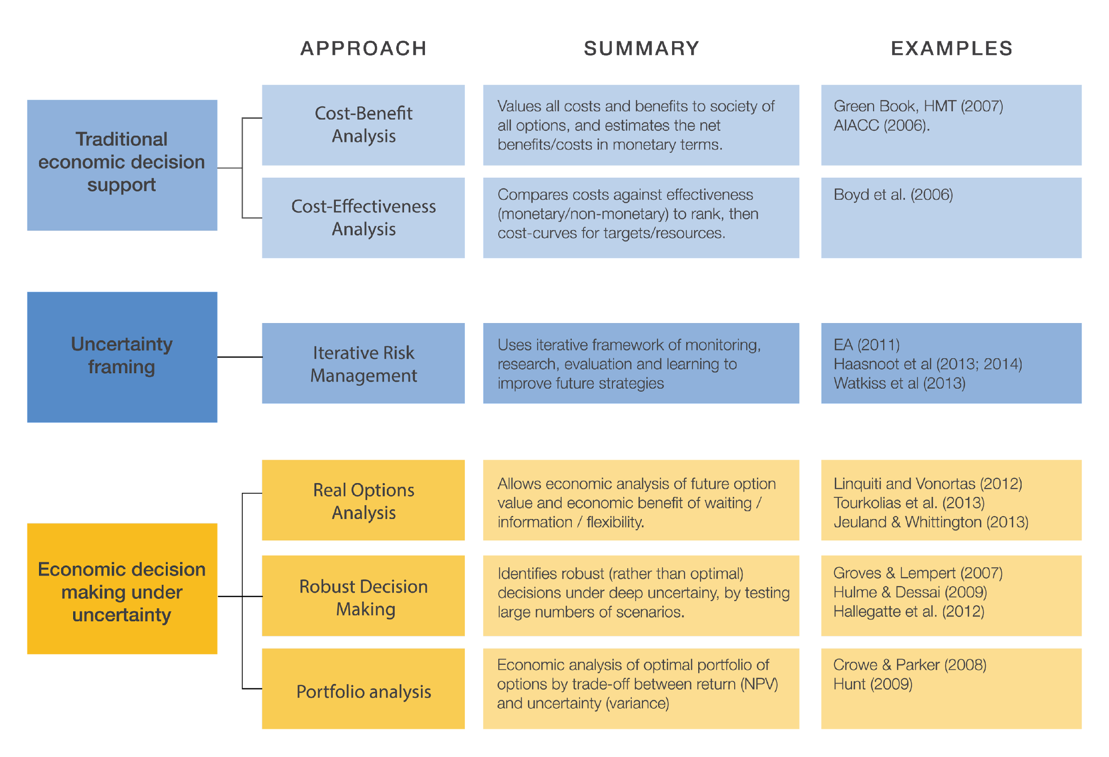
▶ Learning to decide: criteria, methods, and tools
Key decision support tools used today in climate adaptation.
Different approaches will work well in different circumstances, depending on the characteristics of the adaptation options being considered, data availability, and the time and skills available to the decision-maker.
Some adaptation context may benefit from or require using to two or three methods to gain extra perspective.
Figure 5: Key decision support tools in climate adaptation planning

Slide 12
▶ Planning for horizontal, vertical, and cross-sectoral integration
Integrating climate change adaptation across different levels of government is one of the main objectives of the NAP process.
In national adaptation planning, vertical integration represents:
the process of creating intentional and strategic linkages between national and sub-national adaptation planning, implementation and monitoring & evaluation.
The NAP process can also enable a cross-sectoral and integrative approach to integrate disaster risk reduction and climate change adaptation and to mainstream both into other activities on sustainable development.

Slide 13
THANK YOU

