Slide 1
Phase 2: NAP Implementation and Monitoring

Slide 2
▶ What is NAP implementation?
The NAP process should consider multiple temporal and spatial scales.
Adaptation activities require systematic investments on the ground.
The specific actions to be implemented will depend on the activities prioritized in the national adaptation plan.
Successful adaptation governance requires:
Understanding of practices at different levels,
Relationships between actors and across levels.
NAP implementation allows countries to make adaptation a long-term priority and supports the establishment of national climate policy and governance.

Slide 3
▶ Top-down: strategy, policies, options, and coordination
Top-down implementation stems from select sources of expertise, power of law, and authority. It tends to centralize decision-making.
National governments or their authorities often take the lead in defining a NAP policy and legal framework, as well as adaptation priorities.
Top-down actions are important for:
Effective collection of data and insights;
Building an internally coherent and consistent database;
Understanding of capacities across levels and regions; and
The distribution of nationally channelled resources to actors based on their differentiated needs and vulnerabilities.

Slide 4
▶ Bottom-up: urban climate governance and community-based adaptation
Bottom-up implementation leverages local capacities, cultural backgrounds, and situated knowledge to generate adaptation outcomes that resonate with the needs of specific local actors or larger communities.
Local actors often exemplify high commitment, a good understanding of their needs, and the capacity to generate novel adaptation solutions.
These actors also often lack the necessary capacities to make use of complex models, financial means, skills, and tools to make sound decisions.
Two of the most common approaches to local-scale climate adaptation action are:
urban climate governance (the capacities of local authorities)
community-based adaptation (citizen-driven)

Slide 5
▶ Climate science and information services for NAP implementation
NAPs serve as a vehicle for the implementation of climate services.
NAPs benefit from information on climate variability, trends and extremes and contain provisions that promote the climate services needed to achieve desired climate-related development outcomes.
NAP implementation involves decisions related to climate risk management.
Climate services are thus necessary for an effective NAP process, assessment of climate vulnerabilities, identification of adaptation options, and development of activities that improve resilience to climate change.
Climate indices are an example of a climate information product that helps countries with NAP implementation.

Slide 6
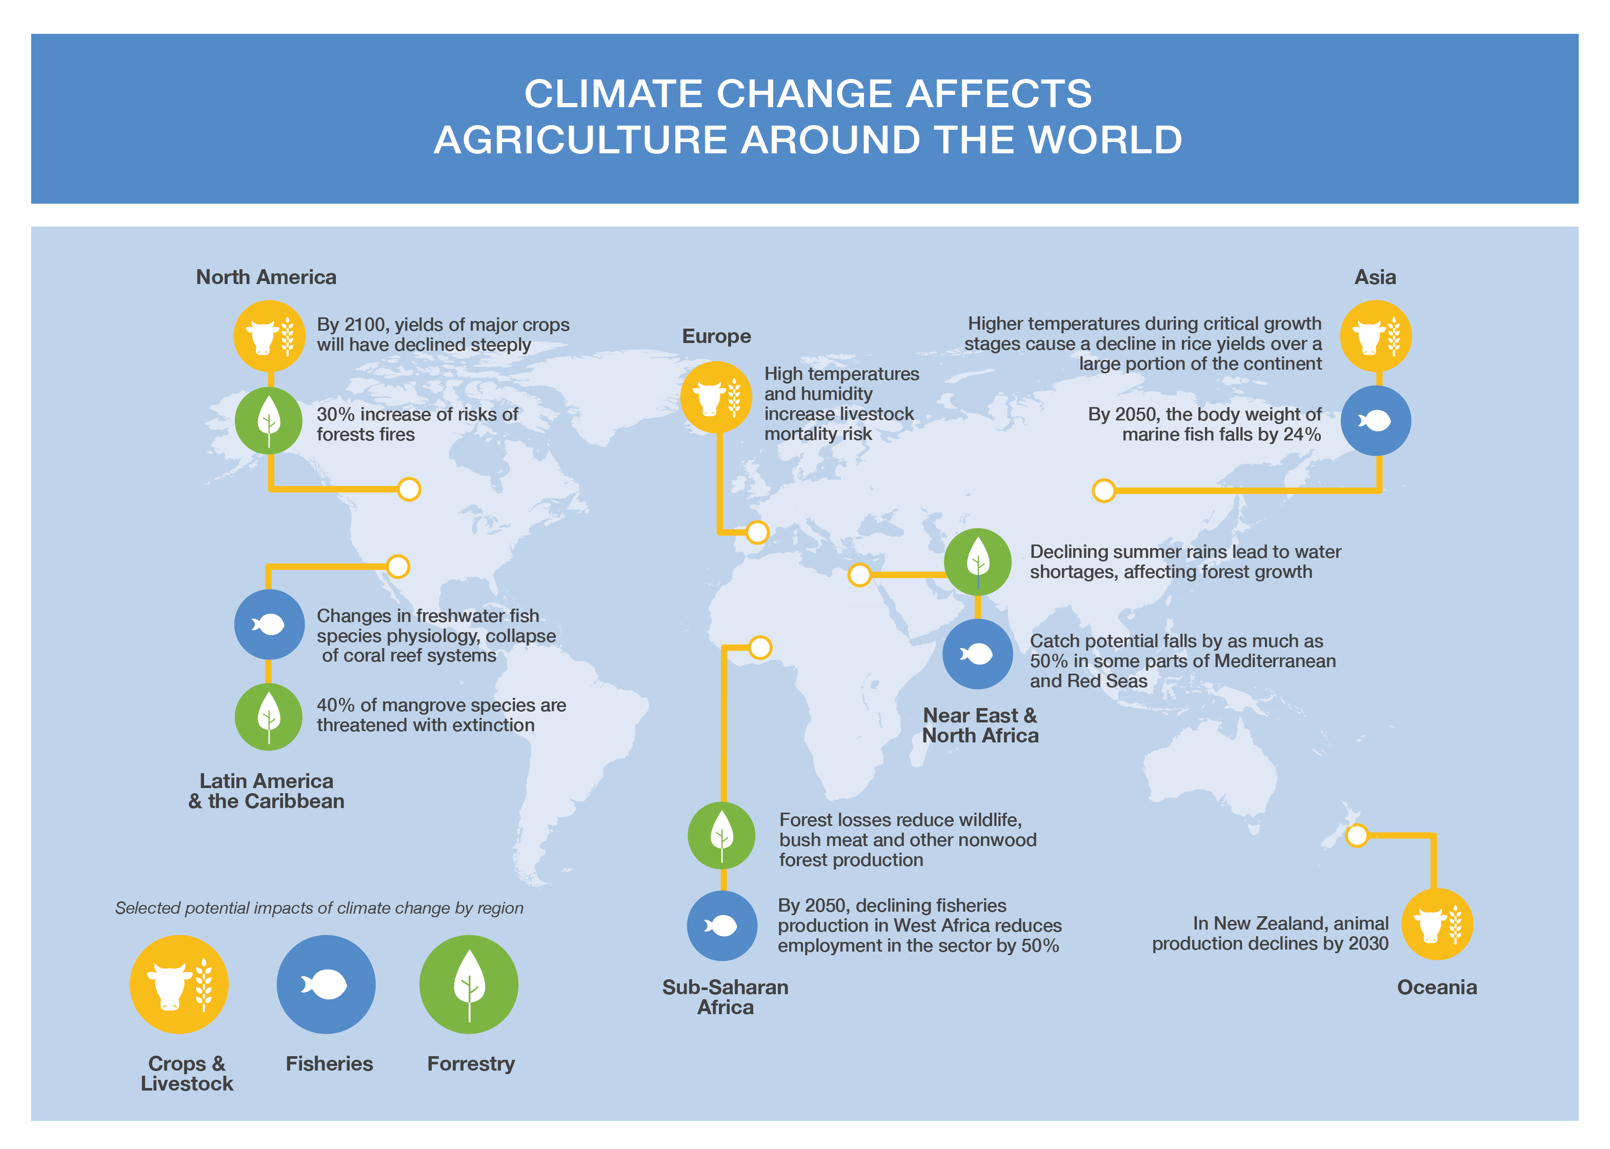
EHFG VGYDF CYGRVG CSU
▶ Sector-tailored activities: forestry, agriculture, and fisheries
First Level
Second Level
EIWFH DCGGBC WEIUIVHKJ UDHF
Feeding the growing global population amidst climate change is a complex challenge.
Farmers, fisherman, and foresters are employed in one of the most climate-vulnerable sectors, highly affected by climate change yet with limited capacities for effective responses.
Figure 1. Climate change affects agriculture around the world

Slide 7
EHFG VGYDF CYGRVG CSU
▶ Sector-tailored activities: forestry, agriculture, and fisheries
First Level
Second Level
EIWFH DCGGBC WEIUIVHKJ UDHF
The prospective impacts of climate change on fisheries, forestry, crops, and livestock around the world include:
effects on production and yield,
distribution,
seasonality,
overall ecosystem dynamics
These trends highlight the importance of food system transformation in adapting to climate change.
It is important to consider the complex dynamics of multi-level and multi-actor contexts.

Slide 8
▶ Forestry, agriculture, and fisheries
Traditional farming practices that build on natural processes help to improve soil fertility, prevent soil erosion and nutrient loss, will play an important role in a technologically enabled and highly automated future.
Tailored policy regimes and institutional arrangements can be highly beneficial in certain contexts.

Slide 9
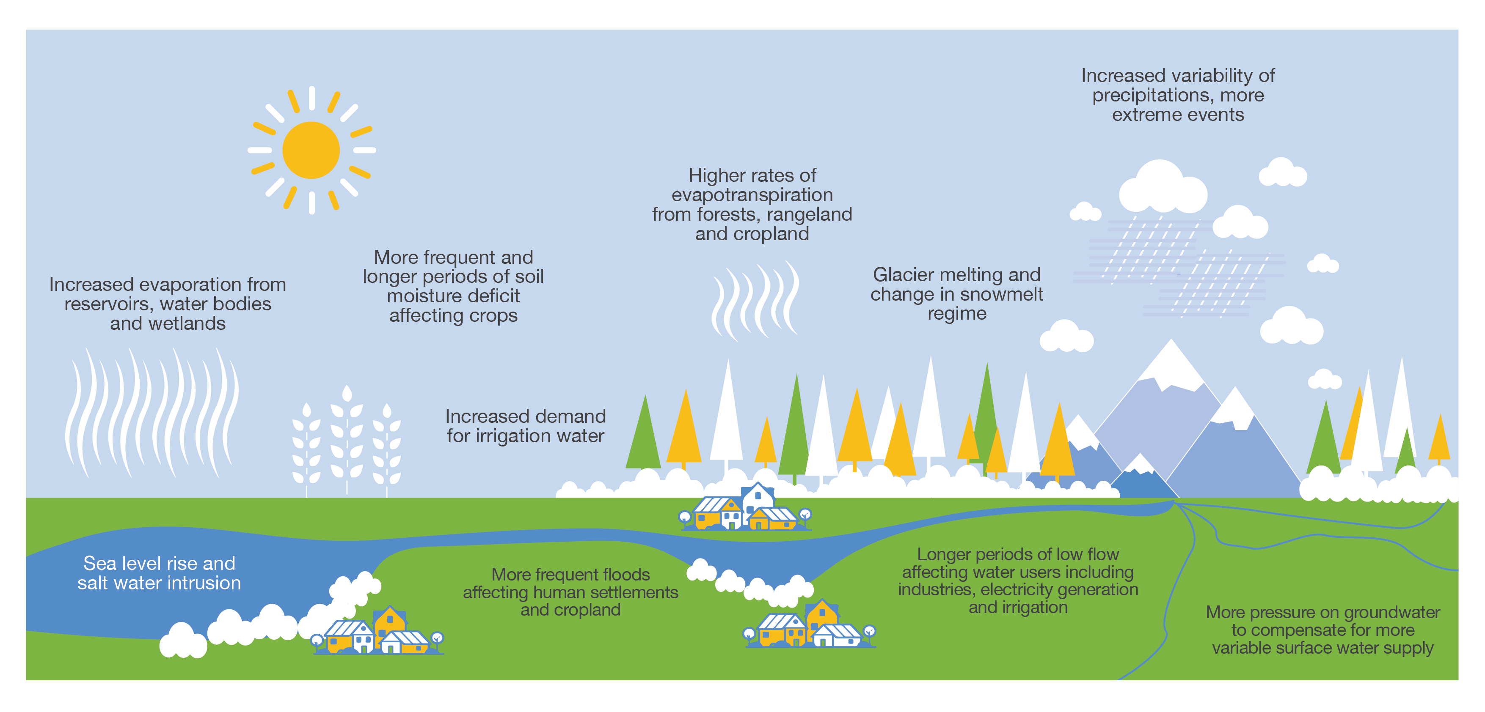
EHFG VGYDF CYGRVG CSU
▶ Water
EIWFH DCGGBC WEIUIVHKJ UDHF
Figure 2. Links between climate change, water cycle, and agriculture
Climate change presents an evident challenge for water stewardship, which in turn has consequences for human wellbeing.
Droughts, floods, melting glaciers, sea-level rise, and storms are all manifestations of changes in the water cycle, triggered by climate change.
This may lead to conflicts over the availability of water, climate migration, as well as significant losses and damages.

Slide 10
▶ Infrastructure
Infrastructure is highly vulnerable to the physical impacts of climate change, yet also plays a critical role in developing resilience to future climate shocks.
Climate-resilient infrastructure helps to achieve greater reliability of services, longer asset lives, and safeguard asset returns.
Flexible and adaptive approaches to infrastructure are essential for lowering the costs of developing climate resilience in an uncertain future.

Slide 11
▶ Energy
Climate change affects energy provision and security, through changes in seasonal and annual heating and cooling demands, or risks to energy production and supply conditions.
Public actors can build more climate-resilient energy systems by:
supporting further knowledge development,
establishing specific funds for energy system adaptation,
sharing risks and investments through public-private partnerships,
introducing reporting requirements for Strategic energy firms.

Slide 12
▶ Health
Health is strongly influenced by climate change, with key impacts classified into:
direct (e.g., physical damage caused by climate change);
those mediated via the environment (air pollution, vector-borne diseases) or
society (climate migration, quality of life, undernutrition).
NAP implementation in the health sector should consider:
Building a climate-resilient health system includes multiple tasks, such as
ensuring universal access to essential health services;
adequate infrastructure
monitoring to manage the spread of climate-related diseases;
continuous work to reduce inequalities in terms of exposure to health hazards.
Health system transformation should be considered across multiple scales.
how the delivery of health services will need to transform under different climate scenarios and
how capacities of and load upon health systems will change under those conditions.

Slide 13
▶ Nexus
EHFG VGYDF CYGRVG CSU
First Level
Second Level
EIWFH DCGGBC WEIUIVHKJ UDHF
Energy, agriculture, water, health, and climate change feature complex linkages.
They can lead to both benefits and trade-offs.
Building synergies is a key task of nexus thinking.
Disruptions in food, energy, or water supply are highly probable under climate change and can undermine human health over short or long periods, which in turn can lead to lower economic productivity.
Figure 3. The food, water, and energy nexus

Slide 14
▶ Cross-cutting activities: from sectoral action to nexus thinking
NAP implementation means continuous engagement and collaboration with a wide range of stakeholders, many of whom are responsible for action on the ground.
Adaptation requires action by different actors at numerous levels within and outside of governments.
The coordination can be horizontal (e.g., among ministries), vertical (e.g., among national, global, and subnational actors) or among stakeholders (e.g., between government and businesses).

Slide 15
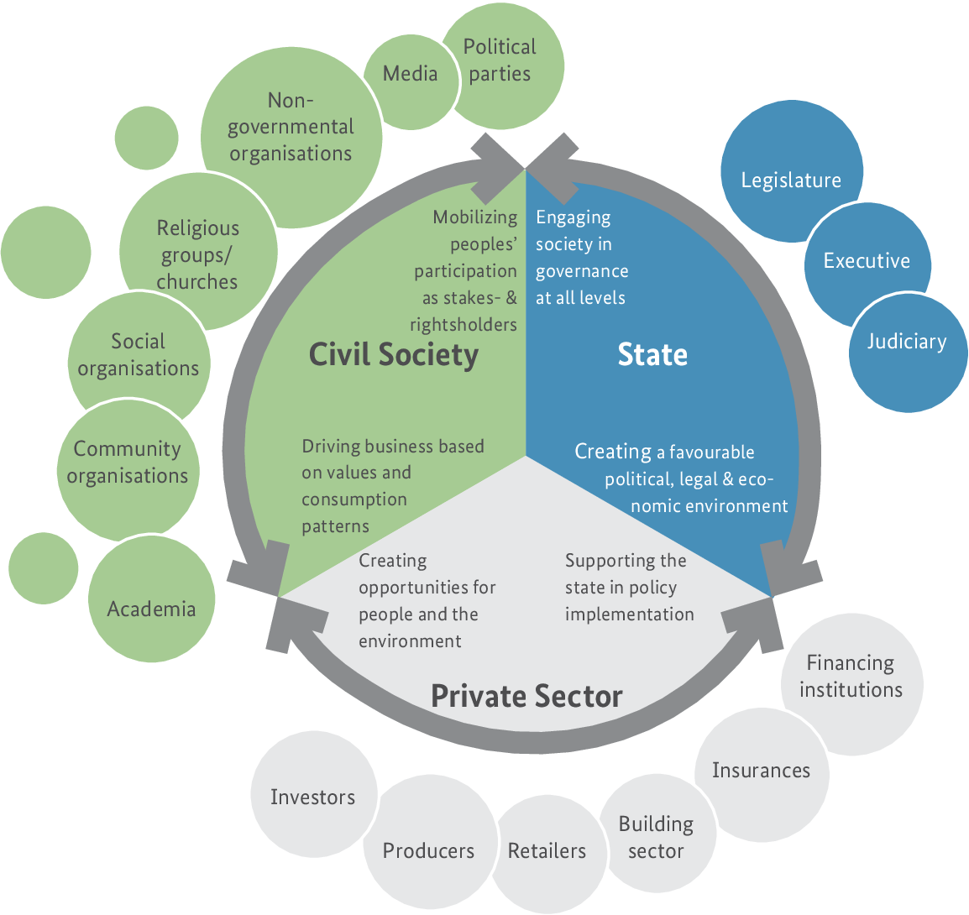
▶ Basic principles for choosing methods of stakeholder engagement
NAP implementation requires involving a wide range of actors such as:
policymakers,
subnational entities,
the private sector,
academia, research institutions,
civil society,
local communities,
indigenous people, and
the general public.
Figure 4. Ecosystem-based adaptation governance: key actors and their mandates

Slide 16
Figure 5. Considering different rightsholder and stakeholder perspectives
The NAP process should include diverse target groups at different stages.
When it comes to implementation, however, local decision-makers, private and civil society actors will come to the centre, as mechanisms and policies need to be manifested via on-the-ground actions.
By incorporating the voices of many stakeholders, particularly the most vulnerable, long-term adaptation can be better tailored and more effective.

Slide 17
▶ Capacity development
Capacity development allows individuals and organizations to discover, build, update, sustain and evolve their ability to define and reach their goals.
The assessment of the technical and functional capacities for NAP across capacity development needs to ensure a participatory stakeholder process.
An important element of effective capacity development is drafting effective terms of reference to hire consultants for general or specific positions.
At the initial stages, it is important to effectively assess institutional capacities for adaptation.
Capacity building takes place under constant interaction of individuals and organizations with dialogue between other organizations.

Slide 18
THANK YOU

