Slide 1
Phase 3: Monitor, Evaluate, Report, & Learn

Slide 2
▶ Monitoring, evaluation, and reporting
Monitoring, evaluation, and reporting regard implemented policies, plans, interventions, and investments, as well as achievements behind specific outcomes.
They help to find out whether specific interventions help decrease vulnerability and improve preparation and response capacities.
Monitoring aims to map climate change impacts and adaptation efforts across actors via criteria or indicators and showcases changes over time.
Evaluation classifies and assesses the efforts, based on monitoring the defined criteria and indicators. It usually takes place regularly. It is an iterative process.
Reporting aims to showcase and present the monitoring results to a broader audience and make the experience gained and lessons learned available to all kinds of stakeholders.

Slide 3
▶ Monitoring, evaluation, and learning
The process serves multiple purposes such as:
Tracing progress made;
Assessing what has been accomplished;
Communicating the processes and outcomes of adaptation;
Providing feedback on adaptation progress and performance
The overarching goal is to enable:
The evaluation itself needs to be a specific and separate effort to focus on getting deeper insights into some elements and to progress from these insights, feeding back into adaptation policy revisions.
new information and lessons learned to shape future decisions within an iterative policy and agenda-setting cycle.

Slide 4
▶ Monitoring, evaluation, and learning
Monitoring, reporting, evaluation, and learning should continuously improve knowledge on climate impacts and vulnerability, present and prospective challenges, opportunities, and remaining knowledge gaps.
It is useful to consider learning via a triple-loop lens:
Single-loop – improving routines, e.g., adapting to irreversible consequences
Double-loop – questioning assumptions, e.g., reconsidering approaches to assessing vulnerabilities
Triple-loop – revisiting discourses, e.g., questioning power dynamics and feasibility of present frameworks.
Single loop learning allows for incremental improvements. Double-loop learning helps to step beyond established practices and try something new, while triple loop learning allows to fundamentally reshape present systems and build a qualitatively new ground for adaptation, addressing the core drivers of climate change.

Slide 5
▶ Reporting and transparency
The Enhanced Transparency Framework (ETF) has been established to build mutual trust and confidence among parties of the Paris Agreement, allow comparability of progress, support mutual accountability, and promote effective implementation of the agreement.
Several countries have established systems of NAP monitoring and evaluation to date.
Most of the currently implemented systems sufficiently cover tracking of established documents and measures, targeting of vulnerable groups, and effectiveness of inclusion.
Most countries that have submitted NAP documents expect to update them once every five years.

Slide 6
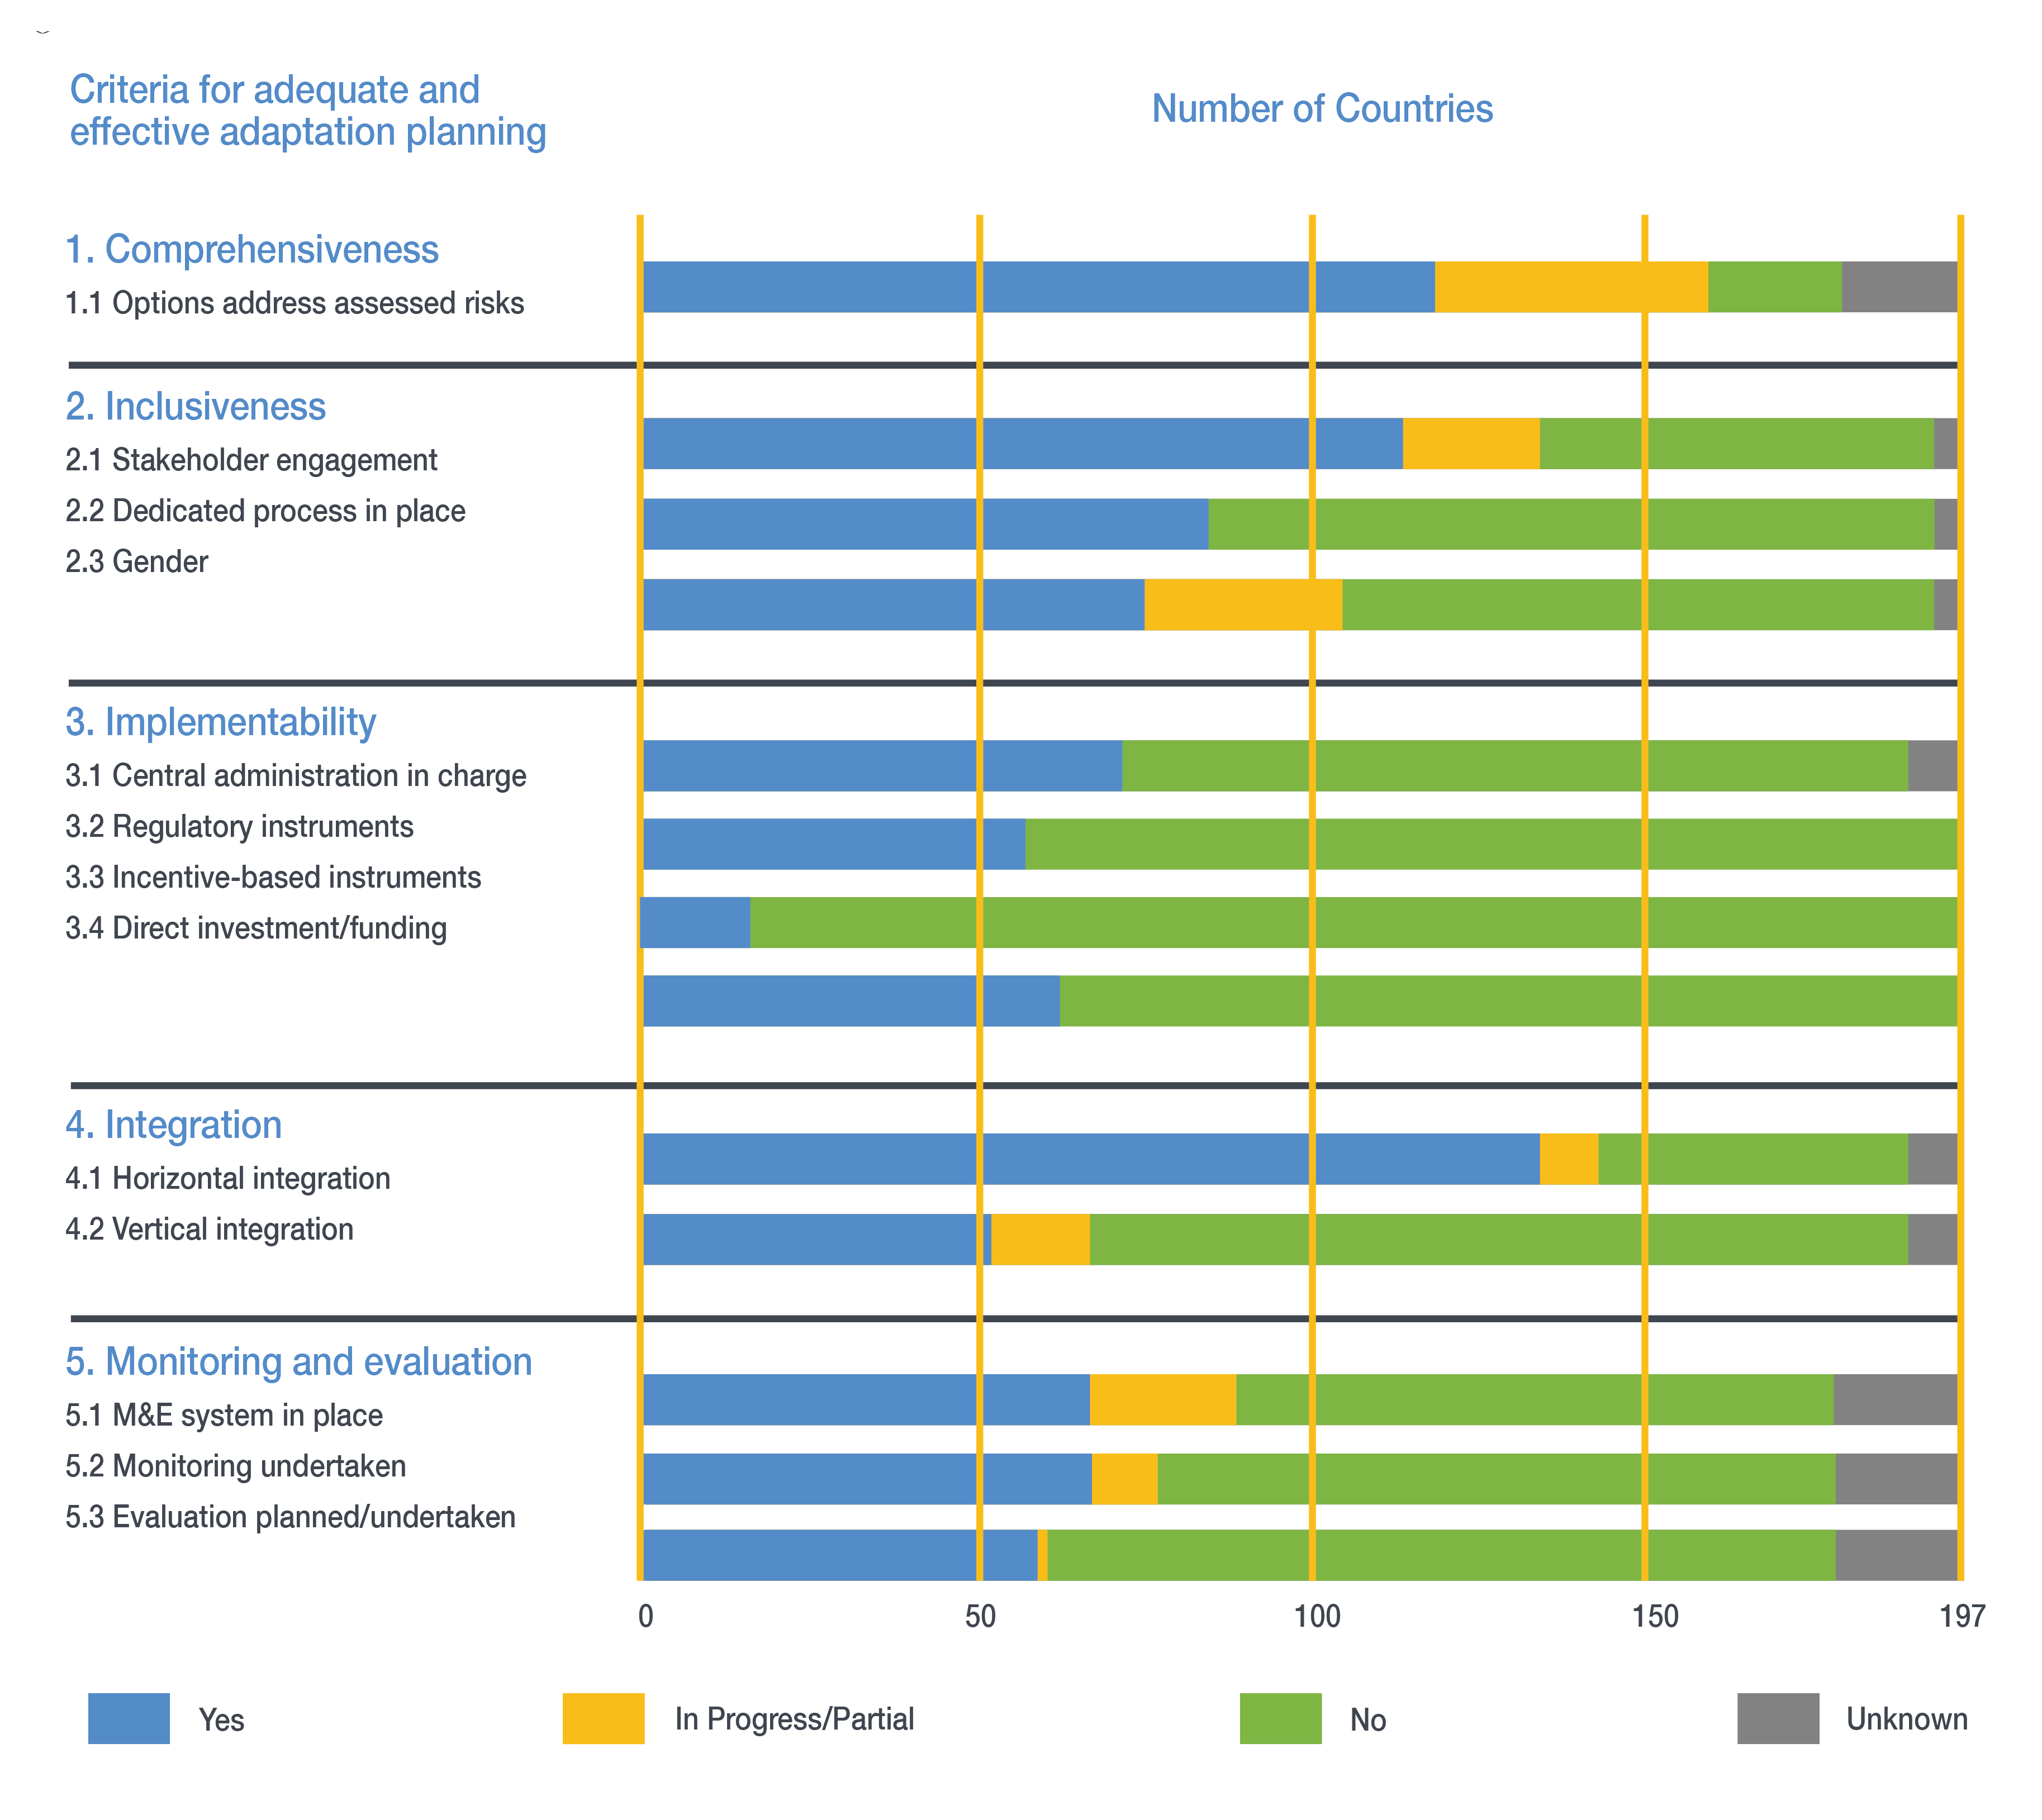
EHFG VGYDF CYGRVG CSU
▶ NAP Global Progress: how well are we doing?
EIWFH DCGGBC WEIUIVHKJ UDHF
Countries diverge significantly in how they satisfy the criteria for adequate and effective adaptation planning.
There are low capacities on data collection and management, procedures for reporting on NDC progress and achievement, and procedures for reporting support needed.
Figure 2. Criteria for adequate and effective adaptation planning

Slide 7
▶ What have we learned until now?
The UNFCCC systematically assesses and classifies gaps and needs related to NAP processes, and necessary support activities to overcome them.
The NAP process significantly depends on finding effective entry points, which can be complicated by lack of awareness, lower than expected funding, or new urgent issues requiring attention.
To ensure an effective start, it is essential to establish linkages between climate planning and broader national priorities and strategy.

Slide 8
▶ Agenda for action on adaptation
Adjusting systems and decision-making based on previous experiences and new developments allow countries to move forward on their adaptation priorities.
The specific systems to track the most recent development are also essential to be established.
Building a long-term political culture and dialogue among stakeholders is one of the key-ways to ensure this process evolves.
The COVID-19 pandemic brought valuable lessons, such as facilitated digitalization, and showed that rapid emission cuts are possible.
Despite all the challenges, we need to accumulate resources and accelerate action, with renewed knowledge of recovering from shocks.

Slide 9
THANK YOU

