Slide 1
Phase 3: Financing the NAP Process

Slide 2
▶ Key concepts and ideas
The Paris Agreement suggests the need for countries to align their financial flows to support climate action.
Article 9:
“developed country Parties shall provide financial resources to assist developing country Parties concerning both mitigation and adaptation in continuation of their existing obligations under the Convention”.
Article 7:
“strengthening scientific knowledge on climate, including research, systematic observation of the climate system and early warning systems, in a manner that informs climate services and supports decision-making”.
This will allow Parties to pursue adaptation actions based on and guided by the best available science. Financing is necessary throughout the entire NAP process.

Slide 3
▶ Key concepts and ideas
Adaptation finance: Climate finance, targeted specifically at adaptation needs, often framed within the NAP process, as well as broader measures with adaptation benefits or reduction of exposures.
Climate finance: Local, national, or transnational financing from public, private, and alternative sources seeking to support climate change mitigation and adaptation
Adaptation benefits: “The avoided damage costs or the accrued benefits following the adoption and implementation of adaptation measures”.
Loss and damage: Losses and damage may occur where﻿ adaptation limits are reached – because actions are unaffordable, not physically or technically possible, socially difficult or simply not sufficient to prevent some harm to humans, the environment and assets – and where adaptation has not been optimally implemented.
Adaptation costs: “Represent the costs of planning, preparing for, facilitating, and implementing adaptation measures

Slide 4
▶ Embedding adaptation finance
Governments need substantial financial resources throughout the entire NAP process.
Climate science provides the basis for identifying and selecting investments necessary for adapting to climate change.
Climate science allows decision-makers to right-size, plan, and design investments and solutions that account for local circumstances and needs.
This leads to a smoother, more effective, and financially viable implementation of the selected actions.

Slide 5
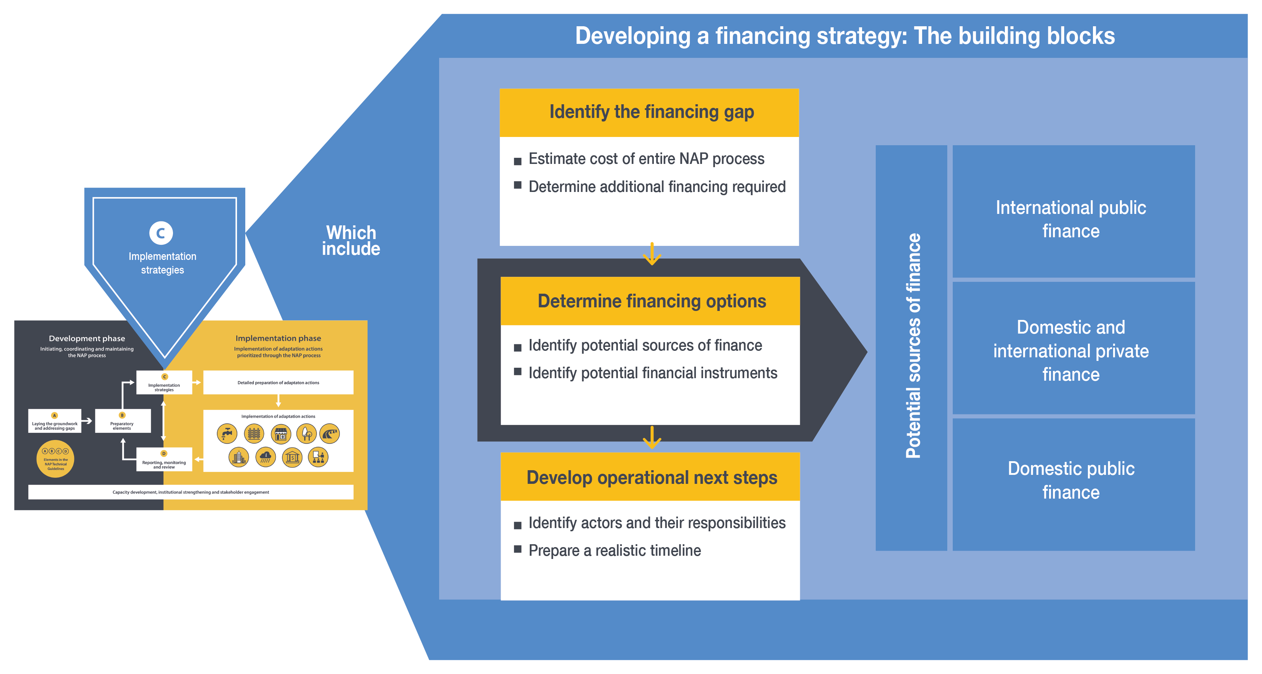
EHFG VGYDF CYGRVG CSU
▶ Monitoring, evaluation, and learning
First Level
Second Level
EIWFH DCGGBC WEIUIVHKJ UDHF
There are three-step process for systematically embedding adaptation finance into national climate finance, budgeting, and planning processes.
These include:
identification of needs, costs, and gaps
identification and prioritization of sources and options based on national needs and priority actions
defining steps and actions that can improve the likelihood of securing finance from identified sources
National adaptation finance should be designed to meet the needs of the NAP process across different temporal horizons and mandates.
Figure 1. Main building blocks of a NAP financing strategy and its link to the NAP process

Slide 6
▶ Identify needs and gaps
It is beneficial to establish grounds for effective tracking of adaptation finance flows, which allows:
A better understanding of the sources, users, and uses of adaptation finance
Builds transparency
Improves understanding of the available mechanisms
Strengthens the capacity to raise resources in the future
Builds an effective foundation for adaptation finance budgeting
Throughout the NAP process, it is recommended to consider both operating and investment costs.
The development costs will be covered mostly by public resources while the implementation costs are borne by a wide range of actors that are contributing to the implementation in a variety of ways.
Thus, it is important to assess and build the administrative capacities within the NAP core team to be able to develop the necessary instruments to facilitate effective stakeholder involvement in adaptation planning.

Slide 7
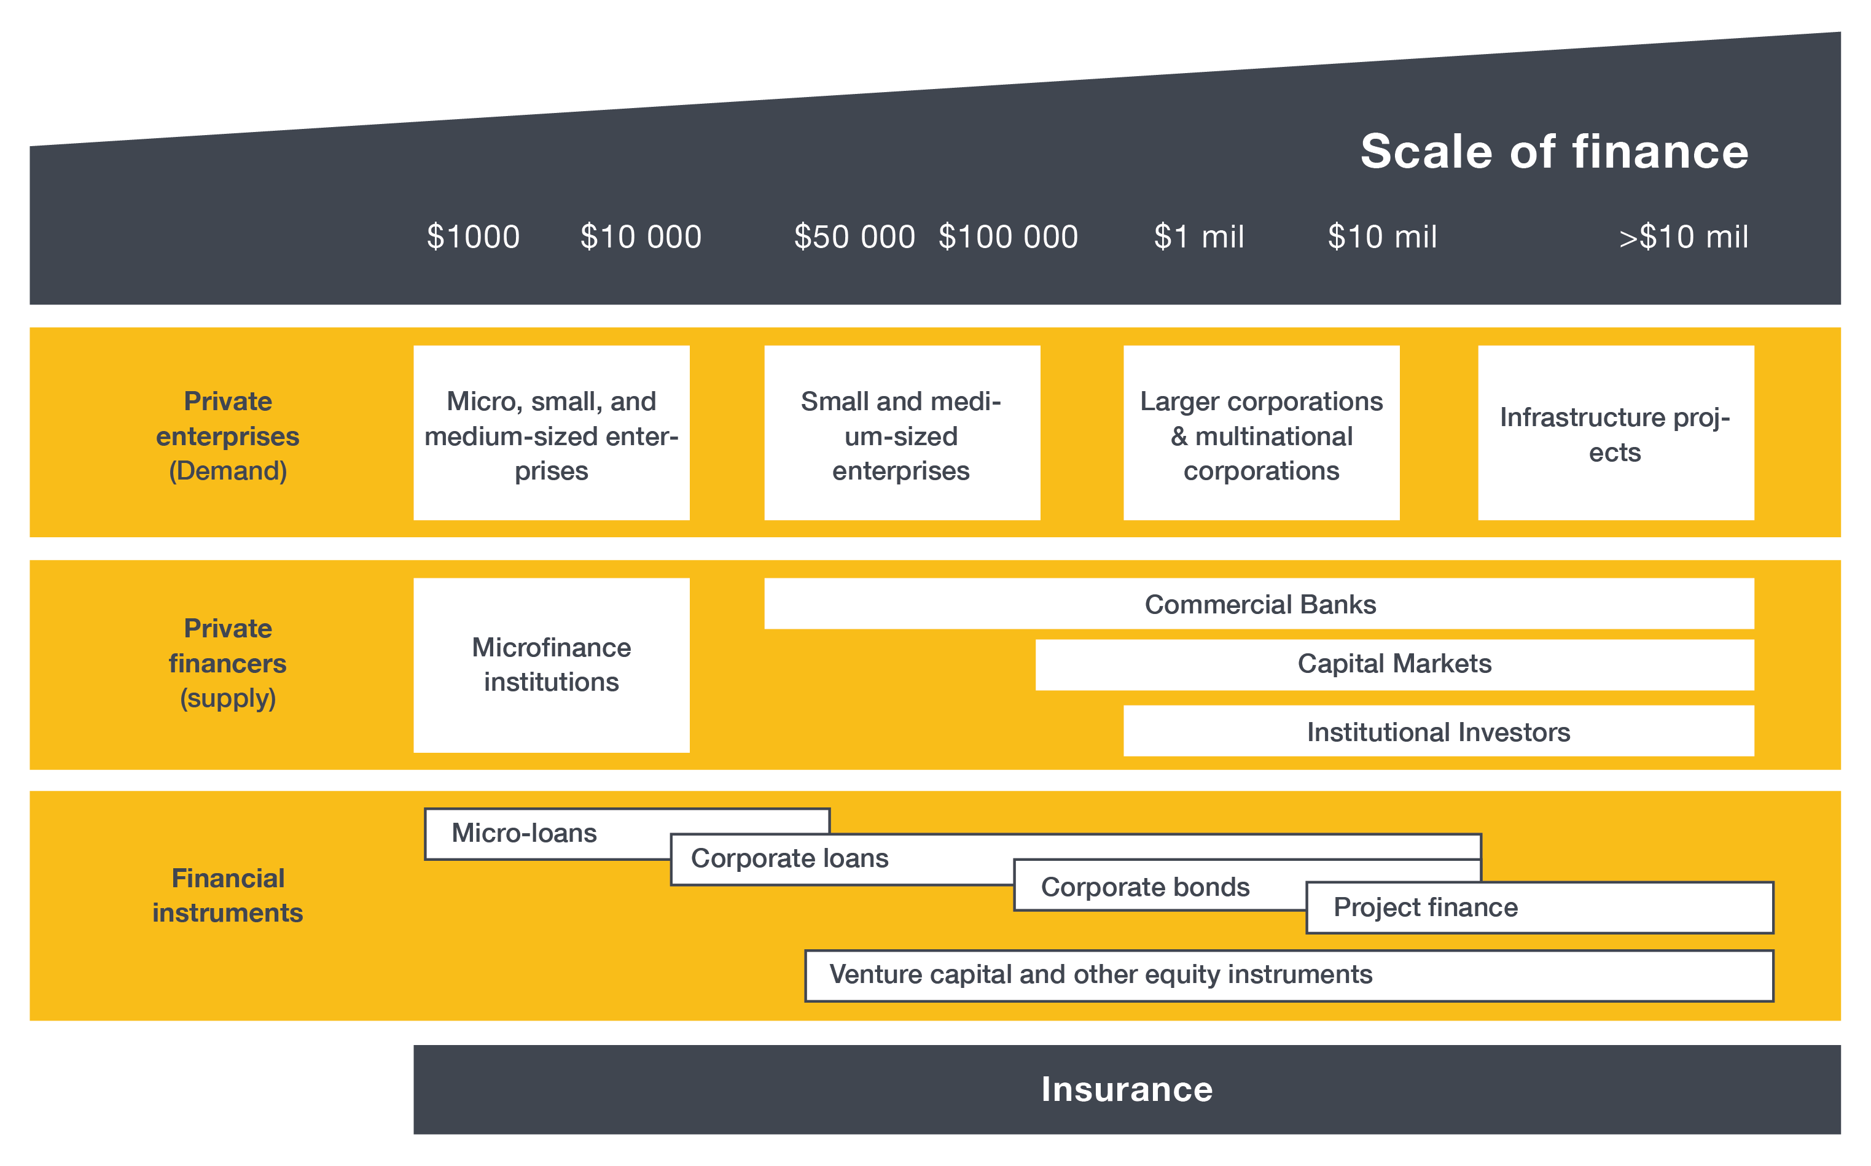
EHFG VGYDF CYGRVG CSU
▶ Explore finance options: seek diversity
EIWFH DCGGBC WEIUIVHKJ UDHF
Every country needs to determine how to best combine different sources of finance to meet their needs considering their capacities and contexts.
Effective combination of finance options requires understanding their similarities and differences.
The type of instruments that can be used and how they are applied differ vastly depending on:
associated return expectations,
transaction costs,
risk levels, and
other factors.
Figure 2. Interdependence between private sector actors, influence, and scales of finance

Slide 8
▶ Develop strategy and budget
A comprehensive government led approach that engages all relevant stakeholders toward the mobilization, management, and targeting of climate change finance facilitate identification of available financial means.
One approach to facilitate this is through the establishment of a Climate Change Finance Framework (CCFF).
The CCFF is a comprehensive and strategic approach through which governments can review financing gaps and outline key governance, planning, sourcing, and budget system reforms that better link climate finance with the delivery of priority actions.
NAP finance strategies may be formalized into an operational document featuring a general framework, a realistic timeline, key steps, and actors engaged at every stage.
Current experience suggests that establishing coherent adaptation finance strategies or broader climate finance frameworks can be a crucial factor behind overall progress on the adaptation process.

Slide 9
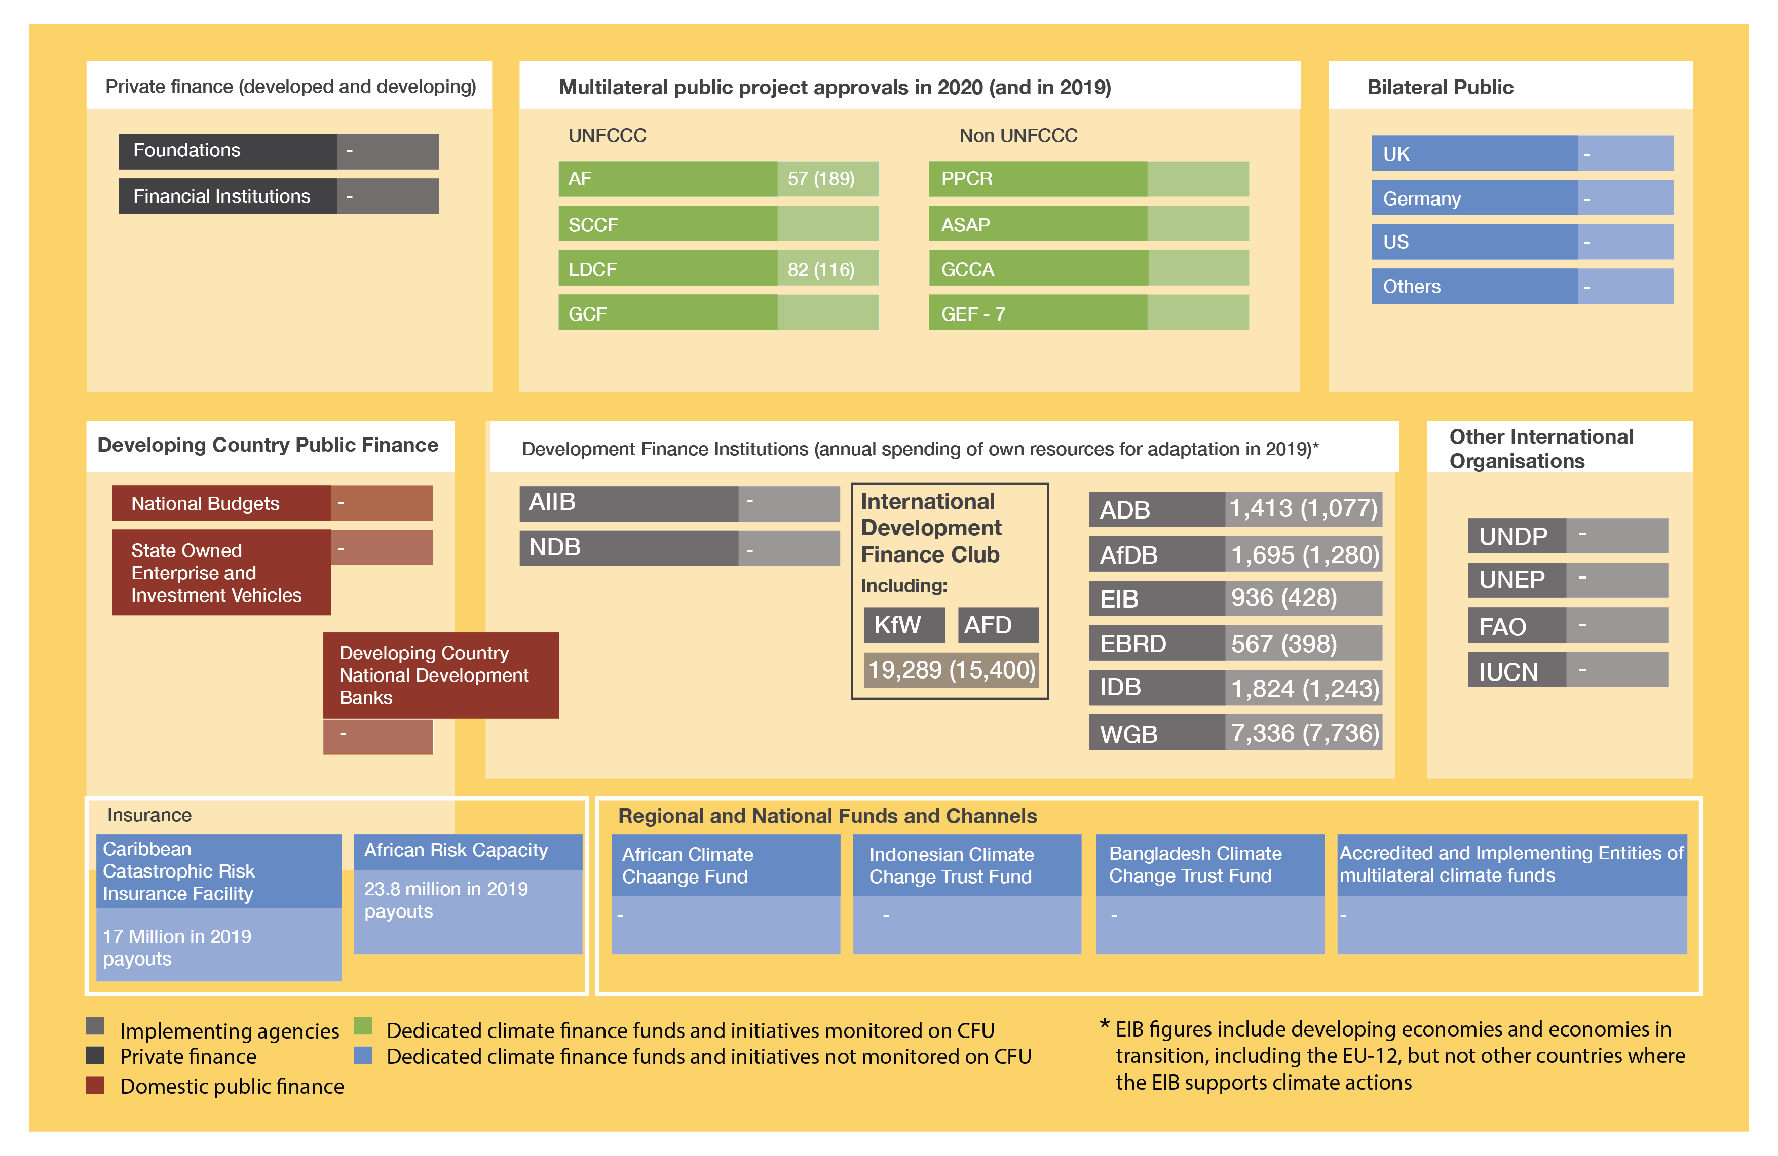
EHFG VGYDF CYGRVG CSU
▶ Sources of adaptation finance
EIWFH DCGGBC WEIUIVHKJ UDHF
The current adaptation finance architecture includes:
private and public finance,
both international and domestic,
resources from development finance institutions and
increasingly from insurance and risk pooling mechanisms.
Countries can access diverse financial sources to support their NAP processes.
The implementation phase is particularly resource-intensive while also offering a wide scope of opportunities for finance.
Figure 3. Adaptation finance architecture diagram (US$ millions)

Slide 10
▶ International public finance
Bilateral donors focus on grant-based technical assistance as part of broader support packages, as well as bilateral development banks focused on specific projects.
There are two key channels they use, as outlined below:
Government-to-government commitments: Build on country priorities and collaborative arrangements and financed via either bilateral assistance overall portfolio.
Targeted climate funds: Finance specific adaptation projects.
NAP processes provide a strategic opportunity to communicate a country’s adaptation needs and to integrate adaptation priorities into frameworks for development assistance.
Bilateral finance may provide simpler and quicker access modalities than some multilateral mechanisms.
Bilateral providers place a strong emphasis on capacity development and technical assistance for adaptation, creating opportunities to finance the building of in-country capacity.

Slide 11
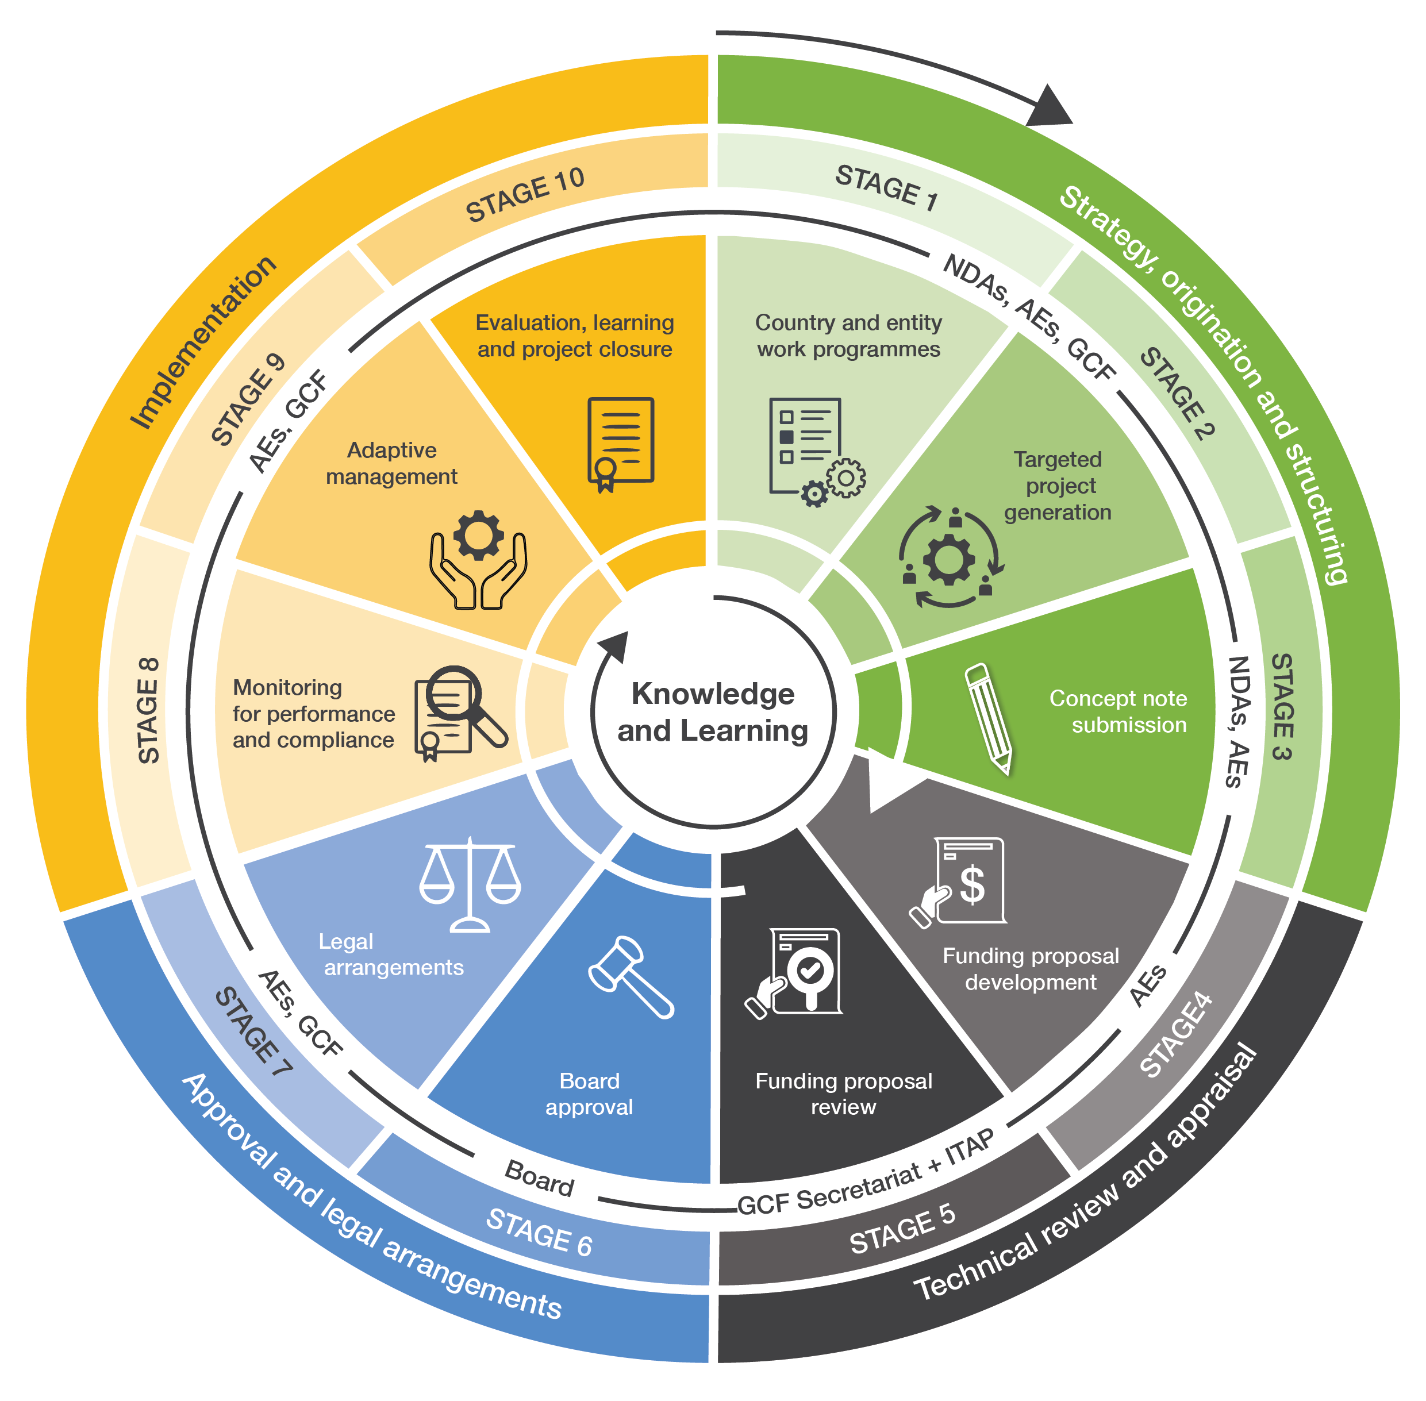
▶ International public finance
Multilateral providers comprise a heterogeneous group of funds both under and outside of the UNFCCC.
The largest sources of approved funding for adaptation projects are:
The Green Climate Fund (GCF),
he Pilot Program for Climate Resilience (PPCR),
Climate Investment Funds,
the Least Developed Countries Fund (LDCF) of the Global Environmental Facility (GEF), and
the Adaptation Fund (AF).
The GCF is the largest source of adaptation finance to date.
Overall, the GCF project approval process includes 10 stages, from project origination to closure.
Figure 4. GCF project/program activity cycle

Slide 12
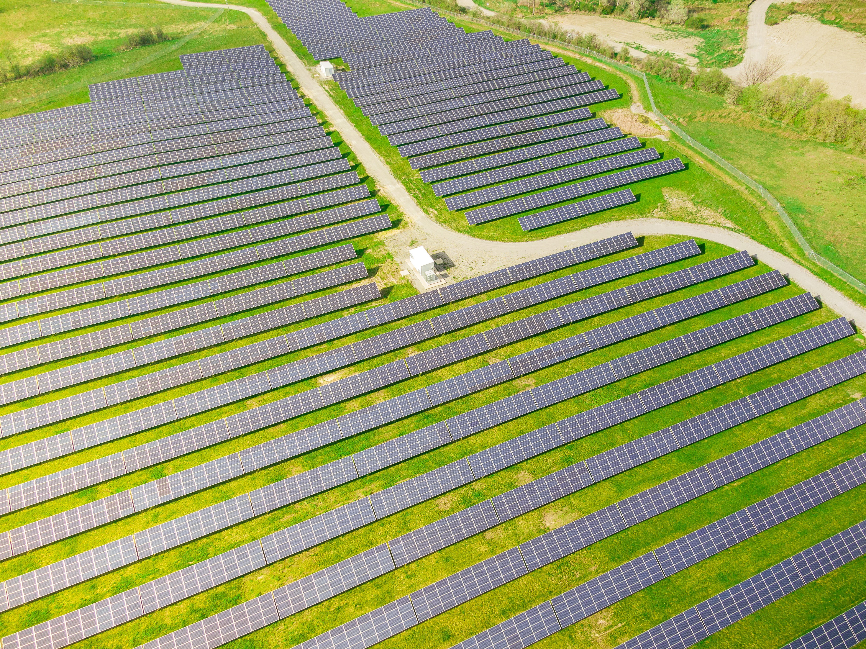
▶ International public finance
Development Finance Institutions / Multilateral Development Banks can support the implementation of adaptation measures, particularly those that are within the sector or scope of MDB priorities.
MDBs often finance specific adaptation or development projects with adaptation co-benefits. They can also help attract extra resources from the public and private sectors.
National authorities need to have a clear understanding of the agendas and expectations of different multilateral actors to achieve an optimal mix of different sources.

Slide 13
▶ Domestic public finance
Domestic public finance may serve as a key source for NAP development, coordination, and maintenance.
Identifying and systematically embedding costs into national planning and budgeting is necessary for securing stable and long-term sources of finance.
Mobilizing domestic resources has multiple benefits, such us:
High degree of ownership
Integration within current planning and budgeting frameworks
Defining priorities without relying on external agenda
It can also prove crucial for the maintenance of the NAP process under unstable conditions.
Such longer-term commitments at the national level can also be a signal for private actors to also start investing in adaptation.
While climate finance is often limited, it is essential to back and kickstart priority projects that are not of significant interest to private investors at their inception.

Slide 14
▶ Private sector finance sources
The NAP process allows governments to attract private actors to implement adaptation measures.
Some of the key private-sector initiatives plays an important role in charting the trajectories of adaptation finance.
Engaging private sector actors requires understanding of their motivations, concerns, and scope of options relevant to each actor.
There is also rising participation of microfinance institutions, commercial banks, capital markets, private equity, infrastructure funds, and institutional investors, as well as households.
Smart and viable adaptation investments would rather focus on long-term solutions that prioritize water harvesting and reuse, instead of depleting local capacities.
Every decision may have its implications and thus outcomes and risks of adaptation finance and investments should be considered across different temporal horizons, spatial scales, and groups of stakeholders.

Slide 15
▶ Transformative climate finance
The World Bank has developed a set of key recommendations to guide transformative climate finance:
Recommendation | Explanation
Plan for the long term | Avoid short-term projects that may undermine long-term objectives or are inconsistent with them. Consider interim steps necessary to achieve the desired transformation.
Nurture policy-financing and enabling environments | Target finance to activities that help to overcome the barrier to transformation and not simply support the status quo. Consider capacities and stakeholders necessary to drive this change.
Use a wide palette of instruments | More instruments mean different stakeholders can find the best ways to get their projects funded under optimal conditions and a higher likelihood of effective implementation.
Enhance leverage on a wider, systemic basis | Support projects that can leverage funds from other sources and benefit the economy and adaptation beyond the project scope.
Invest in climate intelligence products | Climate intelligence such as GIS, early warning systems, modelling, and scenario-building software, and risk assessment tools can make or break the NAP process. It is crucial to invest in up-to-date software and technologies that support the NAP process and building skills to use them effectively.
Facilitate just transition | Business-as-usual style climate action poses a risk of significant externalities, pollution displacement, and unemployment. Economic benefits generated by climate action should be used to balance the impact on different groups, particularly ensuring employment and reskilling of those who lose jobs in carbon-intensive industries.
Differentiate by income and vulnerabilities | Poorest countries suffer most from climate change while being least responsible for it. Vulnerabilities also differ across scales and among groups.

Slide 16
▶ The more the better?
Currently, 95% of international public finance is awarded to development projects which do not fully prioritize climate objectives.
An important aspect of adaptation finance is its distribution amongst different types of solutions. Recent years have seen a rise of interest in nature-based solutions (NbS) which provide both mitigation and adaptation benefits.
Investing in NbS is considered a particularly important strategy for developing countries, as these are often low-cost and no-regret options.
Financing for infrastructure projects needs to be carefully assessed, which may have a high financial barrier to unlocking low-carbon and climate-resilient alternatives.

Slide 17
▶ Leveraging climate finance for transformative change
Raising the effectiveness of adaption finance is combining minimum conditions, performance measures, and a menu of eligible investments.
The minimum conditions and performance measures should essentially cover:
Good governance,
Public financial management,
Reporting on physical and financial,
Climate aspects risk and vulnerability assessments,
Mainstreaming of adaptation in local planning, budgeting, procurement/contracting and execution,
Technical compliance for climate-proofing,
The interface between participation of vulnerable groups, gender equality, transparency, and environmental and social safeguards.
Leveraging adaptation finance also requires effective consideration of risks.
Minimum conditions facilitate the creation of a robust transfer system for climate finance and gradually improve the accountability of local governments
Dedicated measures
addressing finance risks allow to prevent possible losses and inefficiencies and achieve a streamlined and robust process.

Slide 18
▶ Making climate finance work for all
Having communities involved in project monitoring or even as implementers of core activities can generate:
New employment opportunities
Improve the sense of ownership
Lead to a greater understanding of adaptation objectives and outcomes
To make climate finance more inclusive, both providers and beneficiaries need to be fluent in using a wide range of financial instruments.
Dedicated adaptation funds and initiatives make an increasingly clear case for greater investment in adaptation in the following decade.

Slide 19
THANK YOU

