Slide 1
Module I.1
The essentials of adaptation
Trainer: [Name]

Slide 2
Concept of the NAP training - I
Objectives
Improve understanding and raise awareness for NAP process
Strengthen the capacities of country teams to realize key NAP tasks
Familiarize with NAP elements, guidelines, support channels and links to other national processes

Slide 3
Concept of the NAP training - II
Method / Approach
Interactive adult learning approach: Harvard Case Method
Emphasis on case work/exercise in groups
Modular training along NAP Technical Guidelines
Tailored to national context
Notes:
Key Messages about the training approach:
The training should directly translate into real world activity – this is why it uses the Harvard Case Method
The Harvard Case Method
Practice-oriented, interactive learning
Bases on intensive examination and discussion of a case
Stimulates active exploration and development of conclusions by the trainee, rather than ready-made teaching messages
Encourages the trainee to make decisions and act under uncertainty
Elements
Short introductory lectures
Case work/exercise in groups
Wrap-up sessions/discussions
‚Real case‘ presentations
Underlying philosophy
Not to teach ‚truths‘ but to think in the presence of new situations.
To put the student in the habit of making decisions.
To encourage the student to act under uncertainty.
„You know the difference between daylight and dark? Well, we spend all of our time at the Harvard School on dawn and dusk.“ (Harvard Professor)

Slide 4
Overview of this module
  Climate change: a serious risk for development
  Adaptation – a definition
  Adaptation options
  “Fine, but is it really adaptation?”
  Adaptation from an economic point of view
  Challenges in adaptation planning
Notes:
Module is called “Essentials of adaptation to climate change”. And we will have a look at climate change as a risk for development.
We will see a definition and different options of how to adapt.
We will have a closer look at what the difference between adaptation to cc and usual development cooperation is.
We will have a quick look at the economic perspective on adaptation,
And learn about the most important challenges in adaptation planning.

Slide 5
What can you expect to learn from this session?
Ensure common understanding regarding basics of climate change and adaptation
Analyze inter-linkages between adaptation and development
Reflect challenges and benefits of adaptation
Notes:
At the end of this module, you should have learned:
You will have a common understanding of what climate change and adaptation is
and understand the “system character” of adaptation.
We will have analyzed the inter-linkages between adaptation and development - adaptation as an aspect of sustainability in development.
And we will have reflected about the challenges and benefits of adaptation including its co-benefits for development.
(After the exercise, establish the link to this slide “what can you expect to learn”)

Slide 6
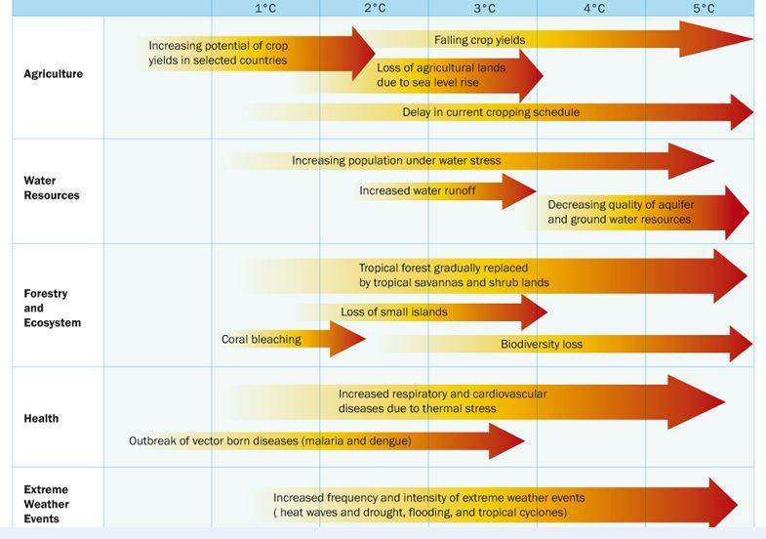
Climate change: a serious risk for development
Notes:
Potential climate change impacts with temperature change
Let‘s have a look at this figure. It shows the climate change impacts that are expected to happen as temperatures change.
As you can see, the impacts are widespread. Key sectors of society that will be affected by rising temperatures include agriculture, water, forestry, and health. The agricultural sector, for example, will in the long-term be affected by falling crop yields, loss of agricultural lands and also increased water stress.
As temperatures rise the costs of climate change also include the loss of small islands and forests due to sea level rise, coral bleaching, worsening human health, and increasing extreme weather events (frequency and intensity) such as droughts and cyclones.
Notes for trainer:
In selected countries, a temperature rise of only 1° will increase the potential of crop yields. However, as temperatures further increase, this will result in a decline in crop yields.
AR5 global warming increase (°C) projections:
(Depending on the Representative concentration pathways RCP)
2046-2065: between 1 - 2 ° C (Mean)
2081-2100: between 1 - 3.7 °C (Mean)
Across all RCPs, global mean temperature is projected to rise by 0.3 to 4.8 °C by the late-21st century.
The projections are relative to temperatures and sea levels in the late-20th to early-21st centuries (1986-2005 average)

Slide 7
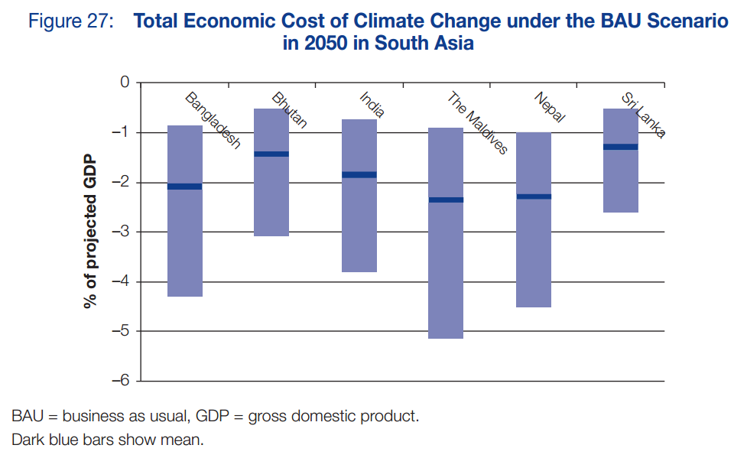
Climate change: a serious risk for development
Notes:
This figure shows total economic loss due to climate change for each of the six countries of South Asia in 2050. (BAU Scenario > if no action is taken)
The model suggests that the Maldives, being the most vulnerable among the six countries (as they are low-lying small coral island depending on fisheries industry and tourism), will be hardest hit in GDP loss. Under the BAU (Business-as-usual) scenario (→ i.e. if no action is taken), the economic damage will be around 2.3% of GDP in 2050.
The annual GDP losses projected for Bangladesh are 2.0%, Bhutan 1.4%, India 1.8%, Nepal 2.2%, and Sri Lanka 1.2%.
In the longer term, the total economic costs associated with climate change impacts are likely to increase in all countries.
Source: Asian Development Bank (ADB) Report 2014: Assessing the Costs of Climate Change and Adaptation in South Asia
(More detailled explanation for trainer:
The model suggests that the Maldives, being the most vulnerable among the six countries, will be hardest hit in GDP loss. The mean outcome of the simulation indicates that the economic damage will be around 2.3% of GDP in 2050, ranging between 0.9% and 5.0% of GDP within the 90% confidence interval. By 2050, annual GDP losses are projected under the BAU (Business-as-usual) scenario for Bangladesh (2.0%), Bhutan (1.4%), India (1.8%), Nepal (2.2%), and Sri Lanka (1.2%).)

Slide 8
Adaptation to climate change: a definition
Adaptation vs. mitigation
“actual or expected”
Reactive component: adapting to current climate
Proactive/preventive component: being prepared for coming events
“adjustments in ecological, social or economic systems or policy processes”
Adaptation related to various dimensions → complex challenge
Result of an iterative process
“Human-driven adjustments in ecological, social or economic systems or policy processes, in response to actual or expected climate stimuli and their effects or impacts”
(Definition by the Least Developed Countries Expert Group, LEG)
Notes:
So what can be done about it?
- 2 ways to respond to climate change impacts: mitigation and adaptation
- Increasing recognition that both mitigation and adaptation efforts are necessary in order to decrease climate risks and capture co-benefits
- Mitigation includes all actions to reduce or eliminate drivers of climate change, i.e. greenhouse gas emissions such CO2, CH4 and N2O. Options to
mitigate climate change are, for example: the use of renewable energy sources or afforestation leading to reduction of CO2 in the atmosphere. > By
implementing such measures, we can reduce the magnitude of climate change itself and thus prevent vast disruptions.
- Yet even if we now stop the increase of GHG emissions in the atmosphere, climate change will have some inescapable (adverse) effects.
(Climatologists have generally concluded that it is too late to prevent a one or two degree warming.)
- Adapting to the changes is therefore vital (for societies) either to keep the development path or, to at least, keep the current living standard.
- But what does adaptation mean? There are many definitions out there. I personally like this one from the LEG:
According to the Technical Guidelines …
read definition.
“actual or expected” climate stimuli:
Adaptation has a reactive component: adapting to current climate
And a proactive/preventive component: being prepared for coming events, anticipatory strategies for solving problems
The definition might sound trivial at first. However, it reveals that
Adaptation is related to various dimensions and needs to balance their different needs → complex challenge.
It addresses systems of economic development, social interaction, participatory decision-making and many others.
2. Adaptation is an iterative process that does not usually evolve in linear motion/ is not achieved at once.
3. Adaptation needs to be integrated into policy processes and sectors
In practice what can that mean?
(Break up rhythm of the slides with questions to the audience:)
What exactely can be undertaken in different fields in order to adapt to climate change? Which good practice examples of adaptation do you know?
Or another definition:
‘An activity should be classified as adaptation-related if it intends to reduce the vulnerability of human or natural systems to the impacts of climate change and climate-related risks by maintaining or increasing adaptive capacity and resilience’ (OECD/DAC, 2010).

Slide 9
Adaptation options - I
Policy
Examples: Adjust development plans; improve regulations; mainstream adaptation; adjust incentive systems; participation of affected communities…
No-/low-regret options
Examples: Avoid building in high risk areas; soil conservation
Technical solutions
Examples: Dyke construction; efficient irrigation systems
Notes:
Let‘s have a look at further examples in different fields.
For instance, in a policy context, this could mean to
adjust development plans in order to reduce vulnerability; improve regulations; to mainstream adaptation, i.e. to systematically include climate risk and adaptation considerations in regular decision-making and planning processes. This is necessary because by taking climate change into account in planning and decision-making regarding investments, we can prevent costs and destructive impacts of climate change. (→ Refer to module III.4); adjust incentive systems; participation of affected communities in territorial planning …
It is advisable to implement no- or low-regret options (as opposed to high regret options):
These are measures that are cost effective to implement today, where the benefits are less sensitive to precise projections
about the future climate, and where there are co-benefits or no hard trade-offs with other policy objectives.
Break up rhythm of the slides with questions to the audience: ) Which no-regret measure comes to your mind? …
Examples: Avoid building in high risk areas (e.g. flood plains) when locating, Soil conservation to improve agricultural yields and keep ecosystem functions intact
Technical solutions:
Examples: Dyke construction, efficient irrigation systems
Research: How does research contribute to adaptation, which initiatives come to your mind?
Examples: regional climate models, climate-resilient breeds/species
Capacity development:
Examples: Train technical staff in ministries in interpreting climate data; improve management skills

Slide 10
Adaptation options - II
Research
Examples: Regional climate models; climate-resilient breeds/species
Capacity development
Examples: Train technical staff in ministries in interpreting climate data; improve management skills
Notes:
Let‘s have a look at further examples in different fields.
For instance, in a policy context, this could mean to
adjust development plans in order to reduce vulnerability; improve regulations; to mainstream adaptation, i.e. to systematically include climate risk and adaptation considerations in regular decision-making and planning processes. This is necessary because by taking climate change into account in planning and decision-making regarding investments, we can prevent costs and destructive impacts of climate change. (→ Refer to module III.4); adjust incentive systems; participation of affected communities in territorial planning …
It is advisable to implement no- or low-regret options (as opposed to high regret options):
These are measures that are cost effective to implement today, where the benefits are less sensitive to precise projections
about the future climate, and where there are co-benefits or no hard trade-offs with other policy objectives.
Break up rhythm of the slides with questions to the audience: ) Which no-regret measure comes to your mind? …
Examples: Avoid building in high risk areas (e.g. flood plains) when locating, Soil conservation to improve agricultural yields and keep ecosystem functions intact
Technical solutions:
Examples: Dyke construction, efficient irrigation systems
Research: How does research contribute to adaptation, which initiatives come to your mind?
Examples: regional climate models, climate-resilient breeds/species
Capacity development:
Examples: Train technical staff in ministries in interpreting climate data; improve management skills

Slide 11
“Fine, but is it really adaptation?”
„New and additional“: important criterion for the allocation of adaptation finance
Adaptation measures are part of a continuum:
Difference between adaptation and “development as usual” is more in defining the problem and strategies
Both may complement each other, but also act against one another
→ Necessity to integrate adaptation into development planning
“Development as usual“, not considering climate change
Specifically climate-change related activities
Notes:
Now you might wonder, whether this is all new? Or whether this isn‘t what people have already done before climate change was an issue or because it has many other benefits.
When we talk about adaptation, of course, we don‘t want to simply re-label what has already been done before. Therefore, it is important that „adaptation measures“ or „adaptation projects“ are „new and additional“. This is not only an important criterion for the allocation of adaptation finance but it is also important, for instance in the marker system for development projects.
The key point of ‘additionally’ in a development context is that, climate adaptation projects consider, above all, the anticipated future climate trends.
In practice, adaptation measures are part of a continuum…
White box: “Development as usual“ or „Business-as-usual“ projects, not considering climate change (no-regret measure).
Blue box: Specifically climate-change related activities (stand-alone measures).
The difference between adaptation and “development as usual” (or “business as usual”) is often more in defining the problem and strategies, not so much in the actual implementation.
Both may complement each other, but also act against one another
(e.g. economic activities in flood zones may increase vulnerability).
→ Necessity to integrate adaptation into development planning

Slide 12
Example: Business-as-usual irrigation project
Business-as-usual (BAU) | With climate change
1) Design, construction & operation of surface water system | Climate-resilient design, construction & operation
2) Technical support to farmers | Technical support to farmers on climate change
3) Support for institutional development and capacity building | Support for institutional development and capacity building specifically concerning climate change adaptation
BAU development cost | Additional adaptation cost (LDCF)
Notes:
Note to the trainer: alternatively look for an adaptation project or an overview of adaptation measures in the country you are giving the training!
Example: Business-as-usual irrigation project
Lets use the example of a fictional Business-as-Usual irrigation project → to show how a climate change adaptation intervention (funded by the LDCF) could be developed. (The project could already be either in the planning/design stage or already under implementation.)
In this example, a low-lying area in a coastal zone is dependent on agriculture that has, so-far, relied on the exploitation of groundwater resources. However, this strategy is leading to the depletion and deterioration in the quality of water resources. To resolve this problem, the Government has reviewed options to replace groundwater with surface water irrigation and decides to request the assistance of a Multilateral Development Institution (from GEF = Global Environment Facility → LDCF = Least Developed Countries Fund (LDCF)).
In the Business-as-usual column of the table, climate change, and its effects on future water resources, is not considered.
Even if implementation is already underway, climate change adaptation could be applied to components 2 and 3. However, as this example demonstrates, the climate change intervention is generally most effective if incorporated in the earliest stage of the development intervention.
Component 1: BAU: (Planning/design stage:) Design, Construction, and Operation of Surface Water System and
Connection Program (US$205M)
With climate change: climate-resilient design, construction, and operation, such as ensuring adequate water amounts to counter climate change effects, planning and prioritizing areas to be irrigated based on climate-change considerations… (US$3M)
Component No. 2: BAU: Market-Driven Technical Support to Small and Medium Scale Farmers (US$2M)
With climate change: Technical Support to Farmers on Climate Change, including sensitization of farmers,
development of resilience-building strategies, such as income diversification, drought insurance,
and water usage systems. (US$0.7M)
Component No. 3: BAU: Support for Institutional Development and Capacity Building of the
Project Management Unit (PMU), Regulatory Office and Water Users Council (WUC) (US$6M)
With climate change: Support for Institutional Development and Capacity Building of the Project Management
Unit, Regulatory Office and Water Users Council (WUC) specifically concerning climate change adaptation (US$1 M)
Budget and funding:
Business-as-usual (BAU) Development Cost (Co-financing: MDB, Donor Government, Ministry of Water
Resources and Irrigation)
+ Additional Adaptation Cost (financed by LDCF)
In general it should be noted that this is a good example, but in reality oftentimes it's pretty difficult to find a 'pure' baseline development project that doesn't include any aspects of adaptation/climate change.

Slide 13
Adaptation from an economic point of view:
Timely measures can help to save cost
Infrastructure | Deep sea port (Dominica) | Norman Manley Law School (Jamaica) | Troumasse Bridge (St. Lucia) | Grand Palazzo Hotel (St. Thomas)
Original project cost (in US$) | 57,000,000 | 685,000 | 185,000 | 28,000,000
Cost of post-disaster reconstruction | 2,310,000 | 28,800 | 32,000 | 5,308,000
Cost of risk management as % of original construction cost | 11.5% | 1.9% | 10.8% | 0.1%
Cost of risk management as % of reconstruction cost | 28.0% | 45.0% | 62.4% | 0.5%
RMNH – Risk management of natural hazards
Source: adapted from Bettencourt et al. 2006
Notes:
Adaptation can save costs if it is started early enough. Here, four infrastructure projects in Caribbean island countries are compared by the proportion of
project costs and
reconstruction costs that would have been necessary to prevent damage, using Risk Management of Natural Hazards (RMNH) measures.
Message: In each example, prevention costs are a fraction of reconstruction costs.

Slide 14
Challenges in adaptation planning
Political/institutional issues | Are politicians willing to promote adaptation? Are administrations willing and able to implement adaptation measures?
Economic / financial issues | Is it possible to provide the funds required for effective adaptation? How does adaptation interfere with economic goals?
Social issues | Is there a broad consensus about the need to adapt? Can citizens be adequately involved in adaptation planning and implementation?
Technical issues | Are proven technologies for adaptation known and accessible?
Notes:
Adaptation is challenging in practice. Common challenges in adaptation-related planning, decision-making and implementation refer to:
Policy / institutional issues: Are politicians willing to promote adaptation? Are administrations willing and able to implement adaptation measures?
Economic / financial issues: Is it possible to provide the funds required for effective adaptation action? How does adaptation interfere with economic goals?
Social issues: Is there a broad consensus about the need to adapt? Can citizens be adequately involved in adaptation planning and implementation?
Technical issues: Are proven technologies for adaptation known and accessible in a particular country?

Slide 15
Exercise: Challenges for effective adaptation processes in your country
Which of the four mentioned challenges of adaptation is especially dominant in the concrete context in your country:
Political/institutional issues
Economic / financial issues
Social issues
Technical issues
Each corner of the room represents one of the four categories. You should go into that corner that best reflects your opinion.
The moderator will arrange a discussion among the four groups and invite you to justify your choice.

Slide 16
Imprint
Published by
Deutsche Gesellschaft für
Internationale Zusammenarbeit (GIZ) GmbH
Climate Policy Support Project
Dag-Hammarskjöld-Weg 1-5
65760 Eschborn, Germany
T +49 61 96 79-0
F +49 61 96 79-1115
Contact
E climate@giz.de
I www.giz.de/climate
Responsible
Nele Bünner, GIZ
Authors
Nele Bünner, Annette Lutz
Contributions by
Stefanie Dümig
This presentation is part of a NAP country-level training that has been developed by GIZ on behalf of BMZ
and in cooperation with the NAP Global Support Programme (NAP-GSP), in particular UNDP and UNITAR.
The training is designed to support countries in setting up a National Adaptation Plan (NAP) process. It builds on the NAP Technical Guidelines developed by the Least-Developed Countries Expert Group (LEG).
You are welcome to use the slides, as long as you do not alter its content or design (including the logos), nor this imprint. If you have any questions regarding the training, please contact Till Below or Nele Bünner at GIZ.
For questions related to the Technical Guidelines, please refer to the UNFCCC’s NAP Support Portal.
As a federally owned enterprise, the Deutsche Gesellschaft für Internationale Zusammenarbeit (GIZ) GmbH supports the German Government in achieving its objectives in the field of international cooperation for sustainable development. GIZ also engages in human resource development, advanced training and dialogue.

