Slide 1
Module VI.1
Roadmap development
Trainer: [Name]

Slide 2
Overview of this module
  Building on the results of the previous group work
  Examples of NAP coordination structures from other countries
  Examples of NAP roadmaps from other countries
Jointly develop a draft roadmap for the NAP process
Notes:
Refer to NAP elements and steps poster again!

Slide 3
What can you expect to learn from this session?
Get to know differences and similarities in coordination structures for national adaptation planning
Learn about key elements of roadmaps
Understand how to condense key findings of previous steps into a consistent roadmap as guidance for the concrete NAP process
Notes:
First of all, you will get to know some examples for coordination structures.
The reason why we want to talk about coordintion structures is that a roadmap itself can just be a document. We want to fill it with live – and live means people and institutions that have tasks and responsibilities to fulfill or are resource persons and drivers of the process.
You will also get to know key elements of roadmaps – in theory (e.g. what UNFCCC/LEG have in mind) and in practice.

Slide 4

What is meant by ‘roadmap’?
A term to describe a format in which one or several people agree on steps, activities and milestones in order to achieve an objective.
There are also other names, e.g. action plan.
For NAP, the term refers to the sequencing activities that create and organize the NAP process.
Notes:
Also ask the participants which term they could imagine or use.

Slide 5
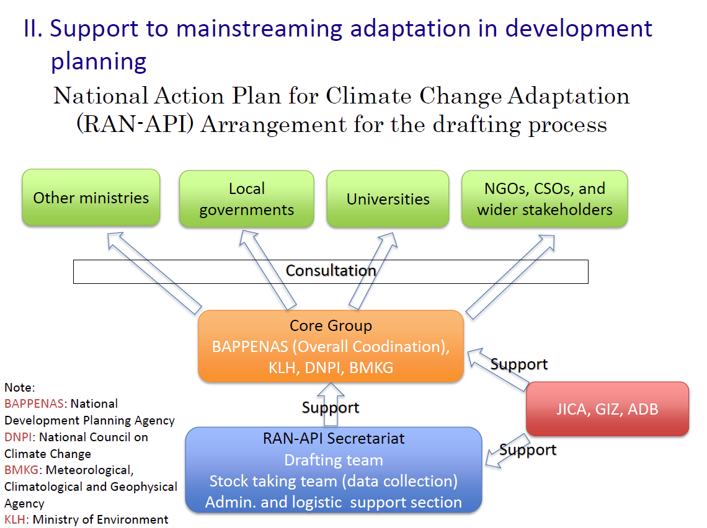
Intersectoral coordination: example from Indonesia
Source: NAP Expo 2014, Day 1, Session III/ I: Sato Ichiro, Japan. JICA support for climate change adaptation in Indonesia
Notes:
So, first of all, I would like tot show you how countries that already developed a NAP, coordinated among different institutions, responsibilities and inputs.
This is the example from Indonesia. What you can see here is an example of the coordination structure for developing the “National Action Plan for Climate Change Adaptation (RAN-API)” or more specifically the arrangements for the drafting of the document:
As you can see here, there was a core group consisting of the National Development Planning Agency (BAPENNAS, who had the overall coordination role), the Ministry of Environment, The National Council on Climate Change and the Meteorological Climatological and Geophysical Agency.
In addition, a RAN-API Secretariat was established. Here one team was responsible for drafting documents that came of out the meetings, another team for taking stock of different sets of data, and of course both teams were supported logistically and with admin tasks.
Three development partners supported both, the core group and the RAN-API Secretariat
The core group held a lot of consultation with other ministries, local governments, science and academia as well as with NGOs and CSOs.
Looking at this structure, what are the success factors, which made this coordination structure work well?
Clear roles between core group and secretariat. Secretariat does main work but steering and expert input from core group
Involvement from stakeholders

Slide 6
Intersectoral coordination: example from Germany
Federal Ministry for the Environment
Federal Environment Agency/KomPass
Research Institutes
NAS- process
Working group of all federal ministries
Stakeholder
(Business, NGO)
Conference of the federal states
Notes:
A second example is from Germany. I would like to present you coordination structure of the German National Adaptation Strategy – the NAS.
The development of the German Adaptation Strategy began in mid-2007 under the supervision of the Federal Ministry for the Environment (todays BMUB). The process was accompanied by an informal, inter-departmental working group on adaptation.
The previously informal working group was formalised after the adoption of the NAS and became the Interministerial Working Group on Adaptation to Climate Change (IMA Anpassung). Nearly all federal ministries are represented in the working group. Its purpose is to coordinate the cooperation among the participating ministries and further develop the NAS.
So, the NAS process was steered by theInter-ministerial working group (IWG) „Adaptation Strategy“ in which all ministries are represented. It was established in 2009 and is chaired by the Environment Ministry.
In 2006 the Environment Ministry set up the Competence Centre on Climate Impacts and Adaptation (KomPass, www.anpassung.net) at the Federal Environment Agency to create a unit which supported the preparation of the national adaptation strategy with technical and environmental advice.
The NAS was developed in cooperation with federal states and also involved research institutes and civil groups.
The IWG (inter-ministerial working group) was responsible for preparing the Adaptation Action Plan, bringing together the initiatives of the various federal ministries, and play(ed) an active part in shaping and accompanying the dialogue and participation process for the Adaptation Strategy, (with the aim of ensuring a consistent conceptual approach by the Federal Government). This group will also be responsible for submitting regular reports for the purpose of updating the Adaptation Strategy and Action Plan and evaluating their implementation.
There is a second central element of the German climate adaptation policy (“Aktionsplan Anpassung”; “Adaptation Action Plan”; APA). This action plan was developed in close cooperation between federal and state governments and subsequently adopted by the federal government in August 2011. During an extensive process allowing for dialogues and participation, it was also accompanied by local communities, science representatives and several social groups. The action plan explains how the objectives and potential measures that are set out in the German Adaptation Strategy can be substantiated with specific activities of the federal government over the next few years. Furthermore, the plan also determines which follow-up measures are necessary to implement and develop the DAS.
Germany shows the example of how a coordination structure evolves over time, into a sophisticated web of actors involved.
As well as for the Indonesia example, the involvement of diverse stakeholders contributes to transparency, the balance of power as well as flexibility. Moreover, the fact that Germany has involved nearly all ministries shows a greatly coordinated mechanism, and further strengthens the exchange of different perspectives and types of knowledge.
Transparency is greatly enhanced by the installment of a Web portal to hold all related communication that is publically available.

Slide 7
Functional coordination structures
Division of labour → functional
  More transparency through close interaction and cooperation
In a practical context: inter-institutional panel comprised of experts → continuous exchange of knowledge
Such interactions provide:
  exchange of different perspectives and types of knowledge;
  problem solving skills;
  power balances among interest groups;
  policy flexibility.
Notes:
The term coordination structures refers to two or more (international) institutions that are independent and as such interact to co-govern a particular issue area. The “division of labour” implies some kind of ‘functional’ differentiation between institutions; some may engage in the regulatory subsets, others in capacity building, and others focus on specific geographic regions. To enhance such cooperation, coordination is of utmost important. To safeguard their ‘functioning’, inter-institutional structures should be sufficiently coordinated to prevent conflict among partners, and respect diverging governance tasks and pronounced differences in world society. -> Coordination structures provide fewer windows for corruptness, and more for transparency through close interaction and cooperation. It usually takes a rather bottom-up approach, in which local level governance is considered important.
A practical application would be a diverse inter-institutional panel usually comprised of experts from different institutions (e.g. environmental organizations, community, industry and academics) that can advise policy making. This provides opportunities for the continuous exchange of knowledge. This would be an essential part of enhancing adaptive capacity.
Such interactions provide for example the exchange of different perspectives and types of knowledge. They provide problem solving skills, and balance power among interest groups. Furthermore they enhance policy flexibility that allows actors to design locally appropriate solutions.

Slide 8
What to consider when developing a roadmap
What: Main goals and milestones? What is needed to get there?
When: Until when shall goals and milestones be achieved?
Who: Who is driving the process? Who is responsible for milestones? Who provides (technical/scientific) assistance? Who implements? Define clear roles and responsibilities
Whose resources: Who will make funds available (state budget, national and international climate funds, private sector)?
Formulate measures!
Consider a follow-up strategy / steps after the roadmap (implementation, revision, etc.)
Notes:
Okay, now coming from structures, let’s have a look on how it is writen down, what they should actually do.
Here we use the term “roadmap” but also another term could be used: workstream, or other that outlines steps in the process, responsibilities and timelines.

Slide 9
Challenges emerging when developing a roadmap
→ To be elaborated together with participants!
Development of different elements / parts of the roadmap in silos
Implementation of elements / parts in silos
‘Free-riders‘
Question on financing
What else?
Notes:
Trainer can ask the participants about these challenges. There is no need to show the slide when participants are discussing freely.

Slide 10
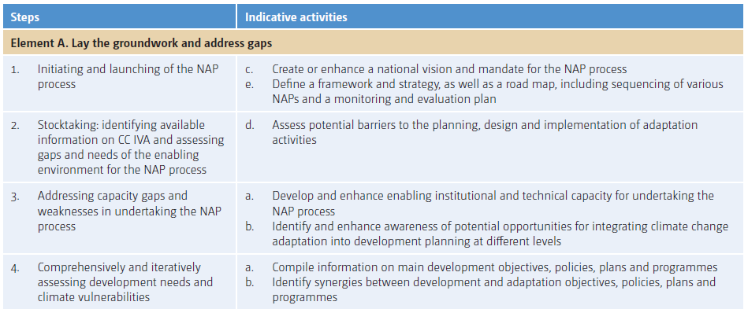
Workstream suggested by NAP Technical Guidelines on “Integrating climate change adaptation into national planning”

Slide 11
Roadmap skeleton: Step by step analysis
What? |  | What does already exist? | Main tasks to be conducted to achieve the step | Potentially emerging challenges
Element | Step
A | Initiate / launch NAP
A | Stocktaking
…
B | Assess vulnerabilities
…
…

Slide 12
Roadmap skeleton: Focus on activities
What? |  | Until when? | Who? (main responsible and assistance) | Which resources?
Element | Step
A | Initiate / launch NAP
A | Stocktaking
…
B | Assess vulnerabilities
…
…
Other steps / milestones important to your country

Slide 13
Roadmap skeleton: Focus on outputs
Workstream | Specific objectives | Activities | Responsi-bility | Other resources | Deadline | Comment
Planning
Implementa-tion
Financing

Slide 14
Visualize a NAP roadmap for policy makers
Workstream I Planning, establishing and stearing the NAP process
Planning phase
Launching the NAP process and drafting roadmap
Workstream II Implementing the NAP process
Planning of activities, providing standards and frameworks
Implementing cross-sectoral and sectoral activities
Workstream III Review and learning
Determining capacity needs, setting up M&E system
Adjustments to the NAP process
Time frame
Short-term (2015)
Medium-term (2016-2018)
Long-term (2019 - 2025 and beyond)
Bi-annual revision of the roadmap based on M&E
Mainstreaming into long-term development planning, budgeting and monitoring systems
Monitoring adaptation to climate change

Slide 15
Exercise step 1: Development of an adequate structure for the roadmap
Document the ‘chapters’ in the first column of matrix VI.1.1
You might get inspiration from the list of exemplary areas for the NAP process as mentioned in chapter 2.1 of the NAP Technical Guidelines

Slide 16
Exercise step 2: Identify main tasks to be conducted in your country
Identify key tasks under each structure item to be conducted in your county
Reflect different issues compiled on the parking lots but also add issues from an overall perspective
Revisit the results in Matrix I.3.1, where you developed elements for the work stream ‘Gaps and needs analysis’.
Identify responsible institutions for the task mentioned in the last column

Slide 17
Imprint
Published by
Deutsche Gesellschaft für
Internationale Zusammenarbeit (GIZ) GmbH
Climate Policy Support Project
Dag-Hammarskjöld-Weg 1-5
65760 Eschborn, Germany
T +49 61 96 79-0
F +49 61 96 79-1115
Contact
E climate@giz.de
I www.giz.de/climate
Responsible
Nele Bünner, GIZ
Author
Nele Bünner
Contributions by
Stefanie Dümig
This presentation is part of a NAP country-level training that has been developed by GIZ on behalf of BMZ
and in cooperation with the NAP Global Support Programme (NAP-GSP), in particular UNDP and UNITAR.
The training is designed to support countries in setting up a National Adaptation Plan (NAP) process. It builds on the NAP Technical Guidelines developed by the Least-Developed Countries Expert Group (LEG).
You are welcome to use the slides, as long as you do not alter its content or design (including the logos), nor this imprint. If you have any questions regarding the training, please contact Till Below or Nele Bünner at GIZ.
For questions related to the Technical Guidelines, please refer to the UNFCCC’s NAP Support Portal.
As a federally owned enterprise, the Deutsche Gesellschaft für Internationale Zusammenarbeit (GIZ) GmbH supports the German Government in achieving its objectives in the field of international cooperation for sustainable development. GIZ also engages in human resource development, advanced training and dialogue.

Slide 18





Indicative institutional setup of NAP at national level
SDGs
High level mandate
Donor
Gov.
Forest/urban
Planning
Finance
Agriculture
Water
Focal Point
What we need:
Champion, leadership, ownership
Sector plan proofing + budgeting (entry points)
Focal Point -> initiator
SDG
NGO, private sector, media
Adaptation process
DRR (Hyogo)
$
POL $
POL $
POL $
POL $
POL $
Technical group
UNDAF
Steering Committee:
Government & Ministries
Donor Working Group:
Multilateral/bilateral organisations
Notes:
UNDAF United Nations Development Assistence Framework

