Slide 1
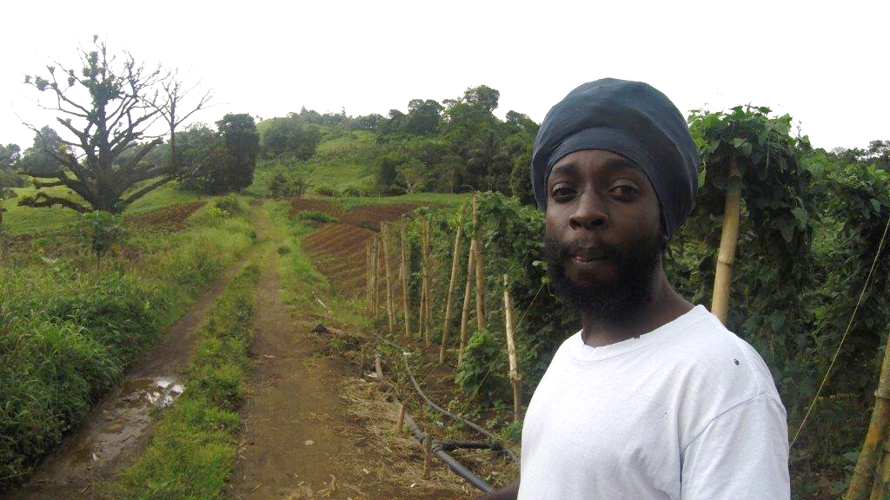
National Adaptation Planning
Gabor Vereczi
Regional Specialist
Climate Change Adaptation
UNDP-GEF

Slide 2
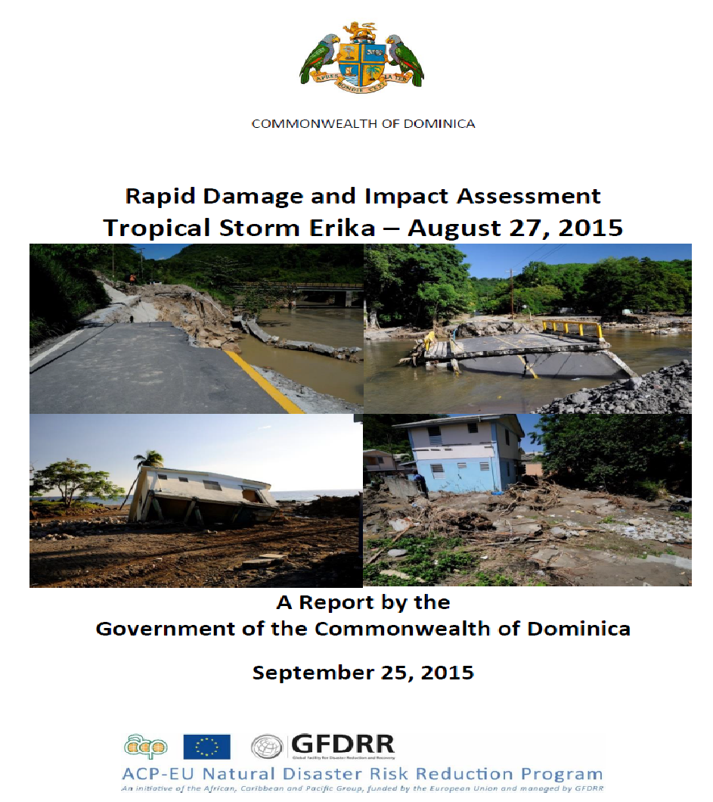
Resilience to Climate Change – a necessity
Scale of Damage in Dominica - Tropical Storm Erica (2015)
Estimated damage and losses:
US$483 million
equivalent to over 90 percent of Dominica’s gross domestic product (GDP)
Climate Change can no longer be treated as only as environment issue

Slide 3
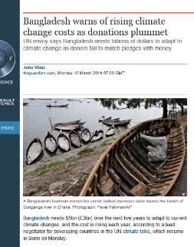
Scale of Finance for Adaptation
Bangladesh - $5b over next 5 years to address current climate change with costs rising each year
Malawi- The National Climate Change Investment Plan (2014) and includes a USD 5 bliion investment over next 5 years in adaptation, mitigation, capacity development and research & technology.
Notes:
Copenhagen Accord- $100b additional finance needed annually by 2020 (50% of this for adaptation)
Estimates of Funding Required
Other Estimates of Adaptation financing Needs:
- $2.129 b (total cost of implementing all Urgent and Immediate Priorities (as articulated in NAPAs)
- $30-100 b/year for period 2010-2050 (World Development Report (2010)
- $290 b/year (Source: Parry et all 2009)
- $326 - $355 b/year for financing adaptation options on natural ecosystems) (Source: Berry 2007)
Most estimates are underestimates; non-market values not taken into account, largely based on costs on infrastructure.
Estimates of Funding Committed
For mitigation and adaptation actions: around USD $140-175b & $70-100 b/year for 2010-2050 (World Bank 2010)
Vertical Funds (Least Developed Country Fund, Special Climate Change Fund, Adaptation Fund): less than $1.5b t-date cumulatively)

Slide 4
NAP Mandate
The national adaptation plan (NAP) process was established in 2010 under the Cancun Adaptation Framework (CAF).
The NAP process enables Parties to formulate and implement national adaptation plans (NAPs) as a means of identifying medium- and long-term adaptation needs, develop and implement strategies and programmes to address those needs.
A NAP process is a continuous, progressive and iterative process, underpinned by a country-driven, gender-sensitive, participatory and fully transparent approach.
NAPs are not a one off plan. The process is intended to be continuous, progressive and iterative. NAPs require building a stronger evidence base, improving skills and capacity and adopting learning by doing approaches. NAPs need to be country-driven, gender-sensitive, participatory and use transparent approaches.

Slide 5
Objectives of the NAP process
Moving from short term towards mid-longer term adaptation planning
To reduce vulnerability to the impacts of climate change, by building adaptive capacity and resilience;
To facilitate the integration of climate change adaptation, in a coherent manner, into relevant new and existing policies, programmes and activities, in particular development planning processes and strategies, within all relevant sectors and at different levels, as appropriate.
Ref: Decision 5/CP.17, paragraph 1, 2011
COP 21 Paris
The support for NAPs is framed through The COP request (under the Paris Agreement) to the Green Climate Fund to expedite support for the least developed countries and other developing country Parties for the formulation of National Adaptation Plans, consistent with decisions 1/CP.16 and 5/CP.17, and for the subsequent implementation of policies, projects and programmes identified by them (decision 1/CP.21, paragraph 47);
Clear recognition by the COP that Parties report information on adaptation action and planning including, if appropriate, their national adaptation plans, … (1/CP.21, paragraph 95(c));
Adaptation communication .. shall be, as appropriate, submitted and updated periodically, as a component of or in conjunction with other communications or documents, including a national adaptation plan, a nationally determined contribution as referred to in Article 4, paragraph 2, and/or a national communication.

Slide 6
A. Laying the groundwork and addressing gaps
1. Initiating and launching of the NAP process
2. Stocktaking: identifying available information on climate change impacts, vulnerability and adaptation and assessing gaps and needs of the enabling environment for the NAP process
3. Addressing capacity gaps and weaknesses in undertaking the NAP process
4. Comprehensively and iteratively assessing development needs and climate vulnerabilities
B. Preparatory Elements
1. Analysing current climate and future climate change scenarios
2. Assessing climate vulnerabilities and identifying adaptation options at the sector, subnational, national and other appropriate levels
3. Reviewing and appraising adaptation options
4. Compiling and communicating national adaptation plans
5. Integrating climate change adaptation into national and subnational development and sectoral planning
NAP process (elements and steps)
D. Reporting, Monitoring and Review
1. Monitoring the NAP process
2. Reviewing the NAP process to assess progress, effectiveness and gaps
3. Iteratively updating the national adaptation plans
4. Outreach on the NAP process and reporting on progress and effectiveness
C. Implementation Strategy
1. Prioritizing climate change adaptation in national planning
2. Developing a (long-term) national adaptation implementation strategy
3. Enhancing capacity for planning and implementing adaptation
4. Promoting coordination and synergy at the regional level and with other multilateral environmental agreements
Notes:
Introduce pillars of coordination, implementation, and monitoring here

Slide 7
NAP – an iterative process
Countries do not start from scratch - have established foundations for integrating climate change into medium- and long-term planning
Critical to focus on “whole of government” approach that supports planning and budgeting that takes climate change into account
Capacities to integrate climate risks and adaptation planning into:
national development policy, strategy and planning frames, as well as related policy instruments (e.g. legislation)
sectoral and territorial policies and plans, and sector specific policy instruments
Fiscal, economic or budgetary planning processes
Community-based development initiatives
Institutional coordination mechanism on CC matters (e.g. CC Working Groups, Country Teams, Committees), Central to local government
Climate information available (e.g. climate impact studies, projections and scenarios, vulnerability analysis, hazard and risk mapping, early warning systems and climate information services.
Capacities of economic, and cost-benefit analysis
Framework to track and monitor climate change adaptation related policy and project processes

Slide 9
Making Systems and Institutions Climate Finance Ready is Important:
Financial Planning
Accessing Finance
Delivering Finance
Monitor, Report & Verify
Assess needs and priorities, and identify barriers to investment
Identify policy mix and sources of financing
Multiple access channels
Blend and combine finance
Formulate project, progamme, sector-wide approaches to access finance
Implement and execute project, programme,
Ensure effective procurement processes
Build local supply of expertise and skills
Coordinate implementation
Monitor, report, and verify flows of results and funding
Performance-based payments and incentives
$ will come from multiple source and through multiple mechanisms:
External and internal, public and private sectors
Notes:
presents a four-part framework through which to understand the different components of readiness and the specific capacities needed to underpin it.
provide a framework through which to understand and the role of the plethora of tools, mechanisms, and modalities available for using climate finance—ultimately improving the capacity of policy-makers to put in place nationally-appropriate systems to manage climate finance.

Slide 10
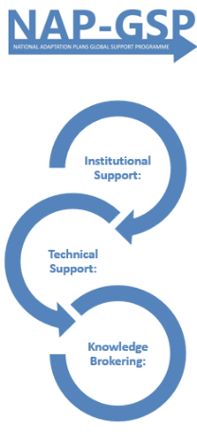
Foundations for integrating climate change into medium- and long-term planning
Targeted capacity building initiatives
Capacity building on
Climate Information
Systems
Capacity building on Climate Expenditure and
Institutional Reviews (CPEIRs)

Slide 11
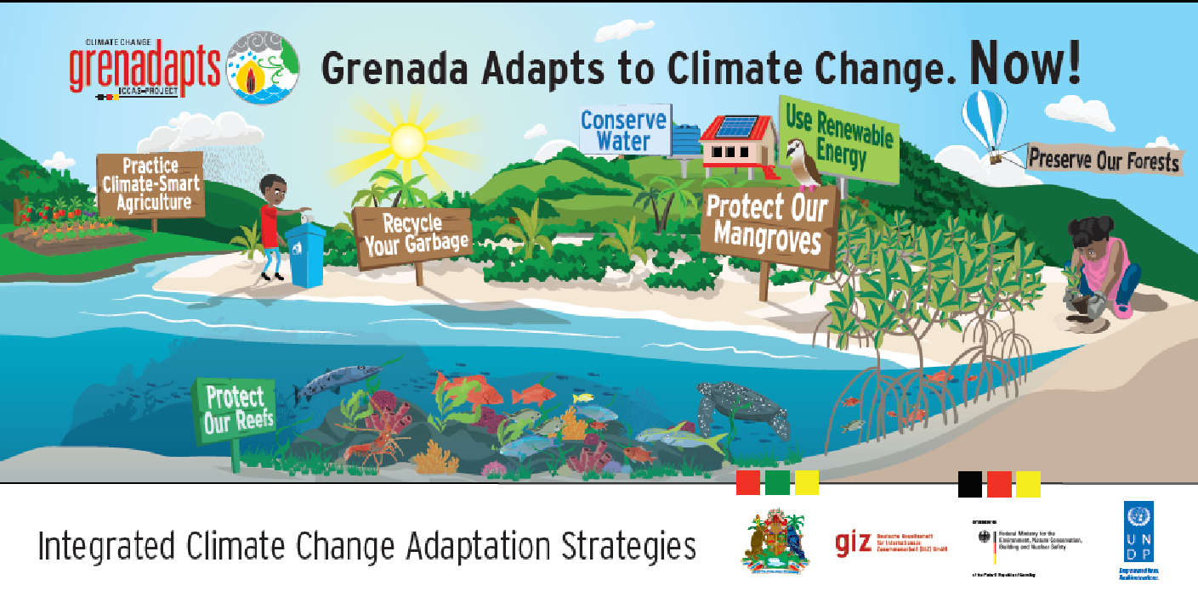
Caribbean Climate Online Risk and Adaptation Tool” (CCORAL)
CC integration - National Sustainable Development Plan
(2015- 2030)
Integrated Coastal Zone Management Policy
Community Climate Change Adaptation Fund
GCF NIE accredition support – proposal preparation (MIE)
Public awareness raising and communications
National Adaptation Plan – umbrella document:
• provides the framework for further mainstreaming,
• establishes implementation and resource mobilization mechanisms and
• prioritizes activities from already existing sectoral
and local plans with climate change adaptation aspects.

Slide 12
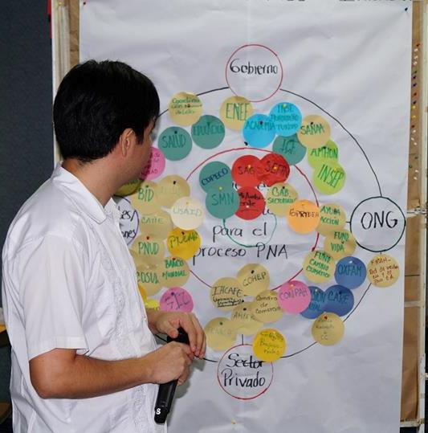
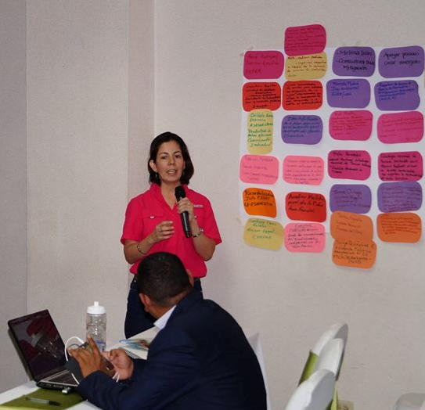
Honduras NAP process integrated
Supported and linked through:
3rd National Communications
AF funded project on drought and flood adaptation
National CC and Water Observatory
Sectoral Mainstreaming
NAP GSP national workshop
Prepartion of a GCF proposal to upscale water sector adaptation in Choluteca basin
National CC Strategy
National Adaptation Plan
REDD+
Climate Finance
INDCs
Technology Needs Assessment

Slide 13
Opportunity
Japan Caribbean Climate Change Partnership
Analyzing entry points and building on ongoing frames and initiatives to:
Support development and/or implementation of NAPs
Strengthen institutional and technical capacities
Support investment in adaptation measures at the community level
Create synergies between mitigation and adaptation processes and interventions
Foster South-South cooperation and knowledge exchnage
Notes:
Fortunately there are a lot of opportunities for countries to seek out support for developing NAMAs and over the next two days we are going to discuss one of the most recent support mechanisms the Japan Caribbean Climate Change Partnership. As mentioned earlier, the JCCCP is a new support mechanism for NAMAs and NAPs.
In terms of mitigation, The objectives of the JCCCP is to provide mitigation assistance that is tailored to a country’s specific needs
Support the development and/or implementation of a country’s NAMAs
Strengthen a country’s institutional and technical capacities and
Support the investment in mitigation technologies via pilot projects

