Slide 1
Japan-Caribbean Climate Change Partnership
Technical Advisory Group
26 – 27 Jan 2016
A Presentation
by the
CARIBBEAN COMMUNITY CLIMATE CHANGE CENTRE
(CCCCC)

Slide 2
Focus of Presentation
Ongoing initiatives and potential synergies
Work at regional and national levels contributing to development or implementation of Nationally Appropriate Mitigation Actions (NAMAs) and National Adaptation Plans (NAPs)

Slide 3
Provides the Vision of
Transformational Change in our Response to the Challenges
of a Changing Climate
The Declaration makes a number of Commitments, Endorsements and Specific Declarations on the Actions needed to Manage the Effects of Climate Change and Development
Issued by the 30th Meeting of CARICOM Heads in Liliendaal, Guyana, 2-5 July 2009
THE LILIENDAAL DECLARATION on CLIMATE CHANGE and DEVELOPMENT

Slide 4
The Regional Framework) is to:
“Establish and guide the Caribbean’s direction for the continued building of resilience to the impacts of global climate change by CARICOM States”.
Articulates the strategic direction for the region’s response to climate change risks.
Approved by the CARICOM Heads of Government at their meeting in Georgetown, Guyana in July 2009

Slide 5
The Implementation Plan (IP) for the Regional Framework, defines the regional strategy for coping with Climate Change over the period 2012-2022
Approved by the 23rd Inter-Sessional Meeting of CARICOM Heads held in Suriname 8-9 March, 2012.

Slide 6
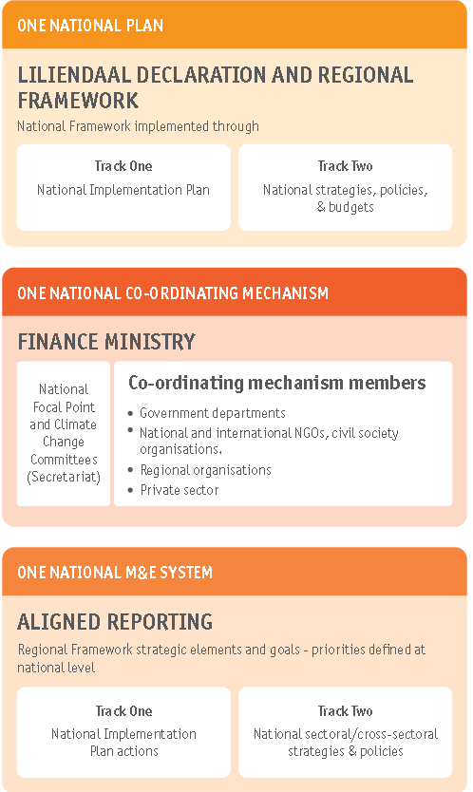

Slide 7
UPLANDS
LOWLANDS
SHORE
OFFSHORE
OCEAN
Natural Habitats / Ecosystems
Wildlife
Scenic Areas
WATER
Mining
Forestry
Agriculture / Aquaculture
Tourism: Ecotourism, Hotels, Water Sports, Yachting, Cruise Shipping, Whale Watching, etc.
Commercial / Recreational Fishing
Utilities: Communications, Potable Water, Electricity
Roads
Airfields
Harbours, Ports, Marinas
Industry, Commerce, Settlements
Waste

Slide 8
Institutional and governance building blocks
IP provides guidance on:
Building resilience requires transformational change and an effective mobilisation of scarce resources
Building a low carbon climate resilient economy is an integral element of the wider sustainable development agenda
Accessing financial and technical assistance to deliver resilience and create low carbon economies
Defining a private sector role in providing financing solutions
Acting regionally to deliver nationally
Creating low-carbon economies in the Caribbean
Developing a risk management ethic in our decision-making

Slide 9
The Caribbean Community Climate Change Centre coordinates the Caribbean region’s response to climate change
The Caribbean Community Climate Change Centre is accredited as a Regional Implementing Entity (RIE) by the Board of the Green Climate Fund (GCF)

Slide 10
EU Global Climate Change Alliance Project (EU GCCA)
To enhance local, national and regional capacities and resilience in ways that link sustainable development, risk management, and adaptation for a win-win-win situation.
Climate monitoring
hydro-meteorological stations and
Coral Reef Early Warning Stations (CREWS)
National Adaptation Strategies and Action Plans
Climate modeling
Vulnerability and Risk Assessments
Adaptation Projects
Support for installation of Reverse Osmosis plants in Carricou and Petit Martinique
Photovoltaic systems
.

Slide 11
The Caribbean Regional Resilience Development Implementation Project (2011 – 2016) - DFID
Project concludes 31 March 2016
Project extension beyond 2016 approved and funded
Resource mobilisation for national adaptation priorities,
Fisheries and Marine Protected Areas
Integration of risk management and adaptation into national planning processes
Demonstration of adaptation projects
Enhanced monitoring, reporting and evaluation functions.

Slide 12
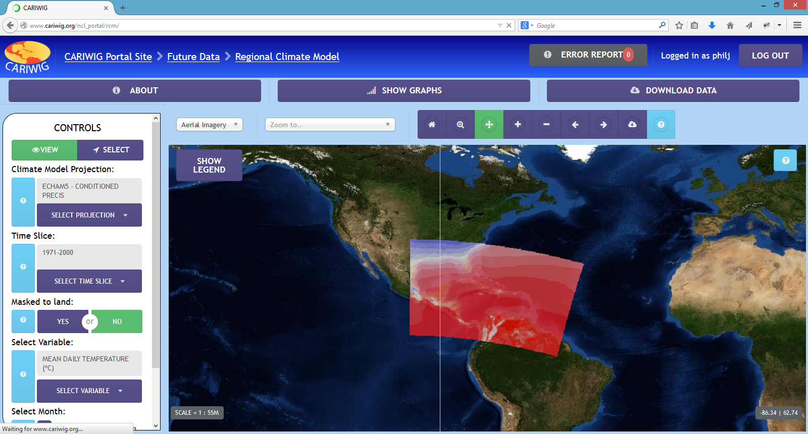
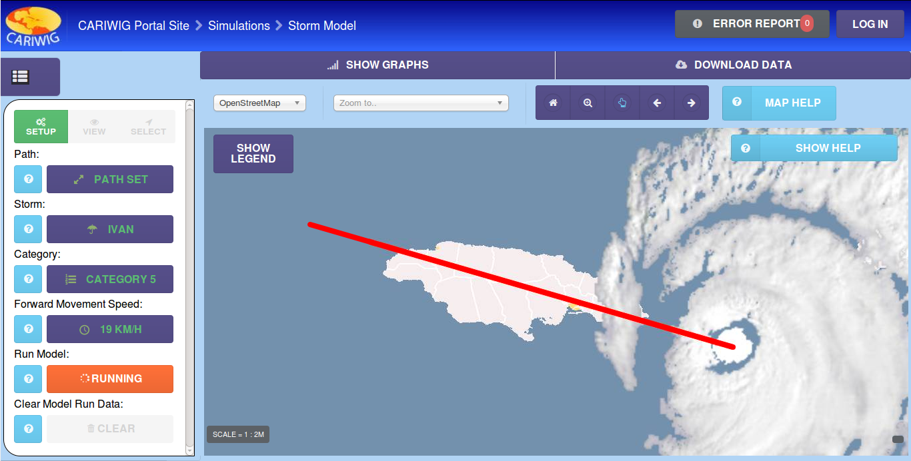
Caribbean Weather Impacts Group Project
Funded by Caribbean Development and Knowledge Network (CDKN)
To address the likely impacts and hazards arising from climate change through the provision of locally relevant weather information for a range of time horizons
Outputs:
Weather Generator
Online Portal
Simple Model For Advecting Storms & Hurricanes (SMASH) – Tropical Storm Tool

Slide 13
CARIWIG
Case Studies
Roger Rivero Jr. et. al. (2015): Assessment of Climate Change Impacts on Agriculture on Cayo District, Belize
Coastal Zone Management Unit (2015): Barbados Coastal Protection Case Study
Diana Ruiz (2015): Dengue Fever in the Belize District Case Study
Abel Centella et. al. (2015): Drought Case Studies using the Caribbean Assessment of Regional DROught (CARiDRO) tool
Junior A. Mathurin & Dr. Yannick Cesses (2015): Effect of climate change on surface water resource (St Lucia)
Raquel Chun (2015): Flood risk and Urban Development in Belize City Case Study
Arpita Mandal et. al (2015): Scenarios of discharge for the Hope River Watershed in response to variable tropical cyclone characteristics Case Study
Dale Rankine et. al (2015): Sweet Potato Case Study

Slide 14
Database Management System
To develop a regional operational Database Management System that would facilitate open access to data products useful for observing environmental change
Key partners:
the Caribbean Institute of Meteorology and Hydrology (CIMH),
the National Oceanic and Atmospheric Agency (NOAA) and
Centro del Agua del Trópico Húmedo para América Latina y El Caribe (CATHALAC)
Participating countries: Barbados, Belize, the Commonwealth of Dominica, Guyana, Jamaica, and St. Lucia
Output: Database management system installed on the CIMH server

Slide 15
Caribbean Climate Online Risk and Adaptation Tool (CCORAL)
Financed by DFID; CDB; CDKN; EU GCCA
Risk Management Tool designed to inculcate a risk management ethos in decision-making
On-line, user friendly,
14 CARICOM Member States trained to date
More training to be rolled out in 2016-2017

Slide 16
Caribbean Climate Change and Risk Reduction Initiative (CCCARRI) Project funded by USAID Sept 2015 - 30 Sept 2020
Parties: Eastern and Southern Caribbean States
Improved institutional capacity to generate and use climate data and information in decision-making
Strengthened institutional capacity to assess feasibility of, and to implement key innovative adaptation approaches inclusive of agricultural, coastal, and water resources management
Increased national and regional capacity to access climate financing for the scale up and replication of cost effective, sustainable adaptation initiatives

Slide 17
Coastal Protection for Climate Change Adaptation in the Small Island States in the Caribbean Project funded by KFW 2015 to 2019
Participating countries of GND, SVG, SLU, JA
Component 1: Investments for sustainable improvements of coastal ecosystems relevant for climate change adaptation, including:
Measures related to the protection and sustainable management of ecosystems relevant for adaptation;
Measures related to the rehabilitation or substitution of ecosystems relevant for adaptation; and
Measures related to the monitoring of coastal ecosystems
Component 2: Assistance in the preparation and implementation of Local Adaptation Measures

Slide 18
Renewable Energy
In its efforts, the CCCCC has been granted the support within the GIZ – REETA program to introduce a mobile biogas Laboratory at the University of Belize (UB) for use within CARICOM Members states and also by the private sector
Installation of Photovoltaic systems
Other Biomass Projects

Slide 19
Focal Area 2: Climate Change, Disaster Management, Environment and Energy – 11 EDF
Objective 1: To improve regional resilience to impacts of climate change and natural disasters affecting sustained economic and social development
Objective 2: To support regional capacity for the sustainable use of natural resources
Objective 3: To promote Energy Efficiency (EE) and development and use of renewable energy

Slide 20
Coastal Protection for Climate Change Adaptation in the Small Island States in the Caribbean - German Development Bank
The Project seeks to pursue the implementation of Local Adaptation Measures (LAMs) for the sustainable improvement of coastal ecosystems relevant for climate change adaptation
Parties: Grenada, Jamaica, Saint Lucia, and St. Vincent and the Grenadines.
The project utilises a call for proposal approach to inform, identify and support LAMs in the participating countries.
Status
1st Call for proposal was launched in Q3 of 2015
16 project concepts received from all countries, totaling in excess of the of the total budget available for investments in LAMs
9 projects pre-selected for full proposal development totaling approximately 75% of the available budget
Contracts to be signed with the 1st batch of LAMs Beneficiaries by Q2 of 2016

Slide 21
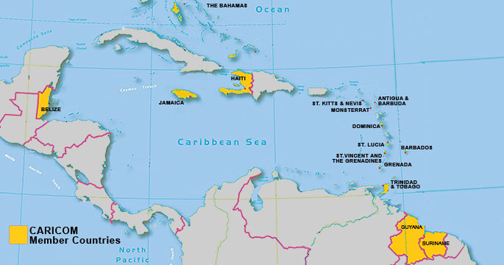
Cooperation on Climate Change, Vulnerability, Adaptation and Mitigation
MOU between Italy and Member States (2016-2021)
CCCCC designated Implementing Entity
Parties:
Antigua and Barbuda; Bahamas; Barbados; Belize; Dominica; Grenada; Guyana; Haiti; Jamaica; St. Kitts and Nevis; Saint Lucia; St. Vincent and the Grenadines; Suriname; Trinidad and Tobago.

Slide 22
MOU with ITALY
Areas of cooperation
Adaptation to CC
Identification and Implementation of Intended Nationally Determined Contributions (INDCs)
Reporting and assessment of INDCs
Renewable Energy
Transfer of Scientific and Technical Knowledge and Experience
Transfer of Technology
Exchange of experts, scientists and researchers
Enhancing capacities for the implementation of mechanisms under the UNFCCC
Promotion of joint ventures between the private sectors of the parties

Slide 23
Climate Finance Access Hub A key outcome of the 2015 Commonwealth Heads of Government Meeting held in Malta on 29 November
The hub will be hosted by the Government of Mauritius, with regional and national nodes across the developing regions of the Commonwealth
Specifically, the objective of the Hub is to:
help unlock climate finance for adaptation and mitigation actions in the most vulnerable states;
enhance the capacity of Small States and LDCs to access and manage public and private climate finance flows;
and facilitate inter and intra-regional sharing of skills, knowledge and expertise.

Slide 24
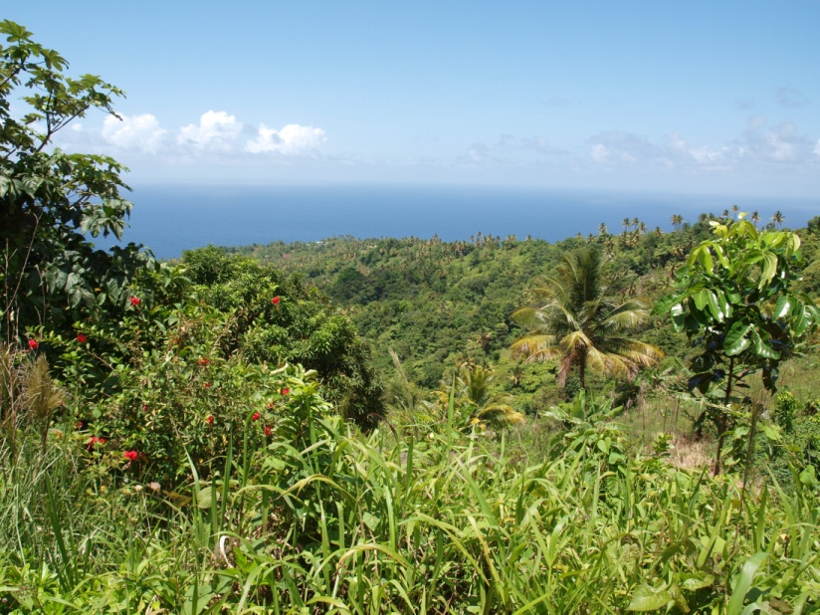
Thank You

