Slide 1
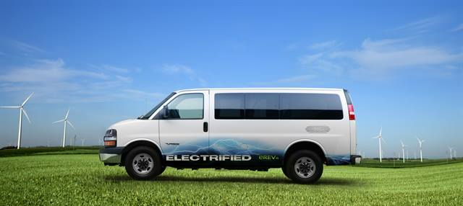
A Transport NAMA for St. Lucia

Slide 2
Transport NAMA
The NAMA will cover all public vehicles, except emergency response vehicles and public transportation vehicles.
The former are being excluded since the market for hybrid/electric emergency vehicles is not that well established and Government may not be keen to be first adopters of these crucial vehicles
Public Buses have been excluded because St. Lucia primarily uses “mini” buses and there appears to be no readily available source of hybrid/electric versions of these vehicles
NAMA will be undertaken in two phases
Phase 1 – Pilot of 25 vehicles, Road/Traffic flow analysis, 2 years
Phase 2 – Remaining 225 vehicles (10% of the GOSL fleet), 8 years

Slide 3
Outcomes
The main outcome of the NAMA will be the reduction in GHG emissions as a result of the improved transport efficiency of the Government vehicle fleet
The secondary component, in which the project will conduct a study to identify options for scheduling and route rationalization should result in reduced vehicle idle time and further reductions in GHG emissions
Contributes directly to the NDC targets

Slide 4
Overall Cost
 | Infrastructure |  | Capacity Building |  |  | Maintenance
 | Vehicles | Charging Stations | Training | Curriculum Support | Central Data Repository | Batteries (after 5 years) | Project Management | MRV | TOTAL
Total Units in the Public Sector | 2,500
Percentage to be covered | 10%
Number | 250 | 12 | 10 |  |  | 250
Average cost of one unit (EC) | 140,000.00
Average cost of one unit (US) | 51,852 | 24,000 |  |  |  | 3,000.00
Total Cost | 12,962,963 | 288,000 | 30,000 | 20,000 | 25,000 | 750,000.00 | 500,000 | 150,000 | 14,725,962.96

Slide 5
Additional Cost Considerations
 | Phasing out of existing vehicles | Resale of batteries
Number of units | 250 | 250
Recovery cost per unit | 3,704 | 2,000
Overall recovery cost | 925,926 | 500,000

Slide 6
Financing – Phase 1
Phase 1 – the pilot phase - will be financed principally through multi-lateral and bi-lateral grants
Phase 1 | Amount | Funding Type | Amount
Curriculum Support | 20,000 | Grant | Bi-lateral
Training | 30,000 | Grant | Bi-lateral
Vehicle Acquisition 10% of total) | 1,296,296 | Grant | Multi-lateral
Charging Station | 144,000 | Grant | Multi-lateral
Central Repository | 25,000 | Grant | Multi-lateral
MRV | 150,000 | Grant | Multi-lateral
Project Management Costs and Technical Evaluation and Pre-Assessment(Feasibility Studies, TOR development, Procurement Support) | 100,000 | Grant | Multi-lateral
Total | 1,765,296

Slide 7
Financing – Phase 2
Phase 2 – the first upscaling phase- will be financed principally through loans and public-private partnerships
Phase 1 | Amount | Funding Type | Amount
Curriculum Support | - | - | -
Training | 10,000
Vehicle Acquisition 10% of total | 11,666,666.67 | Soft Loans | IFIs/ International Market
Charging Stations | 144,000.00 | Soft Loans/PPP/BOLT | Local Market preference
MRV | 144,000 | Soft Loans | Multi-lateral
Project Management Costs | 400,000 | Soft Loans | Multi-lateral
Total | 12,364,667

Slide 8
Transformational Change
Savings should allow for the purchase of new vehicles
Data gathered will inform the Government’s development of in incentives for private sector companies to get involved – subsidies, tax reductions/credits, etc.
Provides a basis for additional project development (looking into bio-fuels, for example)
Growth in the IPP sub-sector
Job creation

