Slide 1
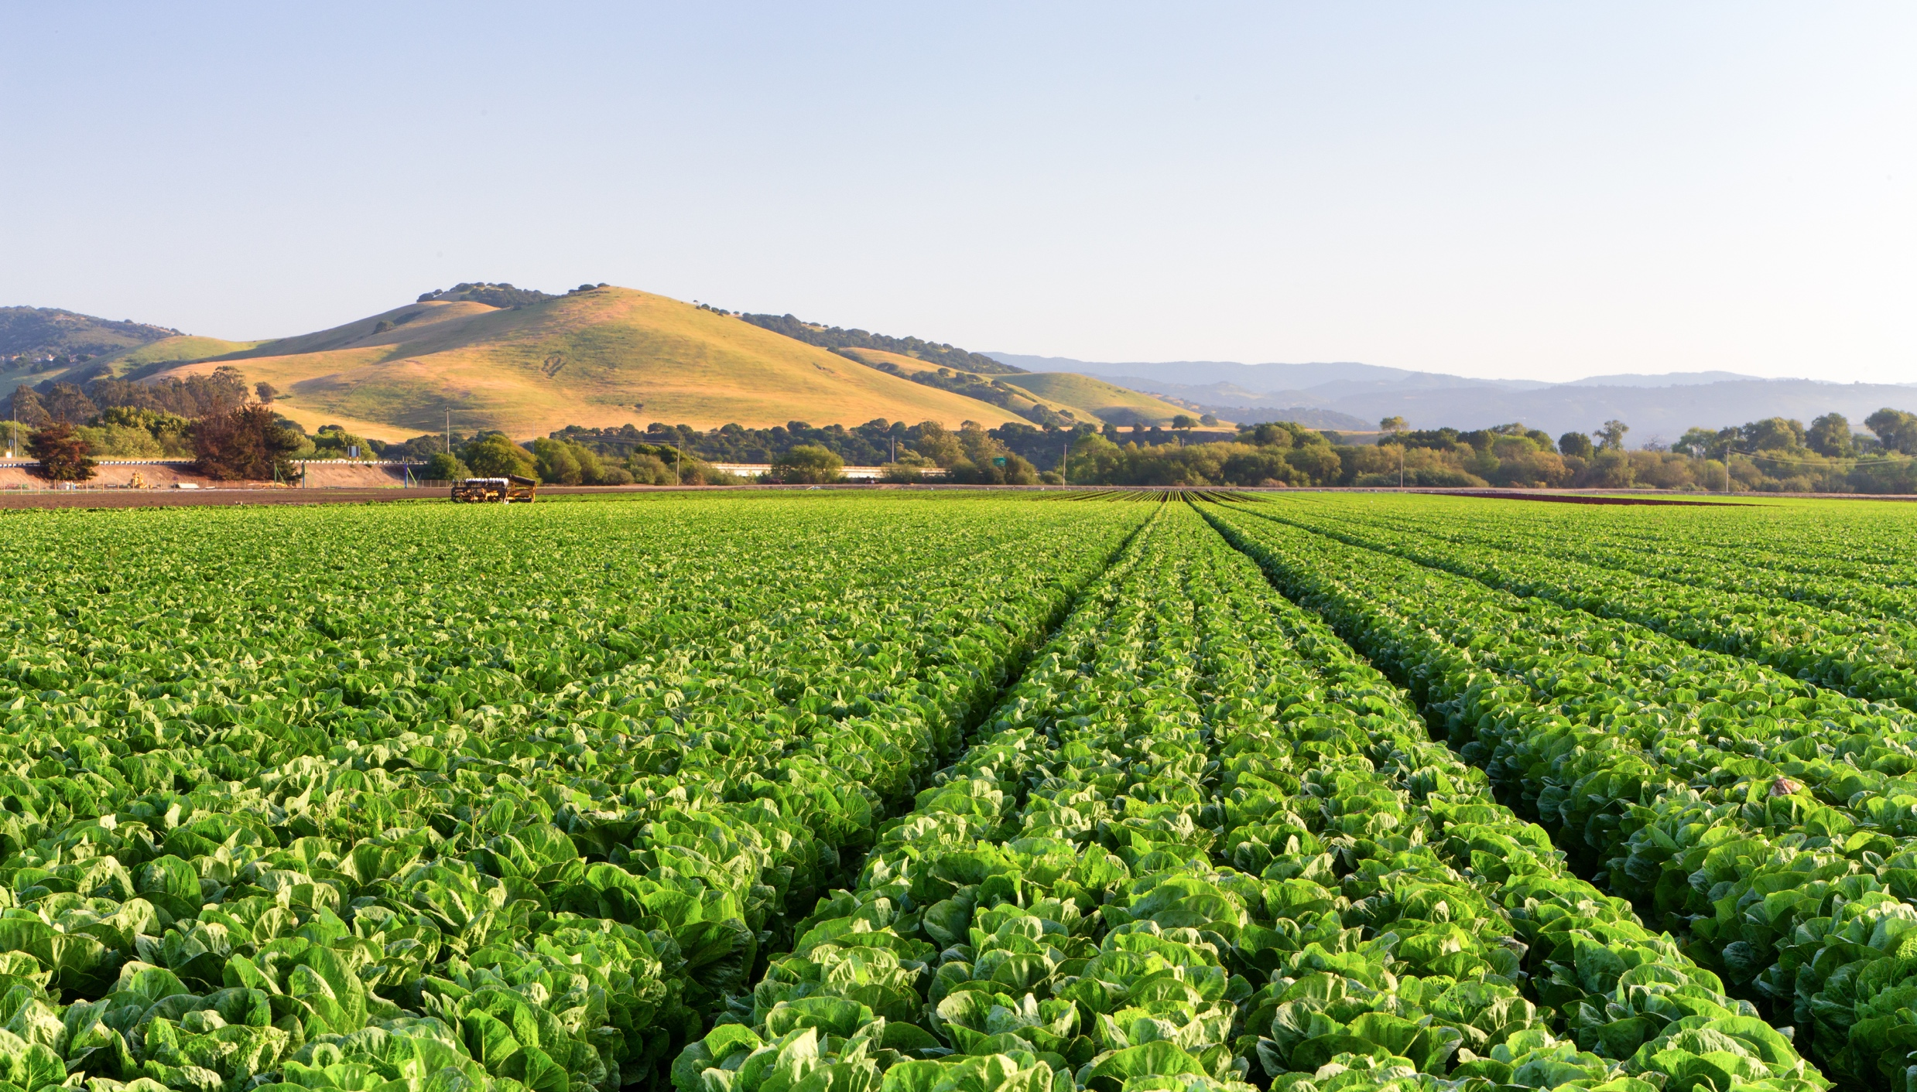
Agricultural Intelligence
Delivering the best agricultural information every day, globally
Stewart Collis
CTO and Co-founder
stewartcollis@awhere.com
@stewartcollis
The Power of Agriculture Intelligence

Slide 2
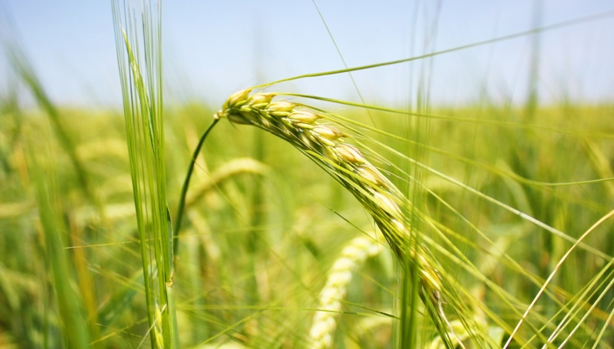
Happy National Agriculture Day!
March 15th 2016
©2016 aWhere, Inc. Customer logos copyrighted by their respective owners. Some images licensed under Creative Commons courtesy NOAA, Ladd Observatory, Stephen Bowler

Slide 3
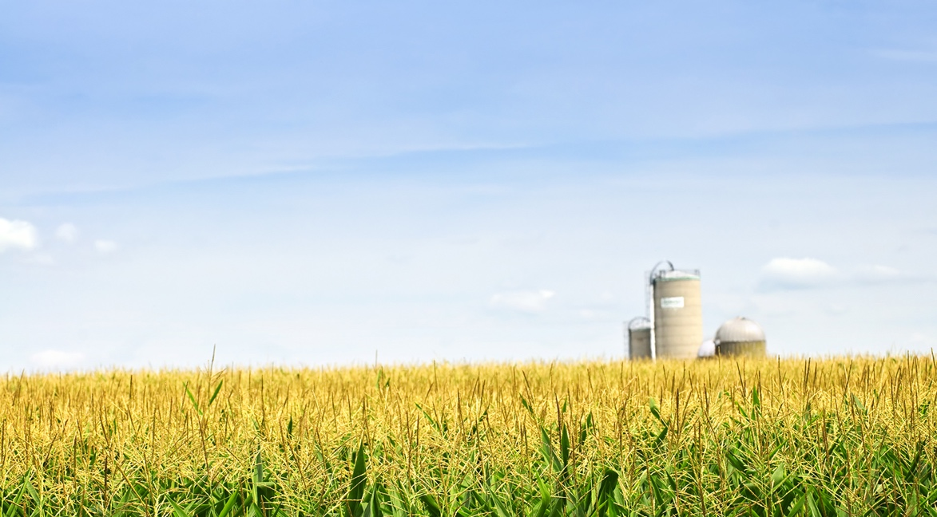
aWhere delivers the best agricultural information every day, globally.

Slide 4
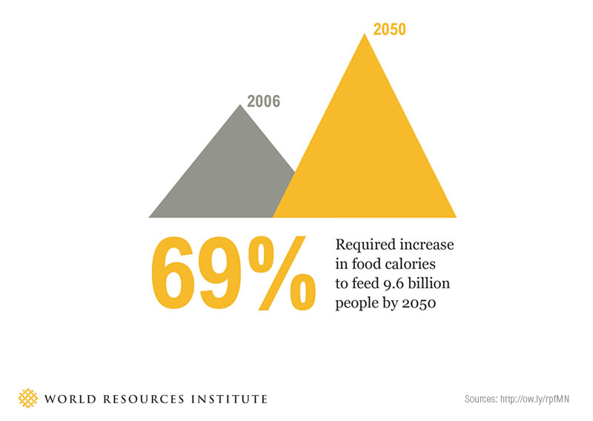
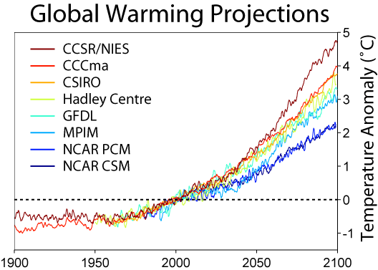
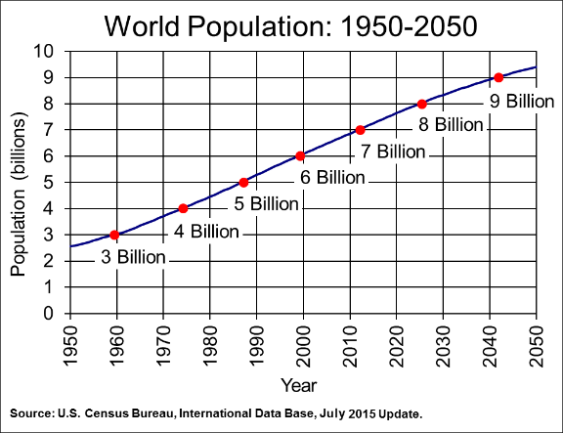
There will be 9.4 billion people on the planet by the year 2050. The only way to feed everyone is smarter agriculture.
A hotter planet is creating wild weather variability, historical trends and traditional practices are becoming less reliable.
Resources are growing scarce and expensive while regulations & consumer preferences are tightening.
Farmers need more reliable harvests and more efficient operations.

Slide 5
Agriculture
We are exclusively focused on agriculture outcomes, and uniquely understand how to leverage weather data and agronomic science to improve food production
Excellent Weather Data
We leverage a wide variety of data sources and advanced processing to provide accurate weather and agronomic insight at the field level.
Robust Technology
Our flexible, standards-based, and easy-to-integrate API Platform supports a wide variety of use cases, and is backed by a comprehensive Developers Portal and Support Team.
Trustworthy Partner
Our clients are partners. Our pricing only grows with your success and we won’t compete by releasing farmer-facing applications in any Ag segment.
Notes:
WHY AWHERE
First = weather data and agricultural intelligence company in the market that focused only on agriculture. Others started elsewhere and are adapting their products to the market without the institutional experience or insight.
Only = wide variety of data sources and advanced processing
Best = technology

Slide 6
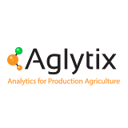
Agriculture Intelligence Business since 1999.
Leadership includes:
Agricultural Climatologist
Climate Scientist
Modeling & Data Scientist
Agronomic Modeler
Meteorologist
Trusted by leading companies and innovative startups alike.

Slide 7
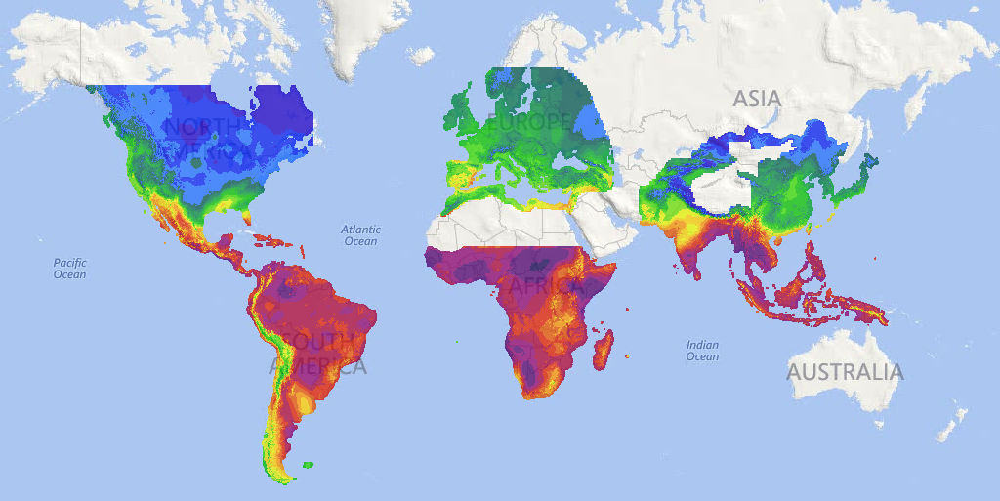
Weather Terrain™
Global Coverage
1.6 million virtual stations
+ Customer fields
Processing a billion points daily
Forecast
8-15 days of hourly forecast
4x daily from multiple sources
Historical Observed (20 years)
Precipitation
Min/Max Temperature
Min/Max Relative Humidity
Max/Mean Windspeed
Solar Radiation
Modeling Platform
Predictive models
Panchagarh, Bangladesh
Embu, Kenya
Notes:
If we look at only the weather data we can see some of the specifics that cover all aspects of the weather parameters for agricultural areas globally. At any location in the colored areas on this map we can drill down through at least 20 years of daily weather history for temperature, precipitation, wind speed humidity plus models built on that data.

Slide 8
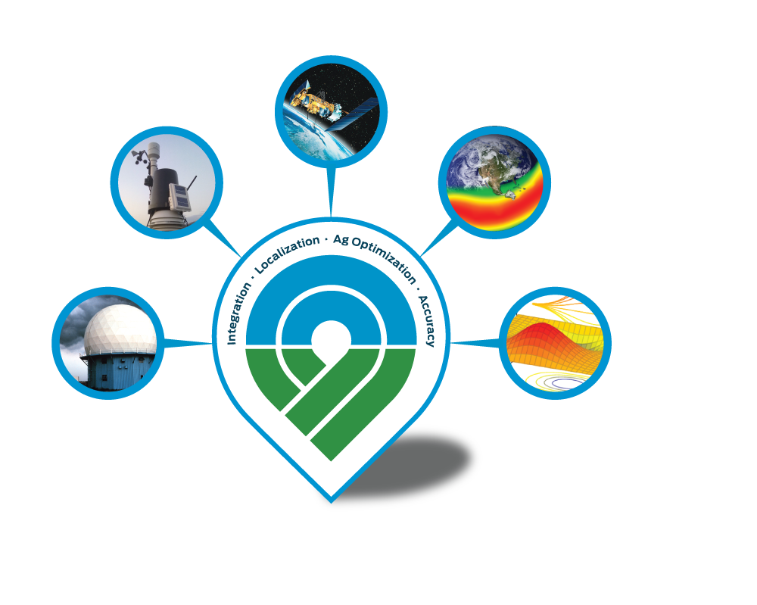
Weather Terrain™ combines many data sources to
create a highly accurate 3D weather surface around the globe,
regardless of station density.
High Quality, Ag-Relevant Weather Stations
Doppler Radar
Satellite Constellations
Multiple Global Forecast
Advanced Interpolation & Quality Control

Slide 9
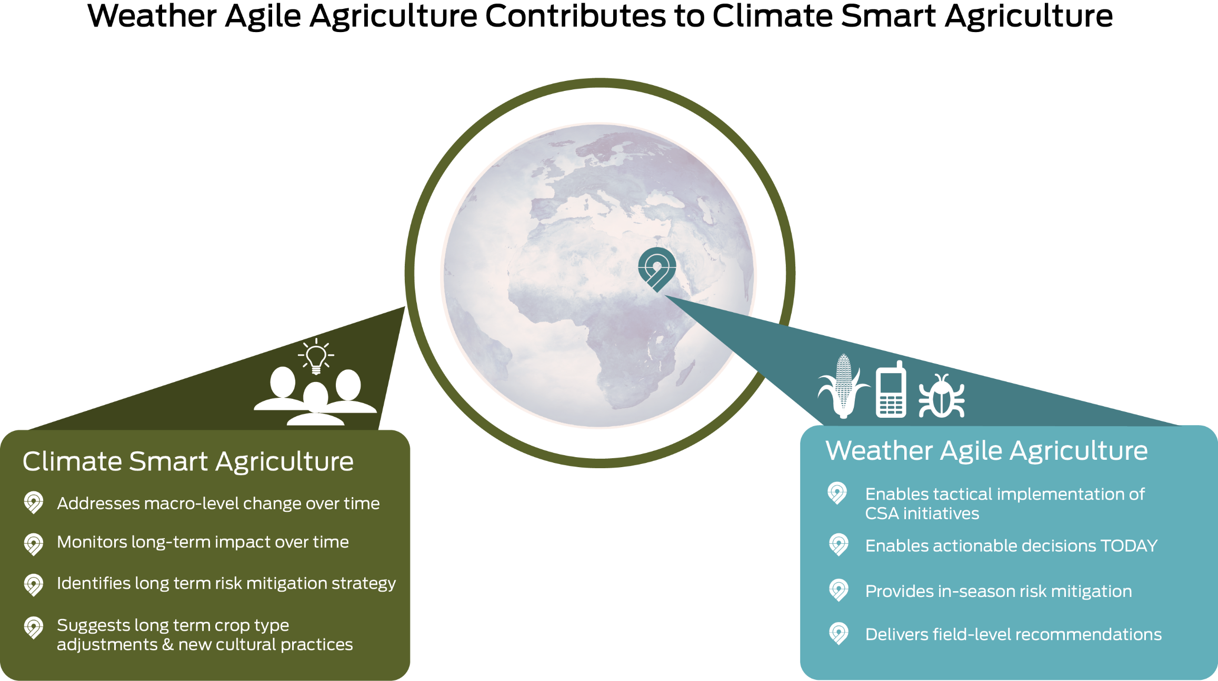
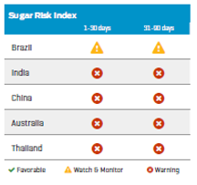
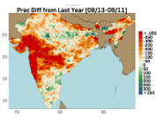
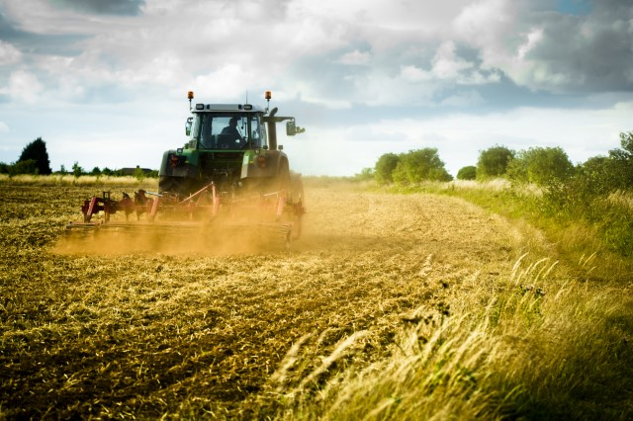
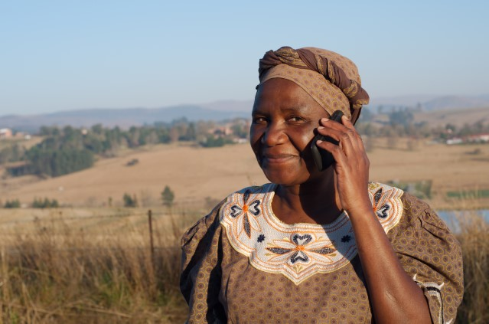
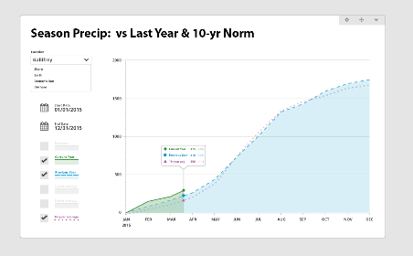
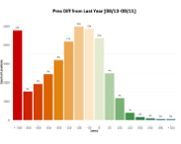
Global Perspective Field Insight Risk aWhere Weather aWhere
Risk aWhere combines data from both Weather Terrain™ and global agricultural commodity sources and Weather aWhere field data to produce market risk management insights and recommendations that are timely, robust and relevant.
Using global daily data (from weather satellites, ground observations, radar, spectral imagery, weather forecast etc.) as input to agronomic models we can monitor any crop planting and provide field specific recommendations, alerts and predictions.

Slide 10
Weather Data that matters for driving agricultural decisions
Accurate Daily Weather Data
Long-Term Averages Any number of years
Snapshot Current Conditions & Advisories
Min & Max Temperature
Min & Max Relative Humidity
Precipitation
Solar Energy
Wind speed
8-Day Hourly
Forecast
Current Imagery
Radar, Satellite, etc

Slide 11
Agronomic Insights that make weather data meaningful
Growing Degree-Days
GDDs / GDUs
Accumulations
(Precip, GDD, PET)
Long-Term Averages (any period)
Potential
Evapotranspiration
Growth Stage Modeling
P/PET
Harvest Date Prediction Modeling
Ongoing seasonal monitoring for high-value crops

Slide 12
1 . {"observations":[{
2. "date":"2015-07-01",
3. "location":{
4. "latitude": 39.8282,
5. "longitude": -98.5795,
6. "fieldId": "field1” },
7. "temperatures":{
8. "max": 99.5,
9. "min": 65.9,
10. "units": "F"},
11. "precipitation":{
12. "amount": 0.0,
13. "units": "in"},
14. "solar": {
15. "amount": 8559.404296875,
16. "units": "Wh/m^2"},
17. "relativeHumidity": {
18. "max": 83.7,
19. "min": 23.3},
20. "wind": {
21. "morningMax": 10.4,
22. "dayMax": 17.3,
23. "average": 18.4,
24. "units": "mph"},
Our API is designed for a wide variety of use cases and applications.
Lightweight microservice architecture
Standards-based fully compliant RESTful API
OAuth2 Authentication
JSON-formatted payloads
Customizable payloads for speed & efficiency
CORS-support for browser-based apps
Batch job system supports large daily downloads
Easy to integrate for any level developer

Slide 13
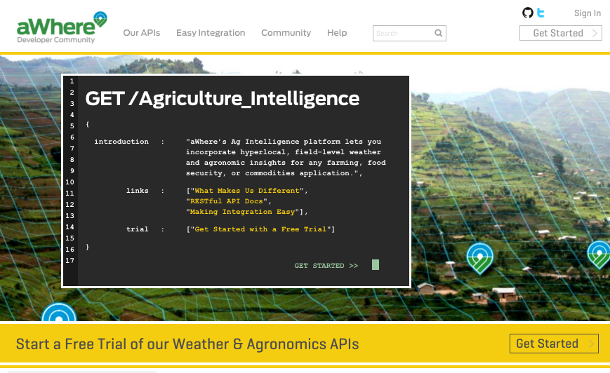
The aWhere Developer Community provides everything needed to get started & stay moving with the API Platform.
Comprehensive Documentation
Tutorials & Best Practices
Sample Code
Postman & Swagger Definitions
Support Community
Self-Service API Keys
Coming in 2016: Access to metrics
Get started with a trial at
developer.awhere.com

Slide 14
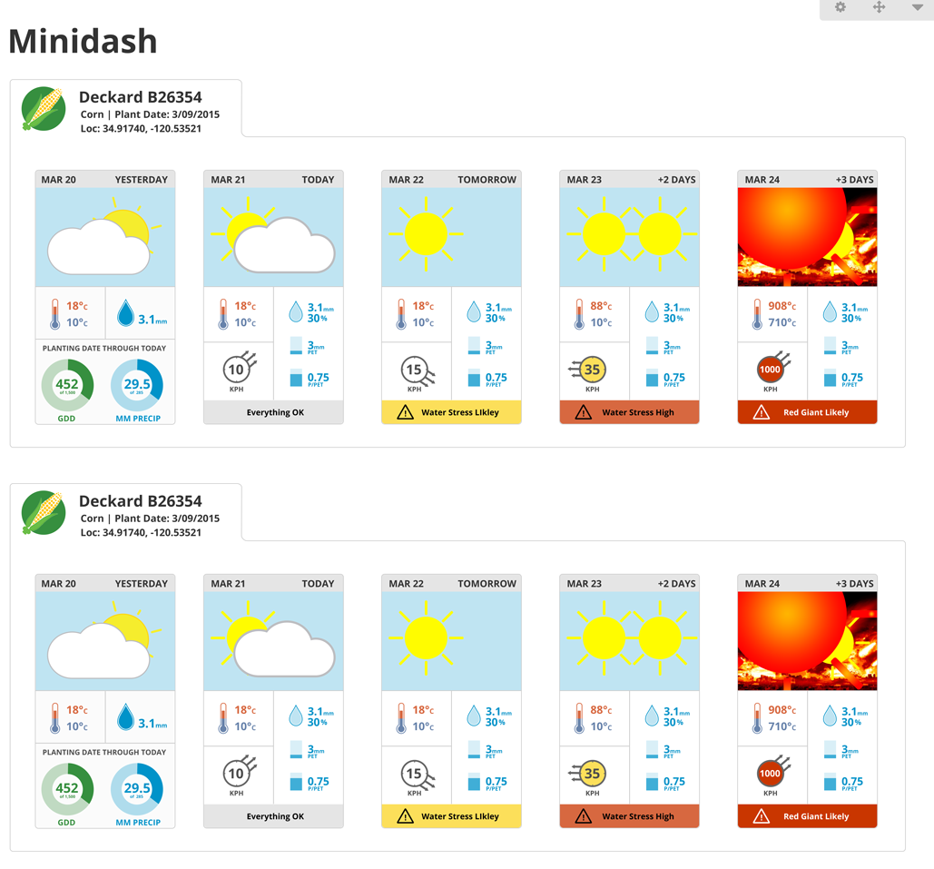
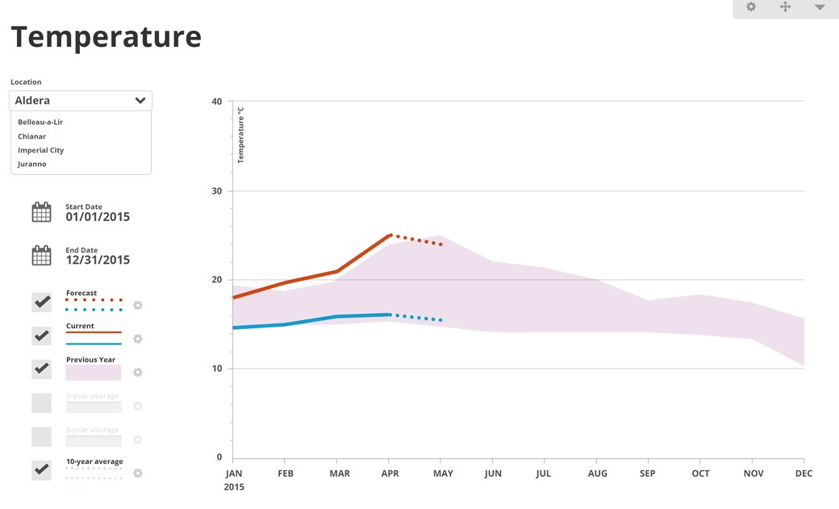
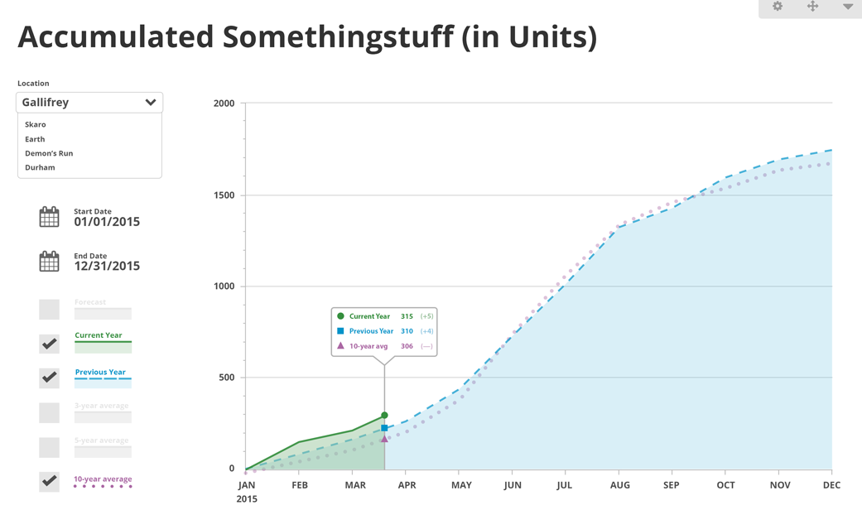
Widgets

Slide 15
Enrich your application with additional context and insight, however it fits. aWhere’s platform powers a wide variety of uses and fits in any user interface.
Monitor conditions at remote fields.
Augment your models & reports with weather and agronomic context.
Proactively adjust daily plans based on weather and crop stage,
What-if scenario testing with interactive charting
Make weather meaningful to farmers by comparing to recent averages.
Measure and mitigate risks from water stress, pests, or diseases.
Combine with irrigation records to track water availability.
Plan harvests with highly accurate GDD and growth stage monitoring.
Increase customer retention and drive up frequency of use.

Slide 16
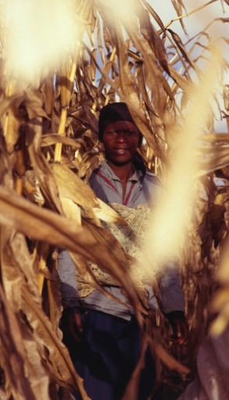
Adjust to Weather Variability
By knowing to
wait 15 days to plant
her corn, a farmer in Uganda misses a drought period
and increases her yield by 3X

Slide 17
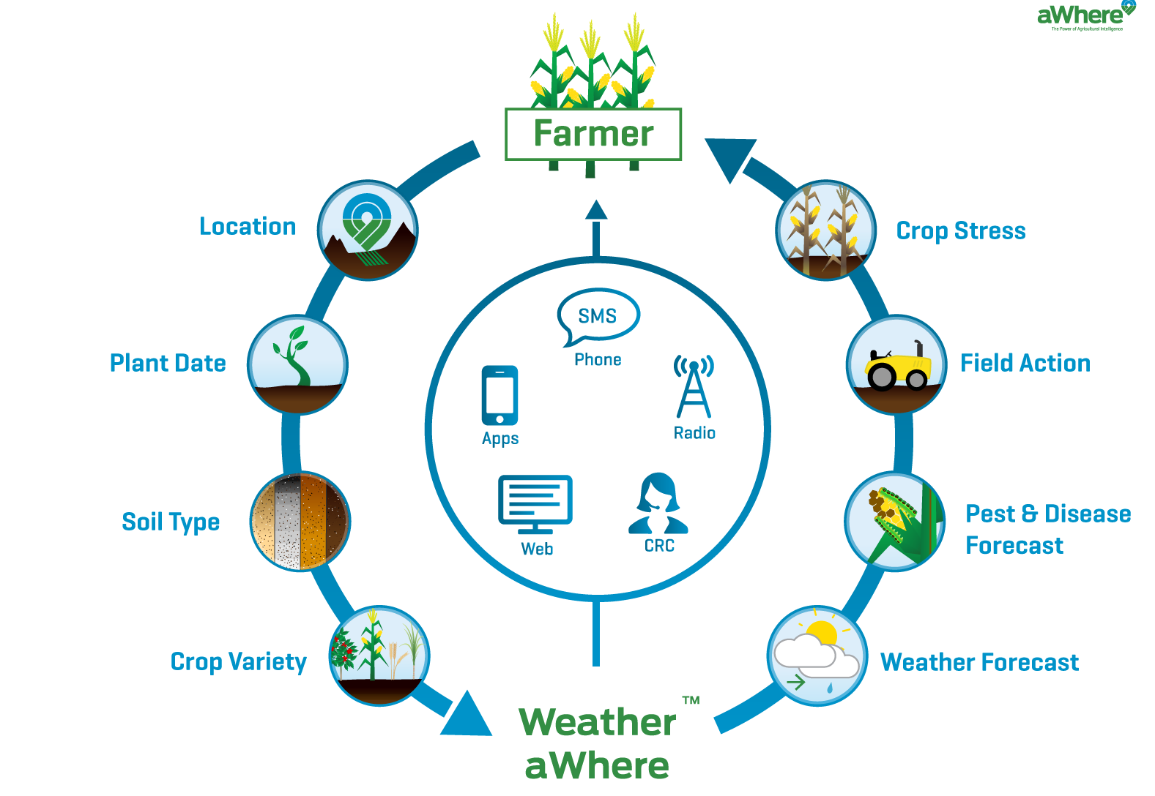
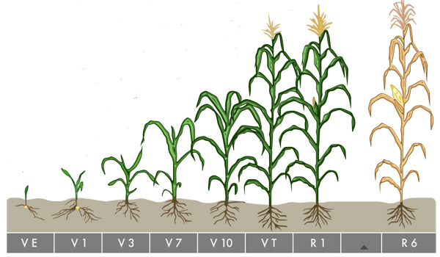
Recommendation Timing
Low rainfall predicted, consider applying nitrogen
Now is the optimum time to apply herbicide to control weeds

Slide 18
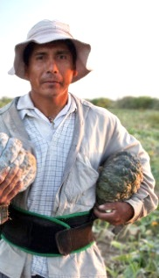
Predictive Harvest Analytics
A commercial vegetable grower receives
real-time harvest date predictions
and modifies his labor and harvesting schedule
to reduce crop loss by 25%

Slide 19
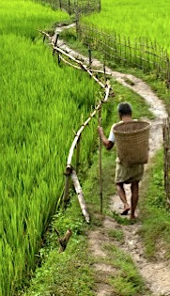
Mitigate Pest and Disease
A farmer receives an SMS alert about Rice Blast Fungus
with a recommendation to fertilize within
7 days and prevents the disease
producing a 30 bushel surplus

Slide 20
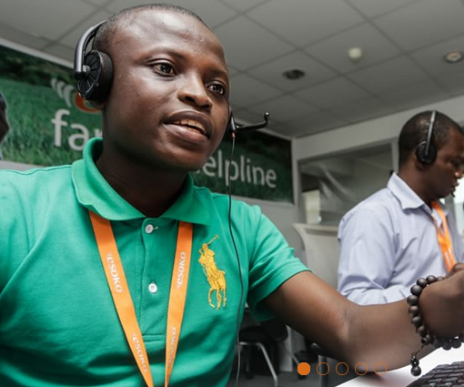
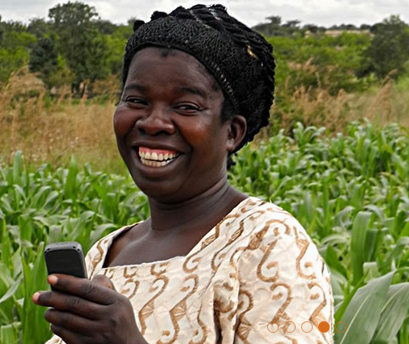
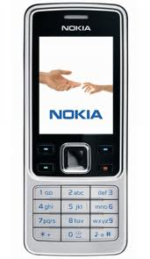
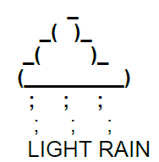
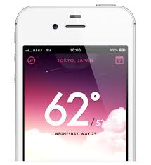
Small Holder Farmers
Working with local partners to push personalized agronomic tips
to farmers via
SMS, Voice and Mobile Apps
supported with Call Center Apps
Farmers are equipped to make
better growing decisions

Slide 21
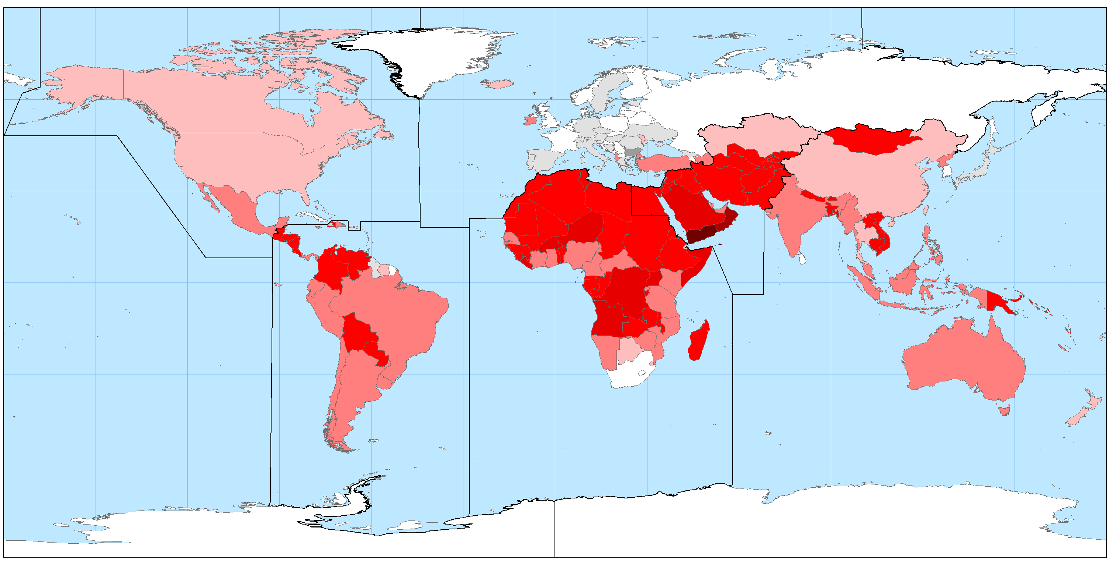
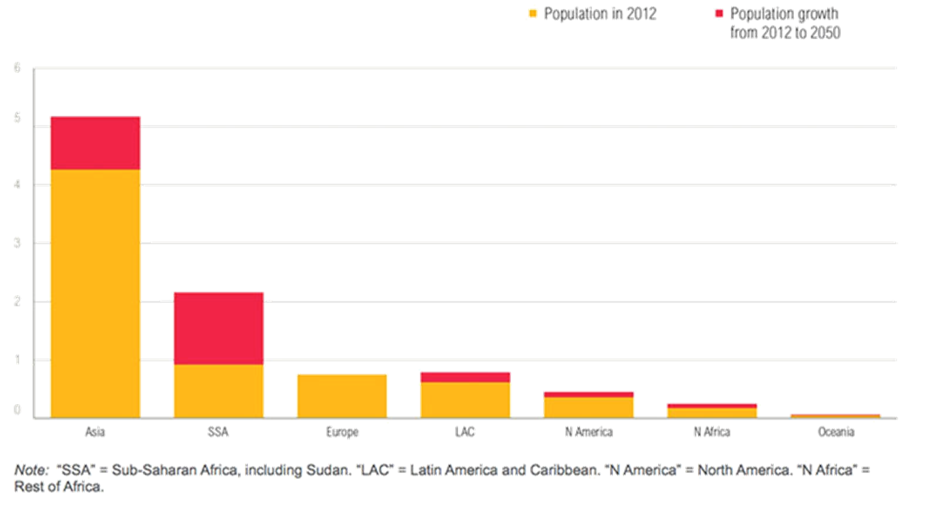
Last Mile: Ag Market Opportunities
Food production needs to increase by 70% by 2050
Less than 1M farmers in the US but 580M farmers globally
Population growth mostly in Africa and Asia
80 million farmers with access to information services in 2020 (GSMA)

Slide 22
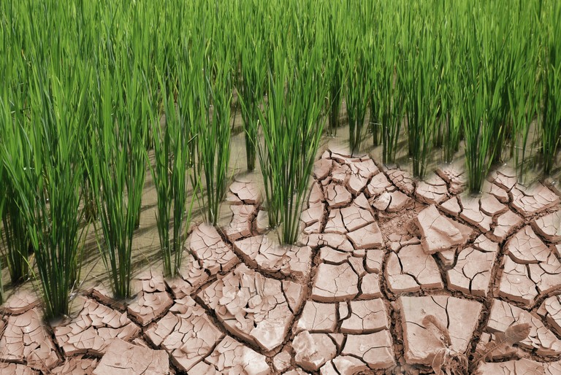
Last Mile: Ag Barriers and Challenges
Data Access
Data standards and open data
Articulating Value
Value vs cost, what is it worth? who pays?
Time to Scale
Scale is required for profitability – but takes time!
Market Demand
Productivity increase must be matched with market access
Maturity of the Ag Value Chain
Seed suppliers, input providers, ag retailers

Slide 23
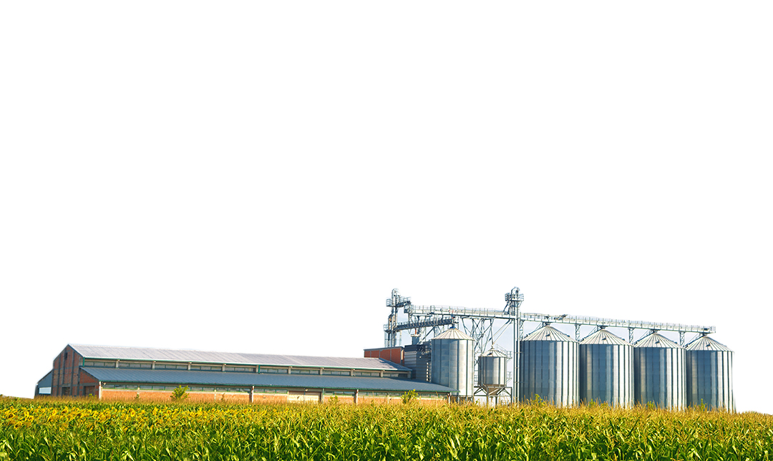
Last Mile: Ag Framework Recommendations
Data Access
Consistent and easy data sharing and integration
API’s, API’s, API’s!
Current, Correct, Consistent, Complete
Flexible Business Models
Innovative business models
e.g. offset free or low cost data with value added services
Flexibility to accommodate a wide range of value propositions
Part of a Data Ecosystem
Integration with a variety of data sets
Big data innovations
Rapid development in IoT and Big Data
Ag/weather investments IBM, Monsanto, Intel, Panasonic, SAP

Slide 24
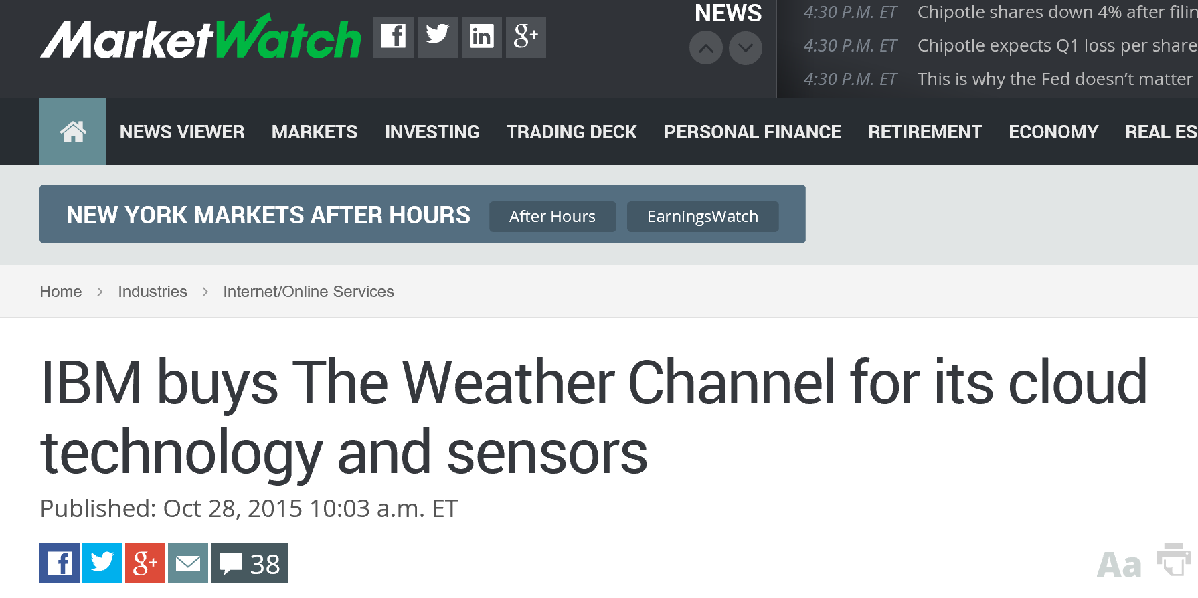
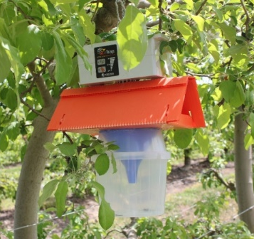
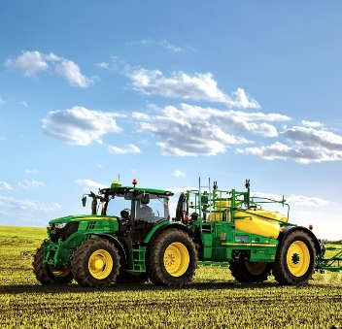
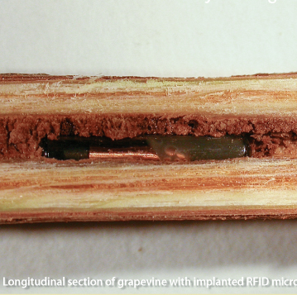
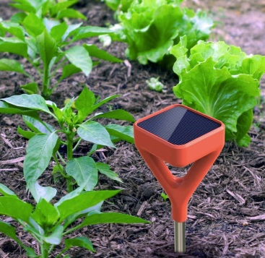
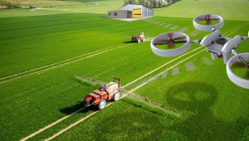
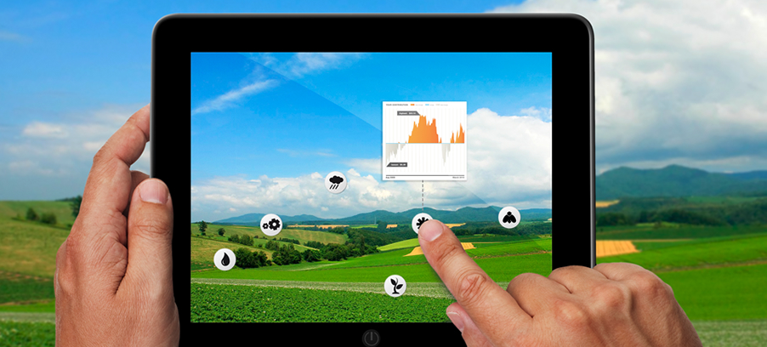
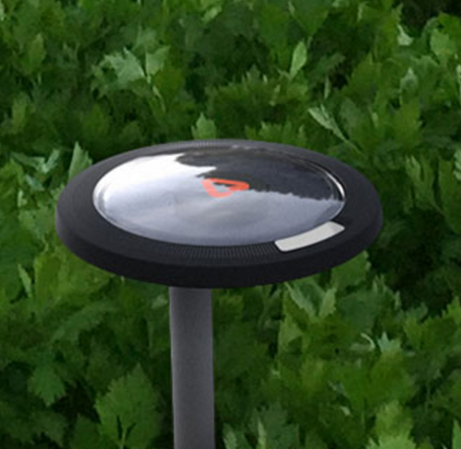
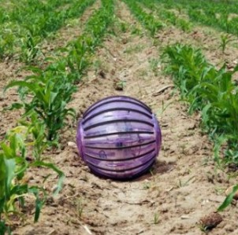
IoT and Big Data in Agriculture
Connected pest traps
Connected machinery
RFID
chips
Soil moisture sensors
Drone imagery
Smaller cheaper weather stations
New sensor technologies

Slide 25
Evolution not Revolution
Coopetition

Slide 26
Denver, CO
awhere.com
303-279-9293
Stewart Collis
stewartcollis@awhere.com
@stewartcollis
©2016 aWhere, Inc. Customer logos copyrighted by their respective owners. Some images licensed under Creative Commons courtesy NOAA, Ladd Observatory, Stephen Bowler

