Slide 1
LESSONS LEARNT FROM THE GFCS ON DISSEMINATING CIS TO SMALLHOLDER FARMERS IN MALAWI AND TANZANIA
Jeanne Coulibaly
ICRAF/CGIAR

Slide 2
GFCS : Global Framework for Climate Services
World Meteorological Organization
(WMO)
World Food Programme
(W\FP)
CGIAR Research Program on Agriculture, Climate Change and Food Security
(CCAFS)
World Health Organization
(WHO)
Nutrition
Food security
Red Cross
Health
Disaster risk reduction
Center for International Climate and Environmental Research
(CICERO)
Most vulnerable populations
National Hydro- Meteorological Services
(NHMS)
Ministry of Agriculture
Department of Disaster Management and Adminsitration
Increase the resilience of people most vulnerable to the impacts of weather and climate-related events

Slide 3
Advantages and disadvantages of forming multi-stakeholder partnership
Advantages:
Holistic approach to the production and delivery of climate information
Enhance weak capacities of some national partners
Improved management of risk and better provision of climate services
Address the numerous of challenges that communities are confronted with: food security, health, sanitation
Greater impact and sustainability in the outcomes and higher chances of achieving long term goal
Challenges
Strong communication to make sure activities are well integrated and connected
Approaches to implement the activities and reach the goal may diverge
Success of one activity may be linked to the success of other activities

Slide 4
Lessons learned on improving the dissemination of climate information
Needs assessment to establish what farmers want and need
Presents some results of the needs assessment

Slide 5
Types of information farmers rely to make their farm decisions
Results of the baseline survey in Tanzania (Coulibaly et al., 2015)

Slide 6
Current climate information received by farmers

Slide 7
Most preferred types of information

Slide 8
Lead time: Timely

Slide 9
Format

Slide 10
Ways to improve delivery of climate information

Slide 11
Lessons learned on improving the dissemination of climate information
Carry out a needs assessment
Co-production of Climate information
Mixed delivery method including radio, mobile, extension workers and village leaders was recognized
Timeliness in climate information
Build trust and greater understanding of scientific climate forecasts
Climate forecast overlay with agricultural extension advice
Location specific climate forecasts
Use of local languages
Traditional indicators should be valued and integrated to the conventional scientific climate information

Slide 12
Challenges and potential ways to respond to Farmers’ needs
Challenges:
Human resource capacity still low
Lack of funds and equipment
Financial resources needed
Private sector representation limited
Coordinated efforts from important stakeholders: CGIAR, NGOs, Ministry of Agriculture, National Meteorological Services, private sector (radio, cell phone operators, etc), academic institutions

Slide 13
Coordinated efforts from Stakeholders
Training and capacity building
Modeling tools and techniques to downscale climate information
Exchange of data, improvement in the availability of high quality , high resolution , satellite data
Coordinated efforts from important stakeholders to support local partners
Nat Hydro-Met Services
Extension workers /lead farmers
ICT related services
Radio and mobile based interventions
Train radio presenters in understanding the concept of climate change and CIS
Provide them with the right information content(forecast and adaptation options)
Training in communicating climate information, agronomic information on frequent basis

Slide 14
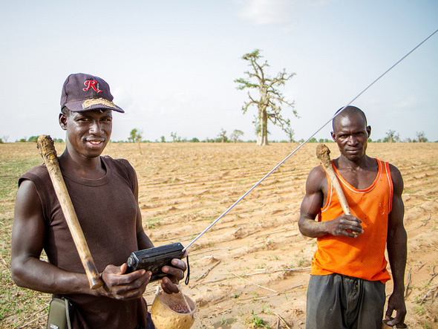
THANKS

