Slide 1
UNDP CIRDA Country Program Managers Workshop 25-27, August 2015 Addis Ababa, Ethiopia
Reports from Strengthening National Climate Information/ Early Warning System (CI/EWS) Projects
Liberia
Kumeh S. Assaf
National Project Coordinator (NPC)
Climate Information for Resilient Development Project
Ministry of Transport, RL
Notes:
Instructions: Complete items in red italics

Slide 2
Sequence of presentation
Introduction
Key agencies
Agencies identified
High level contributions of each agency
Social or economic impact/function of each agency ‘s contribution
Update on implementation
Other relevant information
Notes:
Kumeh Assaf, NPC, EWS Project, I manage the day to day activities of the Project, housed at the Ministry of Transport.
While previously on the ““Boots on the Ground” Program, at the UNDP. I worked closely with Moses Massah, head of the Energy and Environment Unit and is the Portfolio Manager at UNDP level for the NAPA Projects – Mr. Massah is here with us today, he is the only one joining us from Liberia.

Slide 3
General Project Baseline
A coordinated and complete climate information (including weather monitoring and forecasting) and EWS does not currently exist in Liberia;
Infrastructure and capacity related to weather, climate and environmental observations is currently sparse and unconnected in Liberia;
Limited skilled personnel to operate and maintain an observational network, generate information for specific sectors, and interpret the data in a format suitable for intended end-users.
Notes:
This general baseline has been changing through many soft measures by the EWS Project.

Slide 4
Project Objective
“to strengthen Liberia’s climate-related monitoring capabilities, early warning systems and available information for responding to climate shocks and planning adaptation to climate change.”

Slide 5
Project Organisation Structure
Project Board
Senior Beneficiary:
Ministry of Lands, Mines and Energy – Hydrological Services
Ministry of Transport – Meteorology Department
Ministry of Internal Affairs - National Disaster Relief Commission
Executive:
Environmental Protection Agency
Senior Supplier:
UNDP
Project Support
Admin/Financial Officer
Project Driver
UNDP CO
Project Manager
Housed within Ministry of Transport - Meteorology Department
Project Assurance
UNDP (CO
& UNDP-GEF)
TEAM A
Meteorological Department
Hydrological Services
TEAM B
National Disaster Relief Commission
TEAM C
Ministry of Agriculture
Liberia Maritime Authority
National Ports Authority
Ministry of Health

Slide 6
EWS Project Board
The Project Board (Project Steering Committee) is responsible for:
making the management decisions of the LDCF project;
monitoring progress of implementation and ensuring that recommendations from annual and mid-term evaluations are adopted for performance improvement;
ensuring that required resources are committed and arbitrates on any conflicts within the project or negotiates a solution to any problems with external bodies

Slide 7
National Stakeholder Organogram
Environment Protection Agency
(IP)
Ministry of Transport (RP)
MLME (RP)
MIA (RP)
Meteorology Department
Liberia Hydrological Services
Disaster Commission
MET Service
Hydrological Services
Disaster Management
Notes:
Disaster Commission not fully functional

Slide 8
National Stakeholders Organizations
Executing Entity/Implementing Partner: Environmental Protection Agency (EPA)
Implementing Entity/Responsible Partners:
Ministry of Transport (MoT) - Meteorology Department;
Ministry of Lands, Mines and Energy (MLME) - LHS;
Ministry of Internal Affairs (MIA) - NDRC;
Ministry of Agriculture (MoA)*;
Liberia Maritime Authority (LMA);
National Port Authority (NPA);
Ministry of Health (MoH);
Ministry of Finance and Development Planning (MFDP);
Ministry of Defense (DF);
Ministry of Gender and Development (MGD);
Private sector;
Civil Society
Notes:
The sister NAPA Project CCAAP has a component to do with agro-meteorology, they are delaying that activity in other to explore synergy with the EWS Project.

Slide 9
Ministry of Transport (MoT)
MoT (Meteorological Department) functions as
the lead RP;
responsible and held accountable for managing the LDCF project on a day-to-day basis as per UNDP’s NIM procedures;
Endorsement of MoT as the lead RP is based on legislative enactment to host and conduct meteorological services in Liberia.

Slide 10
Ministry of Lands, Mines and Energy (MLME)
The MLME, particularly its Bureau of Hydrological Services (the LHS) is RP for hydrology;
The Norwegian Water Resources and Energy Directorate (NVE)-funded project “Institutional Strengthening and Capacity Building of the Energy and Water Resources Cooperation” is supporting the MLME to install 6 hydrometric stations, more than 30 manual rain gauges and 4 automatic stations in the 6 major river basins in Liberia.
The MLME also hosts the CAP, there will be greater collaboration with this Ministry when we pilot EWS for coastal zones.

Slide 11
National Assessment of Hydrological Sites
Consultations with the local authorities, assistance was requested for a local escorts. This method was adopted to get the local authorities be aware of the presence of the team and encourage local ownership and participation in the assessment;
Recording of the positions/locations of the basic features such as location of GSM service towers, possible installation points of instruments using HAND HELD GARMIN GPS Units;
Photographing of features on and near the sites;
Assessment of the conditions of access roads to the sites; observation of difficult spots such as culvert/log bridges and surface conditions of the access roads as well as distances;
Measurement of the width of rivers on bridges using modern digital distance instrument;
Recording the height of bridges and floodplain of rivers

Slide 12
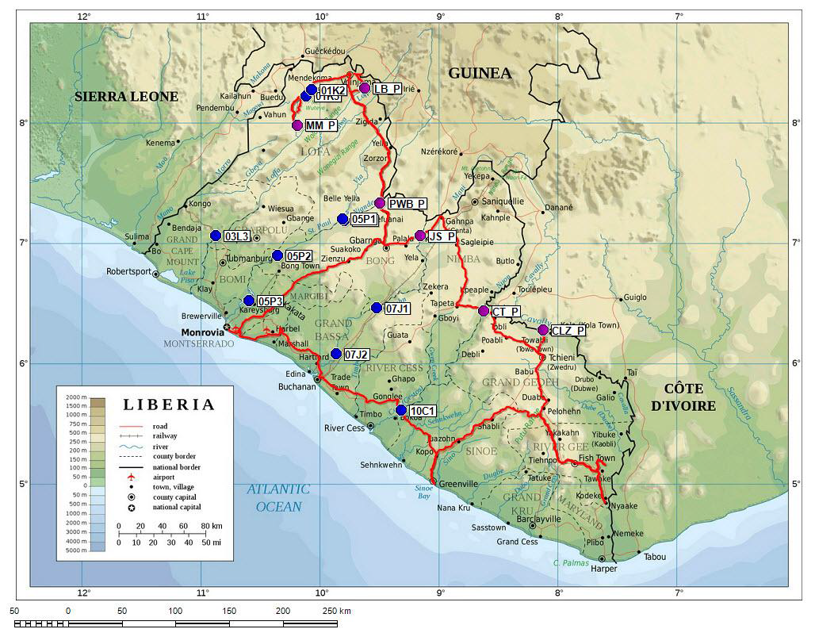
Notes:
Pink dots show proposed EWS/LHS sites for hydrological stations.

Slide 13
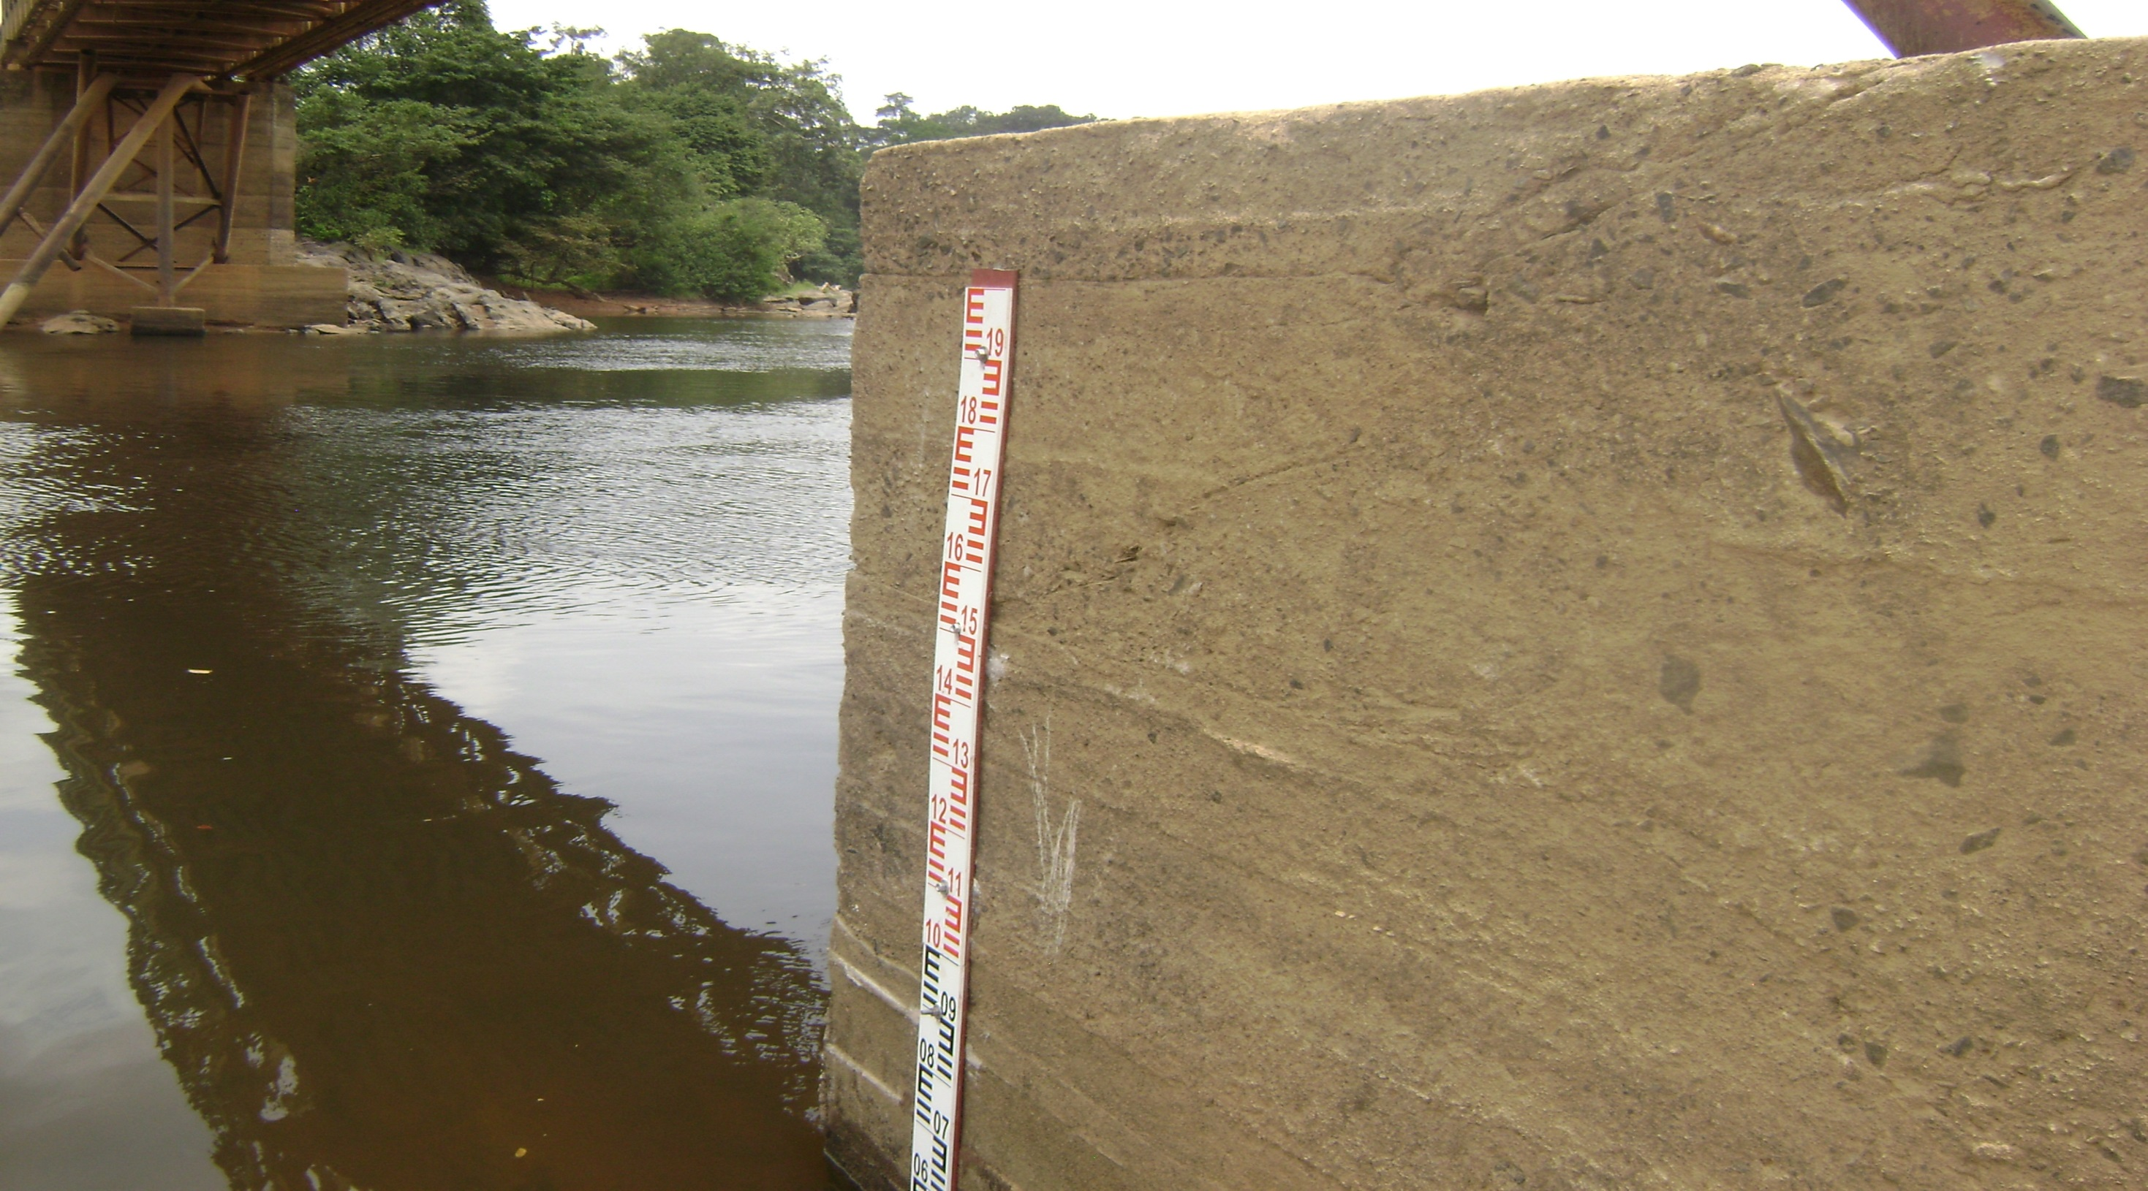
Notes:
Under the Cestos Bridge, water level measurement stick.

Slide 14
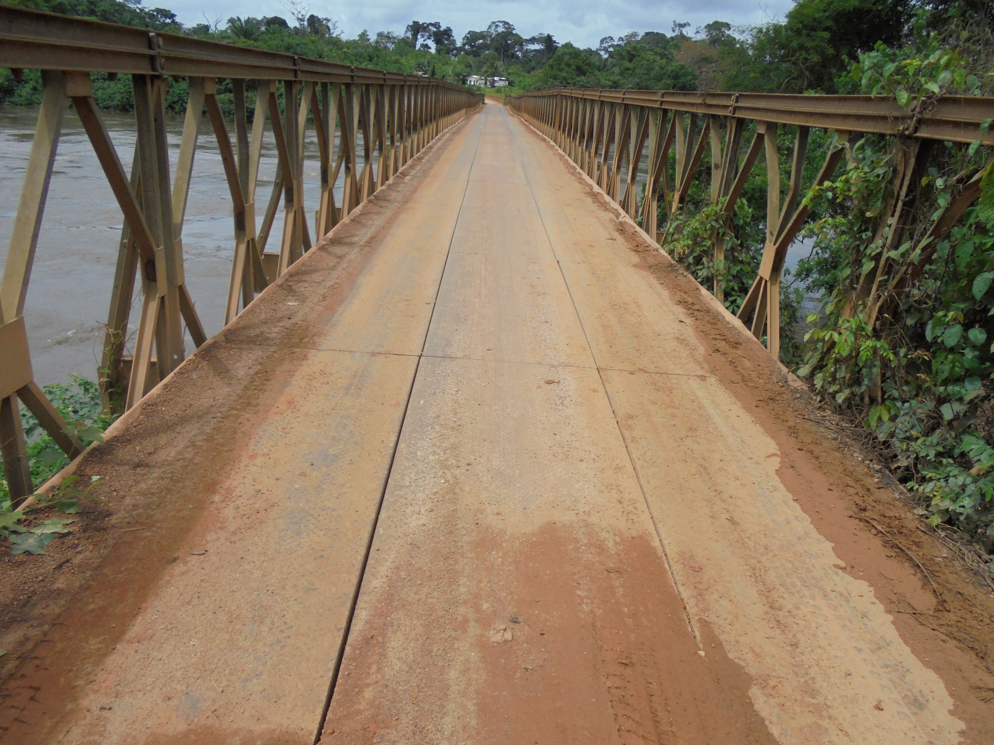
Notes:
The Cestos Bridge, boundary of River Cess and Grand Bassa Counties

Slide 15
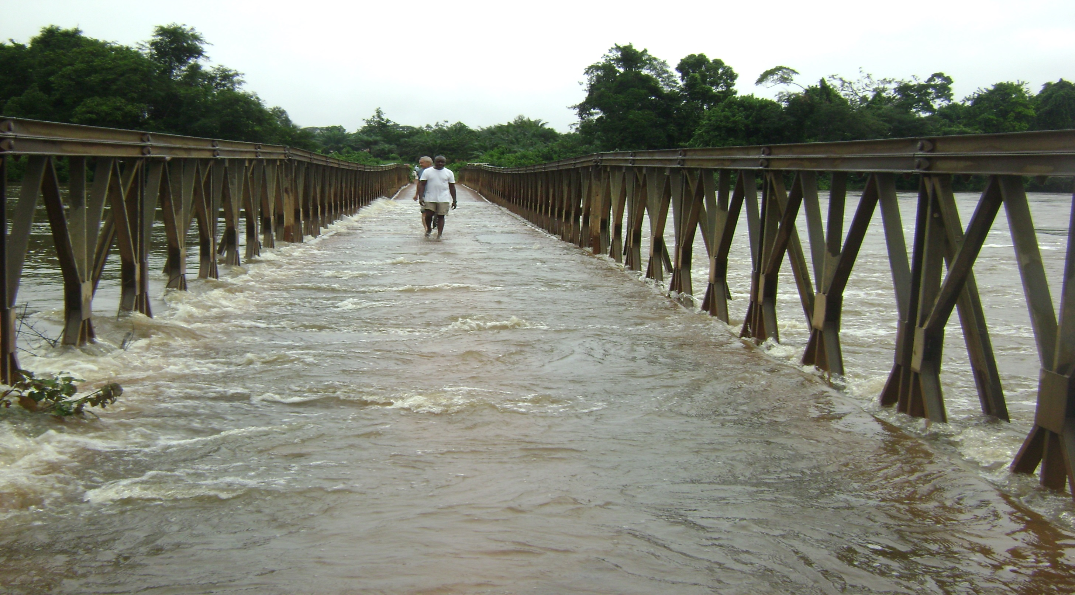

Slide 16
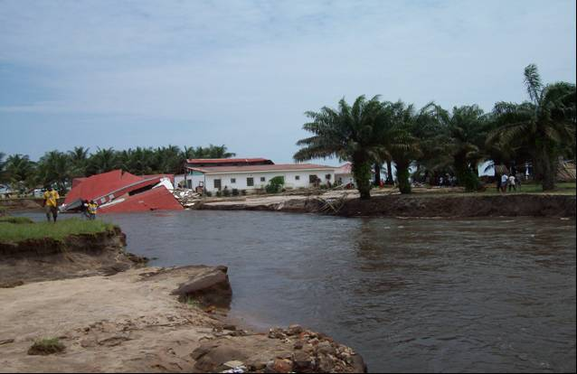
Notes:
Flood damage in Monrovia – destruction of residential communities.

Slide 17
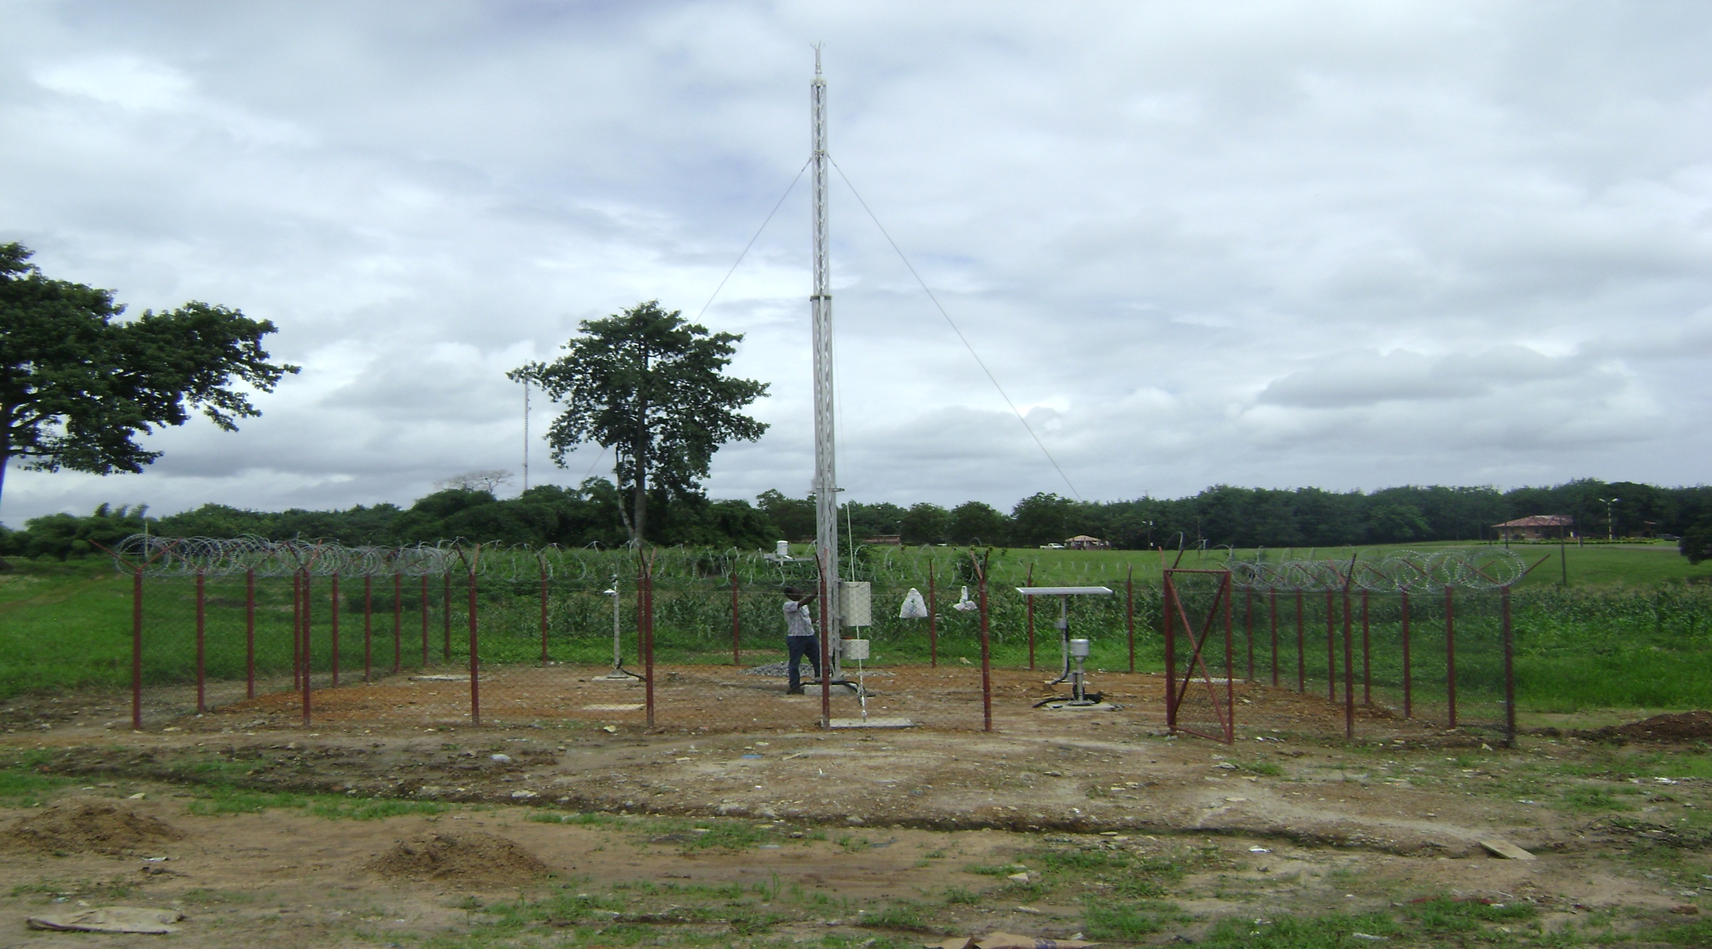

Slide 18
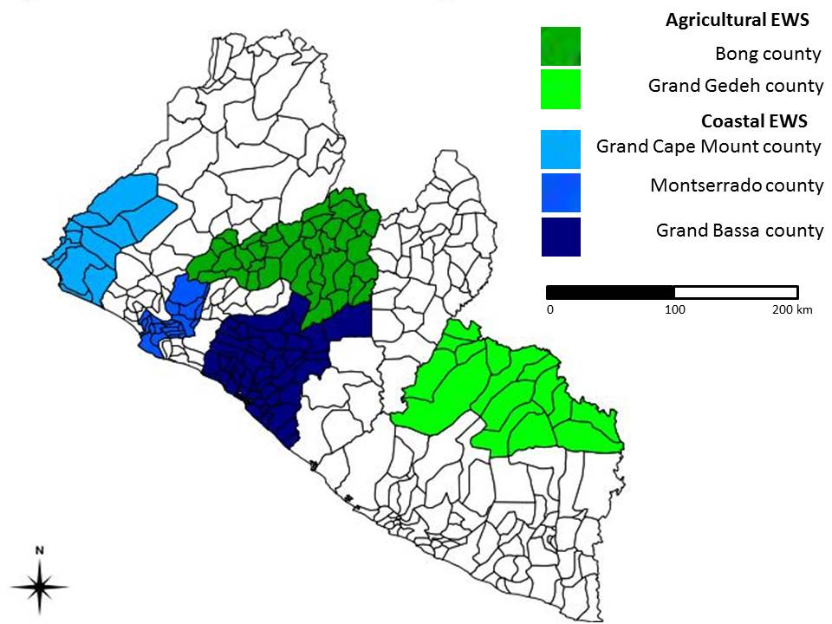

Slide 19
Ministry of Internal Affairs (NDRC)
The National Disaster Relief Commission (NDRC) was established in 1976 to:
cater to disaster victims;
review, coordinate and plan different disaster prevention, preparedness, relief and rehabilitation measures; and
establish and maintain liaison with representatives of UN agencies and donors which have disaster relief related programs in the country.
Although the NDRC is the institution tasked with managing disaster risk reduction and related activities, its approach is reactionary rather than preventative. Furthermore, the institutional capacity to lead and coordinate emergency response procedures is low. The NDRC does not have adequate resources and capacity to effectively carry out this mandate.

Slide 20
National Action Plan and Disaster Risk Management Capacity Needs Assessment – developed by MIA and UNDP
communication equipment to establish and strengthen early warning system at national and local levels;
regular EWS reports to be used for planning and decision making purposes;*
meteorological information disseminated at national, county and community levels;**
support to raise awareness of all actors for risk assessment, incorporation of early warning information/alerts and communication of the risks to district level;***
training for MIA/NDRC staff on the use of SPSS and GIS application;****
establishment of databases in fifteen counties and at a national level;*****
Notes:
*/**/*** - EWS Project
**** - 1 month training in Ghana supported by US Africon.
***** - WFP & UNDP

Slide 21
National Action Plan and Disaster Risk Management Capacity Needs Assessment – developed by MIA and UNDP
motor bike to facilitate data collection activities at district and community levels;
field vehicle to enhance disaster risk management activities at national and county level;
technical support at national and local level to integrate the national early warning system with sectoral ministries, departments and emergency centers;
assistance in establishing baseline information for disaster risk management activities;
support in mainstreaming DRM into development planning; and ******
assistance in establishing disaster risk management structures at national and local levels. *******
awareness training about communication and reporting procedures, protocols and clear indicators;
Notes:
****** - UNDP
******* - EWS, UNDP, WFP, IOM

Slide 22
UPDATES ON IMPLEMENTATION
Liberia has fully subscribed to the CIRDA initiative and news of an LTA is welcome across Government, this will take care of many of our specific needs which we have highlighted earlier;
Discussion with the WMO is advanced to send in Experts to render technical services to the National Hydrological and Meteorological Services. The EWS may need to retain the services of a Technical Advisor (TA) to be sent by the WMO for Hydrology.

Slide 23
UPDATES ON IMPLEMENTATION
MoU signed with the Liberia Airport Authority (LAA) for the renovation of the building used by the Meteorological Services Department of Roberts International Airport as a National Meteorological Center (NMC). The MoU also covers training, equipment upgrade and material support to the RIA, request has been made to the UNDP to commence work on the building and the procurement;

Slide 24
UPDATES ON IMPLEMENTATION
Assessment of sites for the placement of hydrological equipment on the six (6) major rivers of Liberia was concluded and report submitted to the UNDP along with a procurement list which is being validated;
Training list has been prepared and sent to WMO Training Institution in Kenya, but response is to begin training in January, 2016. WMO Regional Training Center in Nigeria has been contacted for possible training to begin in the last quarter of the year.

Slide 25
Plans for 2016
A lot will depend on guidance from the consultants to be hired under the LTA
1. Training - both in-country and outside Liberia
2. Data gathering and processing and putting in place the infrastructure for climate services provisioning to different end-users
3. Market study and communication strategy
4. Training for vulnerability assessment and mapping of disaster zon

Slide 26
THANK YOU
Q & A

